Slide 1
Chapter Two: The Road to Independence
(1750-1781)

Slide 2
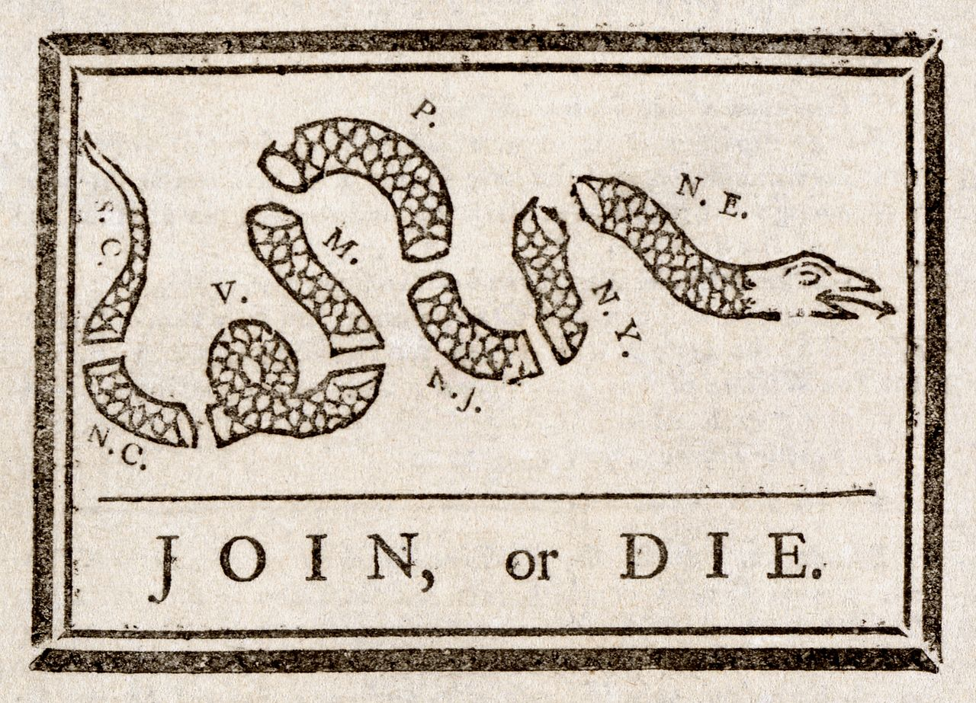
Albany Plan of Union
In 1754, representatives from seven colonies met in Albany, New York
Benjamin Franklin proposed the Albany Plan of Union. Provided for inter-colonial government. System for collecting taxes for colonial defense
Franklin also tried to negotiate with Iroquois Natives
Failed to get approval from even one colony. Colonists didn’t want to give up right to tax themselves. Didn’t want to have a centralized government
Angry Franklin drew the “Join or Die” political cartoon

Slide 3
Seven Years’ War (1754-1763)
Actually lasted nine years. AKA French and Indian War
It was French/Indians (Natives) VS British/colonists. Colonists called it that because that’s who they were fighting (British were already fighting French; colonists got stuck in the middle)
Arguably the first world war. Result of colonial expansion and European power struggles
English settlers moved into Ohio Valley. French tried to stop them, built fortified outposts strategically. Trying to protect profitable fur trade and control of the region
Colonial contingent led by George Washington attacked French outpost. Lost, Washington surrendered, returned a hero in Virginia
In 1756, England officially declared war, though there were skirmishes from 1754 to 1756

Slide 4
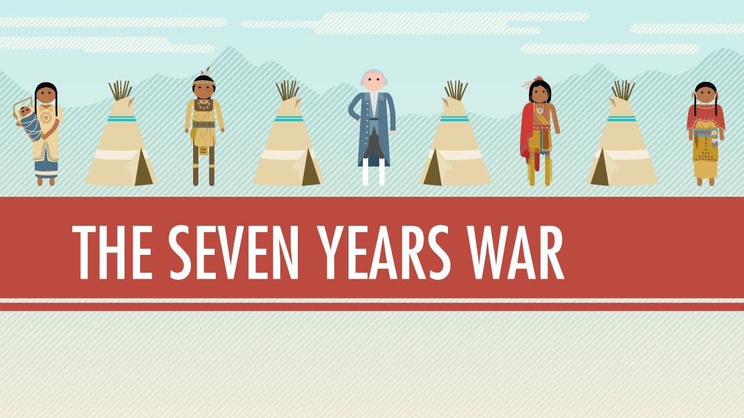
Resolution
Most Natives sided with France, who traditionally had the best relationship with them. They saw Washington lose, and assumed the French would win it all
England ultimately won, and became undisputed colonial power on the continent. Treaty of Paris gave England control of Canada and almost everything east of the Mississippi Valley
French just kept two sugar islands. Shows importance of mercantilism; they thought profit was more important than Canada

Slide 5
What About the ‘Mericans?
Many served in the English army. English soldiers gave bad first impression. Spread anti-British sentiment. Especially strong in New England, where most of the fighting took place/most colonial soldiers came from
Before war, Natives negotiated to be left alone; disliked the English, because expansion hurt war of life
After war, English punished Natives, raising price of goods sold and stopped paying rent on western forts
Ottawa war chief Pontiac rallied tribes in Ohio Valley, attacking colonies
Attacks and wars are called Pontiac’s Rebellion/Pontiac’s Uprising

Slide 6
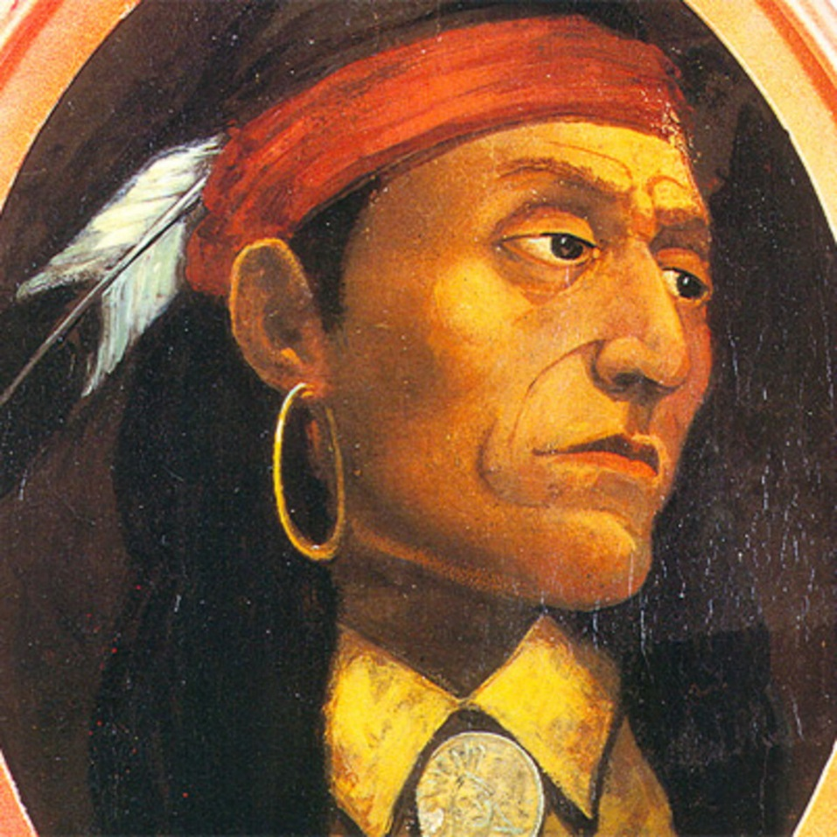
Picture of Pontiac

Slide 7
Proclamation of 1763
British government saw Pontiac’s Rebellion, and made Proclamation of 1763 in response, which forbade settlement west of the rivers running through the Appalachians. Came too late. Settlers were already moving west. All it did was make them mad that British were interfering
Pontiac’s Rebellion was response to colonists expanding into Native lands (remember Pequot War, Bacon’s Rebellion)
British used germ warfare (spreading blankets infected with smallpox) to end rebellion
1763 ends age of salutary neglect, Proclamation is first in series of Crown restricting colonies

Slide 8
Acting out
Financing Seven Years’ War caused British to have huge debt
New King George III and prime minister George Grenville thought colonies should help pay it off. Thought colonies had benefitted from war. Colonies tax burden was light compared to British citizens, even on the same goods. Colonists didn’t want to pay, since they gave a lot of soldiers
Sugar Act of 1764 established new duties, tried to deter molasses smugglers. Parliament had passed taxes before, but there was little resistance; most Americans accepted the Navigation Acts as part of mercantilism
Laws such as Molasses Act of 1735 were on the books, but smuggling was common and little tax revenue was collected. The new Sugar Act lowered the duty on molasses coming into colonies from West Indies, but made it clear that it had to be collected; more difficult to find loopholes
Violators would be arrested and tried in vice-admiralty courts with just one judge and no jury. This annoyed colonists; thought Parliament was overstepping boundaries

Slide 9
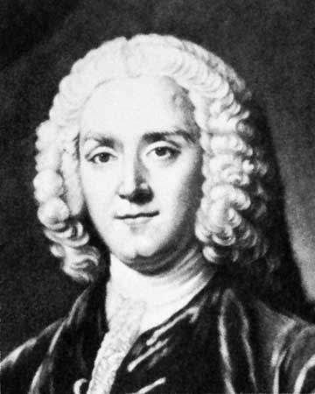
Picture of P.M. George Grenville

Slide 10
Currency Act
The Currency Act forbade colonists from issuing paper money
Collectively, the Sugar Act, Currency Act, and Proclamation of 1763 caused discontent
Acts came during postwar economic depression
Protest was ineffective, though…at first

Slide 11
Stamp Act
The Stamp Act was passed in 1765, one year after the Sugar Act
It was a tax aimed at making money, which made colonists nervous about more taxes. Colonies’ tradition of self-taxation was being overridden. It applied to all legal documents and licenses. This annoyed lawyers. It was a tax on goods produced WITHIN the colonies. This brought on forceful protest
James Otis wrote a pamphlet: The Rights of the British Colonies Asserted and Proved. The bestseller cried “No taxation without representation.” Because the colonies didn’t elect members to Parliament, they were not obliged to pay taxes. Didn’t argue for secession, just either representation in Parliament or more self-governance in the colonies

Slide 12
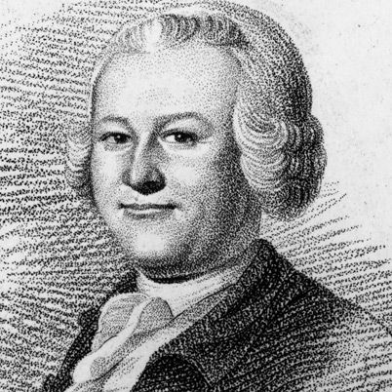
Picture of James Otis

Slide 13
British Rebuttal
Brits said the colonists were already represented
Believed in virtual representation, which says that members of Parliament definitionally represent all British subjects, regardless of who elected them. Colonists wanted the right to determine their own taxes
Opponents of Stamp Act united. In Virginia, Patrick Henry wrote the Virginia Stamp Act Resolves. Protested tax, asserted right to self-govern. In Boston, mobs nearly destroyed the governor’s mansion. Protest groups called themselves the Son’s of Liberty
British duty collectors were too scared to perform jobs, and so in 1766, Parliament repealed the Stamp Act
King George III replaced Prime Minister Grenville (colonists hated) with Lord Rockingham (opposed Stamp Act)
Rockingham oversaw the repeal, but linked it to Declaratory Act. Asserted British right to tax and legislate in all colonies no matter what. Colonists beat Stamp Act, but didn’t take power away

Slide 14
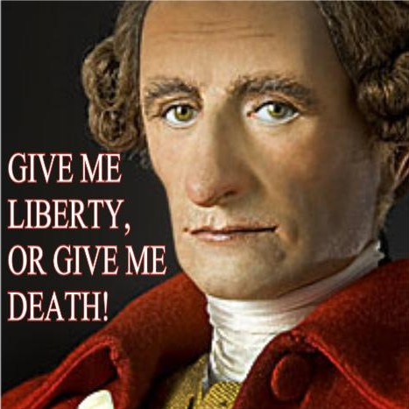
Picture of Patrick Henry

Slide 15
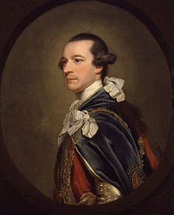
Picture of Lord Rockingham

Slide 16
Townshend Acts
Rockingham lasted as PM for two years. Replaced by William Pitt, who became ill, so he left it up to minister of the exchequer Charles Townshend.
Townshend wrote Townshend Acts. Taxed goods directly imported from Britain. First such tax on imports. Mercantilism approved on imports from other European nations…but not from Britain
Some of the tax was sent aside for payment of tax collectors, so colonial assemblies couldn’t withhold government officials’ wages to get their way
Created more vice-admiralty courts and no government offices to enforce Crown’s will. Suspended New York legislature, since it refused to supply British troops
Instituted writs of assistance (licenses that gave British power to search any place they suspected of hiding smuggled goods)

Slide 17
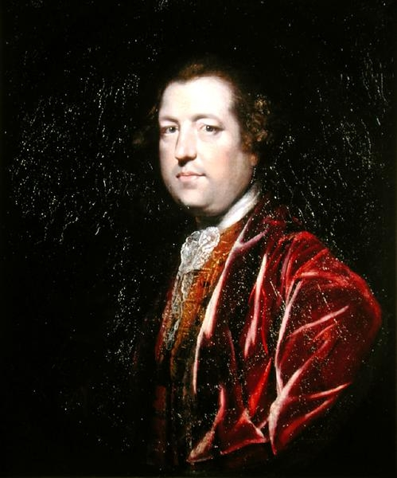
Picture of Charles Townshend

Slide 18
Colonists strike back
Massachusetts Assembly sends Massachusetts Circular Letter, written by Samuel Adams in 1768, to all assemblies so they can protest in unison
British ordered assemblies not to discuss Massachusetts letter…so they all talked about it. Governors of colonies with legislatures that discussed the letter had to dissolve the legislatures, which made colonists more angry
Colonists protested, this time with “commoners” plus wealthy citizens. Boycotts were successful, since British merchants were affected, and so joined in. Colonial women produced “American”/New England goods to replace British imports
After two years, Parliament repealed most Townshend duties, though not the other parts of the Acts

Slide 19
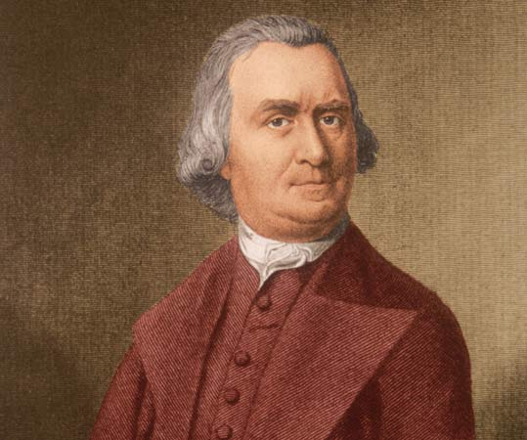
Picture of Samuel Adams

Slide 20
Non-Consumption & Non-Importation
No police departments in colonial America
If a man beats his wife, neighbors threaten him to stop
Patriot leaders used this when protesting Townshend duties
Colonists had to rely on non-consumption and non-importation (boycotting) British goods
It’s only effective if everyone does it
New England newspapers printed pleas to women, who generally managed the family budget, not to buy British linen and tea, and publicly exposed importers
If that didn’t work, they tarred-and-feathered importers, bullying them into stopping

Slide 21
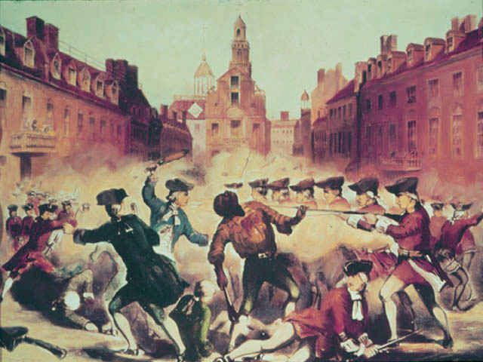
Quartering Act of 1765 and the Boston Massacre
Quartering Act of 1765 stationed many troops in America, made colonists feed and house them. Soldiers remained, especially in Boston. Soldiers sought off-hours employed, competed with colonists for jobs
On 3/5/1770, a mob hit soldiers with rock-filled snowballs. Soldiers fired on the crowd, killing five. Rebels called it the Boston Massacre. Propaganda campaign followed, saying they were shooting innocents only
John Adams defended the soldiers, establishing tradition of giving accused fair trials

Slide 22
Calm before the storm
From 1770 to 1772, nothing major. In 1772, British used part of Townshend Acts that let colonial overseers be paid from customs revenues (not by colonial legislatures)
Colonists set up many Committees of Correspondence to inform each other and convince citizens to take note
British gave East India Tea Company a monopoly on tea trade in colonies, and part of new duties to be collected on colonial tea sales
Colonists got cheaper tea, but hated that they were getting new taxes

Slide 23
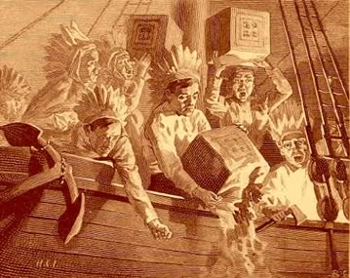
Boston Tea Party
In Boston, colonists didn’t let ships unload cargo, and the governor didn’t let them leave the harbor
On 12/16/1773, Sons of Liberty disguised themselves as Native Mohawks. Boarded a ship, dumped its tea into the Boston Harbor
Took them three hours to throw away all the tea. Called the Boston Tea Party

Slide 24
Intolerable Acts
British respond to Boston Tea Party by passing Coercive Acts/Intolerable Acts
Closed Boston Harbor to all trade but food/firewood until the tea was paid for
More British control of Massachusetts
New Quartering Act put British soldiers in civilian homes
Also passed Quebec Act, which granted more liberty to Catholics and extended boundaries of Quebec Territory, blocking American western expansion

Slide 25
First Continental Congress
All colonies but Georgia send delegates to First Continental Congress in late 1774
Pennsylvania has conservatives like Joseph Galloway; Virginia has radicals like Richard Henry Lee and Patrick Henry (remember him?)
Wanted to list American grievances, develop strategies, get a uniform colonial position on relationship of colonies to Crown. Congress came up with list of laws they wanted repealed and agreed to boycott British goods ‘till that time
Delegates formed a Continental Association so towns could have committees overseeing the boycott; in time, the committees became the town governments
Congress agreed that Parliament can interfere in some places, but not anything else

Slide 26
Lexington/Concord
From winter of 1774 to spring of 1775, committees of observations expand powers
They rebel against British overseers, collecting their own taxes, disrupting court sessions, organizing militias, stockpiling weapons
British thought arresting ringleaders would stop it, so sent troops to take weapons in Concord, Massachusetts in April of 1775
Troops had to first pass through Lexington, where colonial “minutemen” (ready to fight at a minute’s notice) waited
Shots were fired and returned (later called the “shot heard ‘round the world”)
When Battle of Lexington was over, eight minutemen were dead
British proceeded to Battle of Concord, where they fought more Massachusetts minutemen
These minutemen fought the British “redcoats” and forced them to retreat

Slide 27
America rises
Some remained loyal to the Crown, the Loyalists, like government officials, Anglicans, merchants who needed English trade, and religious/ethnic minorities who feared persecution from rebels
Many slaves thought British would tried them better. Royal governor of Virginia offered slaves freedom if they joined British army
Pre-Revolutionary War saw slave insurrections, so South was less enthusiastic about rebellion
Rebels, or the patriots, were white Protestant property holders, and urban artists, especially in New England. In New England, Puritans had antagonized the Anglicans
Most of the population wanted it all to blow over. Quakers of Pennsylvania, for example, were pacifists

Slide 28
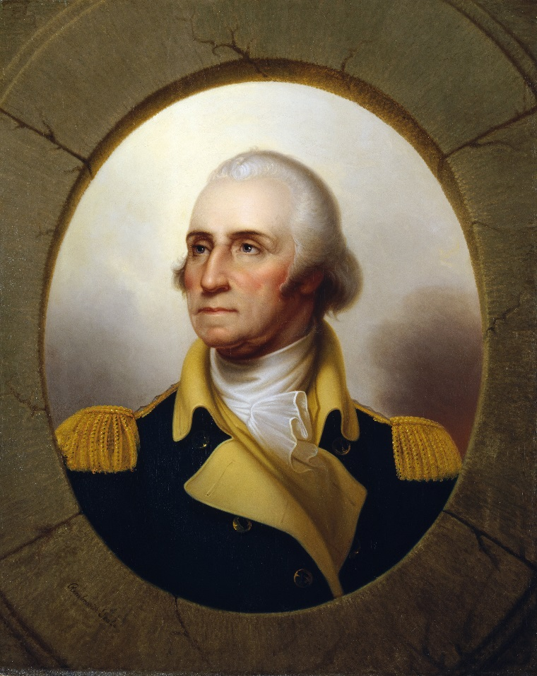
Second Continental Congress
Weeks after Lexington and Concord, Second Continental Congress gathers
They establish a Continental Army, print money, and create government offices to supervise policy
Congress chose George Washington to lead the army. Well-liked, Southerner. Very tall man (John Adams: “Washington was always selected to lead…because he was always the tallest man in the room”)

Slide 29
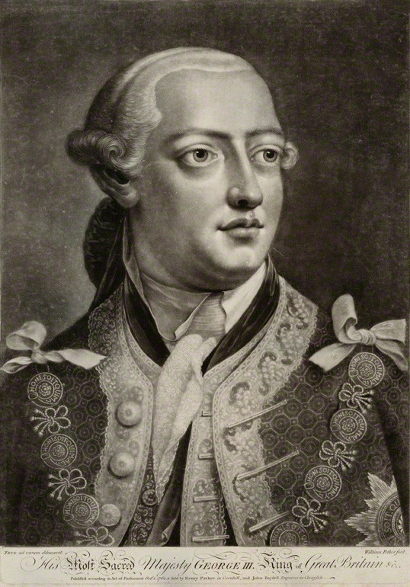
Olive Branch Petition
John Dickinson pushed for reconciliation using Olive Branch Petition
Continental Congress adopted it on 7/5/1775 after a fight at Breed’s Hill (AKA Bunker Hill in Charleston, Massachusetts)
King George III didn’t care about the proposal, since he thought colonists were all in rebellion
All-out war was now inevitable

Slide 30
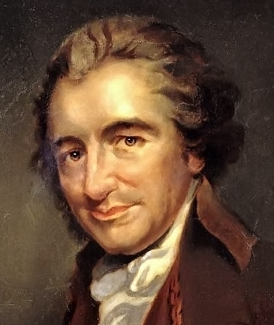
Common SEnse
Englishman Thomas Paine wrote a pamphlet in 1/1776 called Common Sense
Advocated for colonial independence and fought for republicanism over monarchy
Most of nation’s two million couldn’t read, but over 100 thousand copies were sold in first three months
Made argument in plain language to normal folks

Slide 31
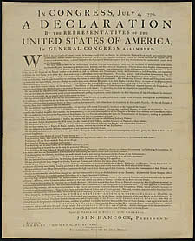
Declaration of Independence
In 6/1776, Congress got Thomas Jefferson to write the Declaration of Independence
Lists colonies’ grievances with Crown, discusses individual liberty, government being there to serve the people
Signed on July 4, 1776

Slide 32
Timeline
1763: French and Indian War ends. Pontiac’s Rebellion. Proclamation of 1763.
1764: Sugar Act. Currency Act.
1765: Stamp Act. Stamp Act crisis. Sons of Liberty formed.
1766: Grenville replaced by Rockingham as prime minister. Stamp Act repealed. Declaratory Act.
1767: Townshend Acts.
1770: Townshend duties repealed (except tea tax). Boston Massacre.
1772: Parts of Townshend Acts implemented. Committees of Correspondence formed.
1773: British gave Dutch East India Tea Company monopoly on tea in colonies. Boston Tea Party.
1774: Coercive/Intolerable Acts. Quebec Act. First Continental Congress meets. Continental Association forms.
1775: Battles of Lexington and Concord. Second Continental Congress meets.
1776: Declaration of Independence.

Slide 33
End of the War
The British surrendered at Yorktown in October of 1781
Continental Army had trouble getting good soldiers
Eventually Congress recruited up to 5,000 blacks (most who were slaves got freedom afterwards)
Ben Franklin negotiated the Franco-American Alliance in 1778, which brought French in to help us (after they saw us win the Battle of Saratoga). The French were still sore at the English after the French and Indian War. It took three years for French to get here, but promise helped our morale. British were outlasted and forced to abandoned an unpopular war on foreign soil
Treaty of Paris, signed in 1783, officially granted U.S. independence and territorial rights

Slide 34
Sad to Say…
Declaration of Independence said “all men are created equal” but slavery was not abolished
Women played big role in revolution, but were not granted additional rights

