Slide 1
Chapter Three: Creating a Functioning Government
(1777-1824)

Slide 2
Articles of Confederation
Colonies didn’t wait for independence to set up governments
In 1777, the Continental Congress sent our first national constitution, the Articles of Confederation, to the colonies
Colonists make little to no central government; afraid of getting rid of Britain only to create their own tyrannical government
Did not let national government tax anything or regulate trade. Amendments to constitution required all states to agree. More concerned with prohibiting tyranny than governing effectively

Slide 3
New Issues
New contentious era of Native American relations, since tribes sided with England against colonies. Women and blacks expected compensation
John Adams’ wife, Abigail Adams, said “remember the ladies”
More free blacks living among free whites, but more racist publications and laws. Led to early “ghettoization” of blacks and other minorities

Slide 4
Problems with the Articles
The wartime government tried to finance war by printing more money. Led to inflation
After war, British tried to punish colonies in trade, denying access to West Indian markets and dumping goods on American markets
Protective tariff made it more expensive to buy stuff from other countries; the additional cost is added to the selling price and makes it too expensive
It backfired against the British—by making domestic products cheaper than imports, these tariffs helped American manufacturers
Americans were hesitant to have protective tariff of their own

Slide 5
No Good News
When the state governments wouldn’t pay loyalist Americans back for lost property, British wouldn’t leave U.S. military posts. “We’re here to protect the loyalists’ rights”
Federal government too weak to kick them out
From August 1786 to January 1787, Shay’s Rebellion. 1500 farmers from western Massachusetts march on Springfield to protest weak governments. Just like Bacon’s Rebellion and Whiskey Rebellion, showed divide between backcountry farmers and coastal elite. Showed Articles of Confederation was too weak to stop these rebellions

Slide 6
Not All Bad
Articles of Confederation made ordinances, which governed sale of government land to settlers
Best known one is Northwest Ordinance of 1787. Contained a bill of rights guaranteeing trial by jury, freedom of religion, freedom from excessive punishment. Abolished slavery in Northwestern territories (northwest of Ohio River, east of Mississippi River up to Canada)
Set regulations concerning when territories could and couldn’t apply to be states. Claimed Native land without consent, caused war that only ended in 1795, when U.S. beat the Native Miami Confederacy. Northwest Ordinance remained important after Northwest was settled because of slavery and territory regulations

Slide 7
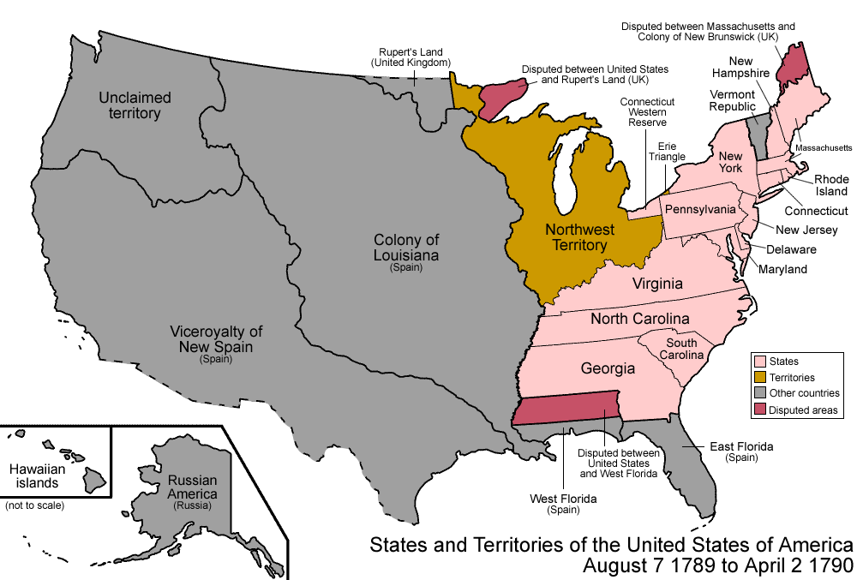
Picture of Northwest Ordinance

Slide 8
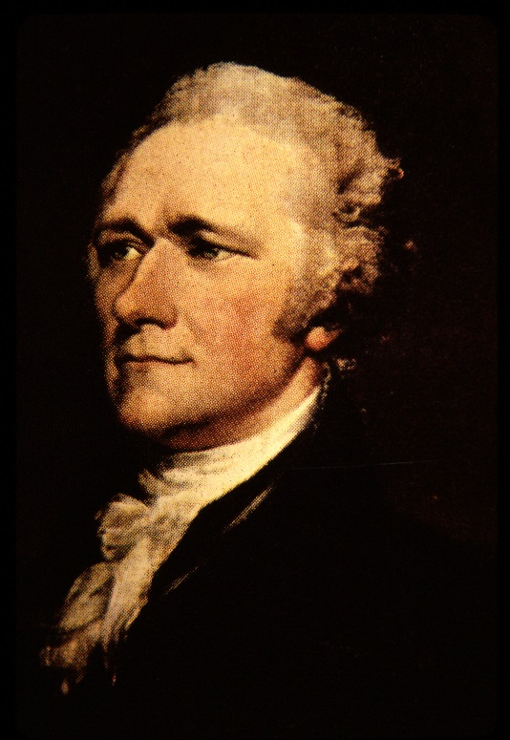
New Constitution
In 1787, federal government obviously lacked authority. Mr. Alexander Hamilton was worried. No uniform commercial policy
He tried to have the Annapolis Convention…and only five delegates showed up
Congress had to agree to a “meeting in Philadelphia” in May to revise the Articles
The meeting became the Constitutional Convention, which had delegates from everywhere but Rhode Island. Met all throughout the summer of 1787

Slide 9
The Framers
All men, all white, many wealthy, many slave-owners, 55 of them
The New Jersey Plan called for equal representation in Congress from each state (gives smaller states an advantage)
The Virginia Plan, from James Madison, called for a new government based on checks and balances and for representation to be proportional to state size (which gives bigger states an advantage)
Convention created the Great Compromise (a.k.a. the Connecticut Compromise), which blended the Virginia Plan and New Jersey plan to have bicameral legislature. Lower house (House of Representatives), elected by people. Upper house (Senate), elected by legislature. Senate being directly elected is modern, 20th century. President/VP were elected by electoral college, not citizens
Also made our Constitution

Slide 10
Constitution
Had a method for counting slaves in Southern states for “proportional representation,” though slaves would not be citizens
This is called the Three-Fifths Compromise, since each slave was considered 3/5^{ths} of a person
Also established three branches of government. Executive, Legislative, Judicial. Powers of checks/balances over each other. Only three of the 42 delegates who stayed to the end (out of 55) refused to sign the finished documents. Two of the three didn’t want to sign because there wasn’t a Bill of Rights

Slide 11
Opposition to the Constitution
Opposition portrayed Constitution as giving federal government too much power
Called themselves Anti-Federalists because they were against the federal government having power over the states
Tended to come from backcountry, hated lack of bill of rights
Federalists argued back in Federalist Papers, anonymously written by James Madison, Alexander Hamilton, and John Jay
Federalist Papers published in New York, widely circulated; swayed opinion in large, important New York
Constitution went into effect in 1789, Bill of Rights followed in 1791

Slide 12
Bill of Rights
Freedom of religion/speech/press/assembly/petition
Right to bear arms in order to maintain a well-regulated militia
No quartering of soldiers in private homes
Freedom from unreasonable search and seizure
Right to due process of law/freedom from self-incrimination/double jeopardy
Rights of accused persons (for example, the right to a speedy and public trial)
Right of trial by jury in civil cases
Freedom from excessive bail and from cruel and unusual punishment
Rights not listed are kept by the people
Powers not listed are kept by the states (or the people)

Slide 13
George Washington
Electoral college unanimously chose George Washington to be our first president
Did not campaign, but was most popular in colonies, and accepted. Knew his actions set precedents. Only used veto if he knew bill was unconstitutional
Delegated responsibility to government full of best minds
Constitution does not grant president power or duty to make cabinet, but every president since Washington followed hid example
Cabinet is made up of heads of executive departments, president’s main advisors, grown in number over the years

Slide 14
Washington’s Cabinet
Secretary of State was Thomas Jefferson
Secretary of Treasury was Alexander Hamilton
Two disagreed about relationship between state government and federal government
Hamilton favored strong central government, weaker state government (Federalist)
Jefferson feared tyranny of strong central government, so favored a weaker federal government which would mainly defend the country and regulate international trade (Anti-Federalist). All other powers go to the states

Slide 15
National Bank
Hamilton proposed a National Bank to strengthen/regulate the economy
Both houses of Congress approved, but Washington considered a veto and allowed a debate
On one side, strict constitutionalists (Jefferson and James Madison). The Constitution allowed Congress ONLY powers specifically granted to it or those “necessary and power” to carry out its “enumerated (specific) powers. “A bank might be nice, but it’s not “necessary” so Congress can’t make one
Hamilton argued for broad/loose constructionism. Creation of bank was an implied power of the government, since the government has an explicit power to coin money, borrow money, and collect taxes. Government can do anything to carry out enumerated powers” so long as Constitution doesn’t outright forbid it
Washington agreed with Hamilton and signed the bill

Slide 16
National Debt
Hamilton was successful at dealing with the national debt the U.S. accrued during the Revolution. Thought national debt was a good thing. Government borrows money a lot, like offering bonds for sale to wealthy American investors. The national debt is sometimes a measure of how much the government owes to the citizens. If the government owed money to its wealthy citizens, then the citizens are invested in the government’s success—if the government fails, they won’t get their money back
His financial plan was to have federal government take on the states’ debt. This increases the influence federal government has over the states
He would repay the debts by giving the debt holders land on the western frontier

Slide 17
Problems
This plan favored Northern banks, who bought up debt certificates at a small portion of their value
Northern states had more debt than Southern states
Hamilton was accused of helping elite Northerners and cheating working Southerners
He struck deals to get the plan implemented anyway
He conceded that a Southern nation would become the nation’s capital
In 1800, the capital became Washington, D.C., a city created to become the seat of government

Slide 18
The French Revolution
During the Washington years, the French Revolution happened. Jefferson wanted to support it and its republic/anti-crown ideals
Hamilton liked rich people, and disliked seeing the poor rise up and kill them
At one point, Britain and France started fighting. The British were still America’s post-war trading partner, so America just stayed neutral
French government representative Citizen Edmond Genet begged America for assistance, inspired pro-French rallies
Washington responded by declaring U.S. “friendly and impartial towards belligerent powers.” This is the Neutrality Proclamation

Slide 19
Two-Party System
Hamilton v. Jefferson was start of the two-party system
Strong federal government supports were Federalists
Followers of Jefferson were called Democratic-Republicans
Development of political parties upset framers/writers of the Constitution, most of whom called factions/parties dangerous to Republic

Slide 20
First Party System
 | Federalists | Democratic-Republicans
Leaders | Hamilton, Washington, Adams, Jay, Marshall | Jefferson, Madison
Vision | Economy based on commerce | Economy based on agriculture
Governmental Power | Stronger federal government | Stronger state governments
Supporters | Wealthy, Northeast | Yeoman farmers, Southerners
Constitution | Loose construction | Strict construction
National Bank | Believed it was “necessary” | Believed it was just “desirable”
Foreign Affairs | More sympathetic towards Britain | More sympathetic towards France

Slide 21
Whiskey Rebellion
In western Pennsylvania, farmers resisted on tax on whiskey. Hamilton created the tax to get more money and pay off the debt
Washington reacted by sending the militia. He beat the rebels, captured the ringleaders, but pardoned them
Like Bacon’s Rebellion and Shay’s Rebellion, the Whiskey Rebellion showed class tensions between inland farmers and coastal elites
Shay’s Rebellion showed Articles were too weak to respond, but Whiskey Rebellion showed America’s new power. James Madison retreats from Federalists, becomes a Democratic-Republican; too scared of tyranny

Slide 22
Washington’s Second Term
Sends John Jay to England to make a treaty so English leave the Northwest Territory (as per the Treaty of Paris that ended the Revolutionary War), and to discuss British violations of free trade. Called Jay’s Treaty
Prevented war with Britain, but opponents thought Jay made too many concessions. Britain wasn’t respecting us as a sovereign nation. Considered to be the low point of Washington’s administration, they burned dolls of John Jay in the streets

Slide 23
Spanish Affairs
Washington sent Thomas Pinckney to Spain to negotiate use of the Mississippi duty, tax-free access to world markets, and removing Spanish forts from American soil
Pinckney also got a promise from Spain to prevent Native attacks on American settlers
This was called Pinckney’s Treaty or the Treaty of San Lorenzo. Ratified by U.S. Senate in 1796, called the HIGH point of Washington’s administration
In 1797, Congress tried to withholding funding to enforce the treaty. House of Representatives asked Washington to submit a bunch of documents related to the treaty
Washington refused, establishing executive privilege (right of president to keep back information when doing so can protect national security)

Slide 24
End of an Era
Washington declined to run for a third term
In his farewell address, composed in part by Alexander Hamilton, he warned future presidents to street clear of permanent alliances with any portion of the foreign world”
This call for neutrality defined American foreign policy until the late 1890s

Slide 25
Republican Motherhood
During 1790s, women’s roles in courtship/marriage/motherhood are changed in accordance with new republic and its ideals. Women were excluded from politics/voting, but they had important civil role: teach/produce virtuous male citizens
Private virtue became a huge quality for women, who had to teach men how to be good citizens through romance and motherhood. Women should only date people with good morals
Feminists argued that educated women would be better mothers, and then produce better citizens. They succeeded…but didn’t change gender roles. Education of women was meant only in service to husbands and family.

Slide 26
The Adams Presidency
Electoral college selected Federalist John Adams as Washington’s successor
The rules were that second place candidate becomes the vice-president
Adam’s vice-president became Democratic-Republican Thomas Jefferson
Adams was argumentative and unlikable
Very hands-off, he let Jefferson’s rival Alexander Hamilton take charge
We had a member of the cabinet (Hamilton) fighting with the VP (Jefferson), and Adams didn’t stop it

Slide 27
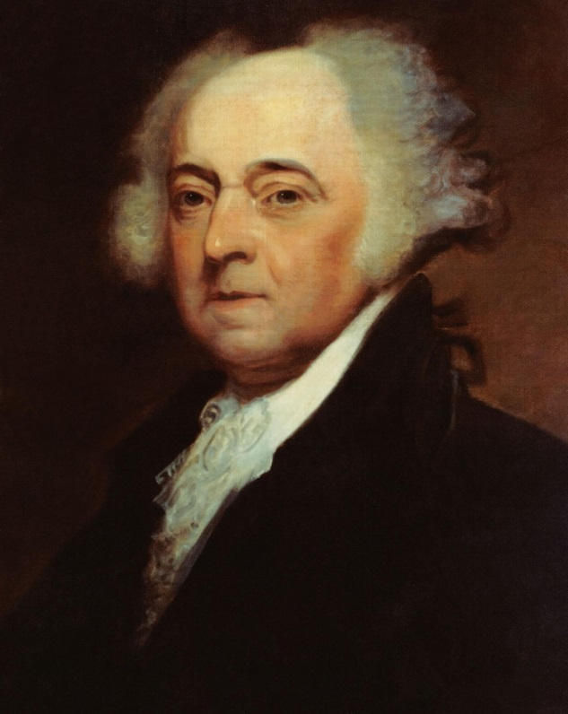
Adams’s Achievements
After U.S. signed Jay’s Treaty with Great Britain, France started seizing American ships on the seas
Adams sent diplomats to Paris. French officials wanted a bribe pre-negotiations. Adams published this in an official American newspaper, quoting the French directly but replacing their names with X, Y, and Z (it was then called the XYZ Affair)
The pro-French Revolution Americans became very anti-French to the point of calling for war. Adams was able to use this to negotiate a peaceful settlement with France

Slide 28
The Low Point
Adams passed the Alien and Sedition Acts. The government could force foreigners out of the country and jail newspaper writers for anything called “scandalous” or “malicious.” Acts were political, made to deport new immigrants’ support for Democratic-Republicans
Sedition Act regulated Free Speech, DIRECTLY violated First Amendment
VP Jefferson and James Madison fought back, anonymously writing the Virginia and Kentucky Resolutions, which said that states could judge if federal laws were constitutional. Said states had right to nullification—declare unconstitutional federal laws NULL AND VOID
Jefferson was clever, didn’t prevent Alien/Sedition Acts from being enforced. Waited ‘till the people were angry, and then used them during the 1800 election so he could become president

Slide 29
Election of 1800
Federalists were split, so Democratic-Republicans could easily win
Two men ran for D-R nomination: Thomas Jefferson and Aaron Burr
Each got an equal number of votes in electoral college, so the Federalist-dominated House of Representatives had to choose the president
Jefferson won. His old rival Alexander Hamilton campaigned for him, since he thought that Aaron Burr was an “unfit and dangerous man.” Burr proved Hamilton right by killing him in a duel

Slide 30
Why the Election of 1800 Mattered
For the second time in two elections, a president got a VP he didn’t want (Adams and Jefferson, Jefferson and Burr)
In 1804, they added the Twelfth Amendment to the Constitution. Allowed electors to vote for a party ticket (they vote for a package deal of a president and VP)
America’s first transfer of power (from Federalist Adams to Democratic-Republican Jefferson) had no violence
Jefferson called his victory the “bloodless revolution”

Slide 31
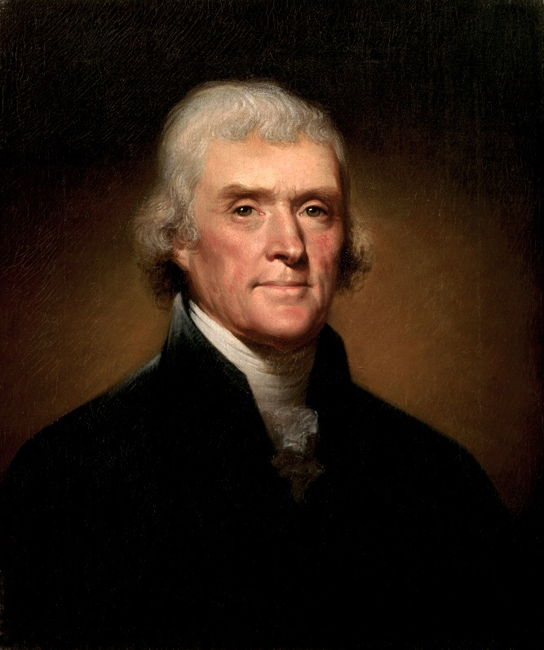
Jefferson’s First Term
Adams was angry that Jefferson won
Made some “midnight appointments,” filling government positions with as many Federalists as possible as he left office
Jefferson either ignored them, replaced them, pressured them to retire
By his second term, most public officials were Democratic-Republicans like Jefferson

Slide 32
Marbury v. Madison
Problems caused by Jefferson not recognizing Adams’s midnight appointees. The Supreme Court dealt with the case of Marbury v. Madison in 1803
William Marbury, a last-minute appointee, sued Secretary of State James Madison for refusing to certify his appointment. Chief Justice of the Supreme Court John Marshall was a Federalist, so he liked Marbury, but he thought it wasn’t the Court’s place to force the federal government to certify the appointment
He establishes judicial review. Marbury had a right to an appointment, but it wasn’t the Court’s job to enforce it. The Court’s power to do so in the Judiciary Act of 1789 was now called unconstitutional
Jefferson got his political victory, and the Court’s job became reviewing whether Congress acts constitutionally or not (checks and balances)

Slide 33
Louisiana Purchase
When Spain gave New Orleans to France in 1802, America thought it could be trouble. France might use the fact that New Orleans is at the mouth of the Mississippi River to mark up prices for transportation and restrict trade
Jefferson sent James Monroe to France; his job was to buy New Orleans for $2 million
Monroe arrived when Napoleon (France’s leader) was going to war in Europe, and didn’t want to deal with the New World territories
The French offered to sell Monroe the WHOLE Louisiana Territory for $15 million

Slide 34
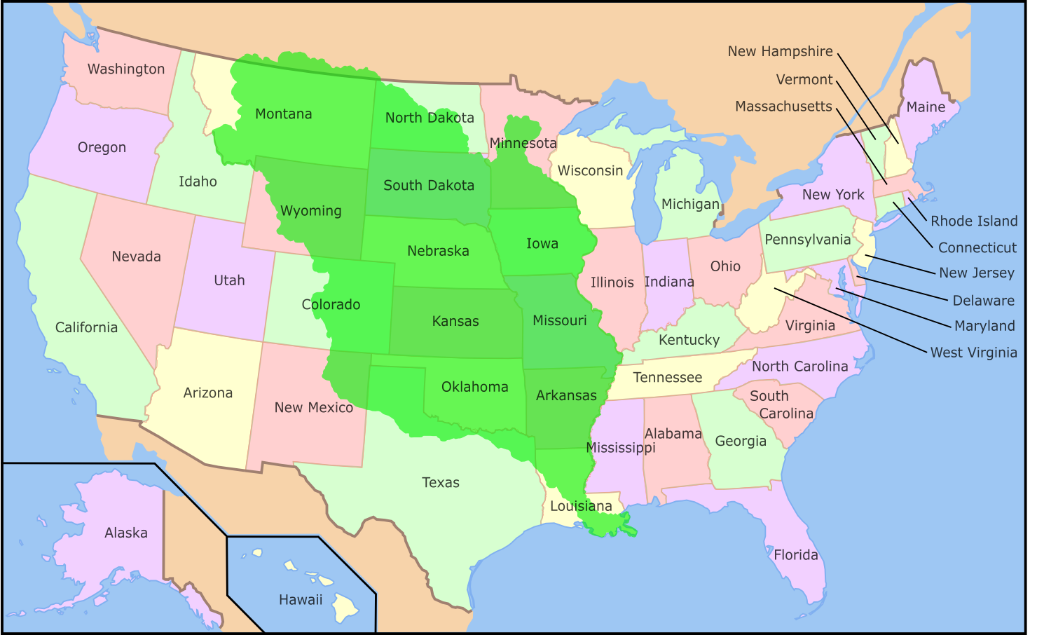
Louisiana Territory

Slide 35
Making the Purchase
When Jefferson was Washington’s Secretary of State, he argued for strict constitutionalism; federal government could only do what’s explicitly in the Constitution. Didn’t say the president can buy land
He didn’t want to pass on a chance to double the U.S. size. He claimed the explicit presidential power to negotiate treaties with foreign nations, and bought it without Congressional approval
Federalists called it too expensive (though it was three cents per acre)
Some Republicans, led by John Randolph of Virginia, said Jefferson abandoned Republican ideals; they called themselves Quids

Slide 36
Lewis and Clark
Jefferson sent explorers like Merriweather Lewis and William Clark to investigate the west
All returned with favorable reports
Led explorers to journey west to find land and money
Early explorers also found British and French troops out West, some of which were never told that the French and Indian War was over

Slide 37
Re-election
Jefferson ran again in 1804, won a second term
Aaron Burr ran for governor of New York. Alexander Hamilton campaigned against Burr
Burr lost, accused Hamilton of sabotaging his career, and challenged him to a duel. Killed Hamilton
Fled to the Southwest and plotted to become King of the Louisiana Territories
Captured, tried for treason, and then acquitted because of a lack of evidence

Slide 38
Jefferson’s Second Term
U.S. got caught in another French-English dispute, led to War of 1812
In 1805, British and French were at war, at stalemate, started blocking each other’s trade routes. The United States, dependent on both, suffered from the blockades
British began stopping American ships, impressing sailors. Said “you’re a British deserter” and forced them into their navy
Tensions built, and a British ship attacked an American ship in American waters
Jefferson didn’t want to lose in a navy fight, so he boycotted Britain

Slide 39
Bad to Worse
Jefferson passed the Embargo Act of 1807
It shut down the American import and export business, totally backfiring, ruining New England’s economy, causing smuggling
The Non-Intercourse Act of 1809 reopened trade with most nations, but banned it with Britain/France
Jefferson was done with being president after two terms, like Washington
He endorsed his Secretary of State, James Madison, who beat the Federalists easily

Slide 40
Madison: Fixing Trade
Congress wrote up Macon’s Bill No. 2 and reopened trade with Britain/France
Madison said that if either country stopped interfering with American trade, he’d stop trading with the second country
Napoleon/France committed first, so U.S. stopped trading with Britain
Britain stepped up their attacks on American ships

Slide 41
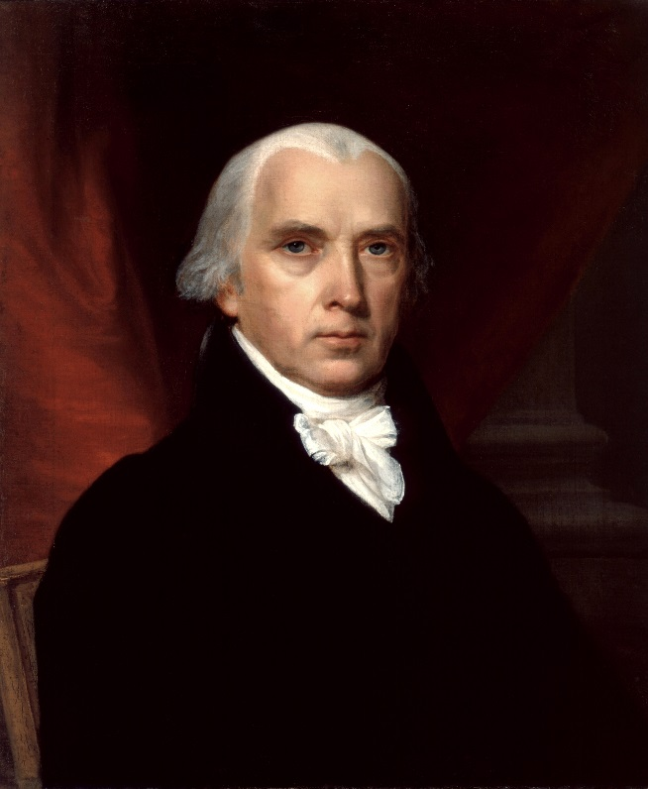
War Hawks
Southern and Western War Hawks wanted to fight with Britain so they could take British land in west/southwest
Led by Henry Clay and John C. Calhoun (they’re important later)
Madison asked Congress to declare war on Britain in 1812

Slide 42
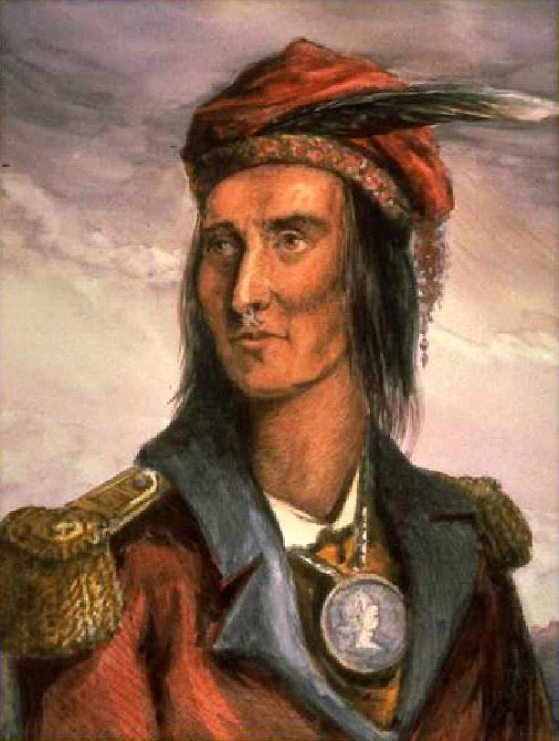
Natives Strike Back
Just like in Revolution, Natives fight alongside British because they hate colonists
Chief Tecumseh unifies tribes to stop American expansion in Indiana and Illinois. His brother Tenskwatawa, also known as the Prophet, leads a revival of Native culture and religion
Tecumseh is killed in battle; movement fails

Slide 43
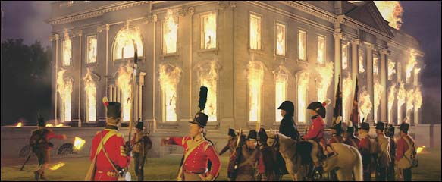
The Roof is on Fire
British capture Washington, D.C. in 1814. Set the White House on fire
America fights to a stalemate eventually
English-French hostilities end when Napoleon is defeated, and British can negotiate peace

Slide 44
End of the War
The Treaty of Ghent ends the war, but American General Andrew Jackson fights and wins the Battle of New Orleans (only fight the U.S. wins in the whole war)
The Federalists didn’t like the war because it hurt trade, and didn’t hear the war was over
They met in Hartford, Connecticut for the Hartford Convention to consider either totally changing the Constitution or seceding
When the war ended, most thought the Federalists were traitors
The national party dissolved after the Hartford Convention

Slide 45
Results of the War
Spurred American manufacturing. Cut off from trade in Europe, the U.S. had to become more self-sufficient. New England became America’s manufacturing center; after the war, we were less dependent on imports than before
End of Native Americans’ ability to stop American expansion
American economy was less reliant on trade with Britain
Andrew Jackson became a celebrity. Victory in New Orleans made us think we were unstoppable. Popularity of war destroyed Federalists, taught politicians that objecting to wars can be dangerous for careers

Slide 46
Post-war of 1812
Madison worked to promote growth but did not expand Federalist power (he was a D-R)
Wanted protective tariffs on imports, improvements to interstate roads (expanded National Road, old kind of highway, from Maryland to Ohio)
Re-chartered National Bank after the first National Bank’s charter expired
Programs were known as American System or Nationalist Program
Speaker of the House Henry Clay wanted them so badly it was called “Henry Clay’s American System”

Slide 47
Era of Good Feelings
When Federalists died out, D-Rs were solely in charge. Period of unity called Era of Good Feelings
Chief Justice John Marshall’s rulings strengthened federalist government. Ruled in McCulloch v. Maryland that states could not tax the National Bank. Showed that national law > state law
Good feelings ends in 1819 with Panic of 1819. After economic growth, there’s sudden turmoil
National Bank called in loans but borrowers couldn’t repay them. Mortgage foreclosures, business failures. Many thrown in poverty
Still, no unified rival to D-R, so Monroe wins re-election in 1820

Slide 48
John Quincy Adams
John Quincy Adams was Secretary of State under Monroe. Son of John Adams. Negotiated treaties to fix borders and open territories. U.S. got Florida from Spanish from the Adams-Onis Treaty of 1819. Adams also handled tension from revolutions in Central and South America (breaking away from Spain)
Monroe and Adams recognized new nations as legitimate. Thought America should dominate the Western Hemisphere
Monroe Doctrine=policy of mutual NON-interference. Europe, stay away from the Americas & we’ll stay away from Europe
Monroe Doctrine also said we have a right to intervene anyway in the Western Hemisphere for sake of our security
No European country interfered, but not just ‘cause of the doctrine…also because Britain prevented any European ships from coming our way.

Slide 49
Missouri Compromise
In 1820, Union had 22 states. 11 had slavery, 11 didn’t
Missouri was the first state carved out after the Louisiana Purchase, and, as the 23 state, it would threaten the balance
Henry Clay made the Missouri Compromise
Missouri was admitted as a slave state. Maine was carved out of Massachusetts, and became a free state. Drew a line along the 36-30 parallel across the Louisiana Territory. Establishes southern border of Missouri as the northernmost point at which slavery is allowed in western territories of U.S. (aside from Missouri itself)
Compromise prevented the civil war from happening for a couple decades
Split the Democratic-Republicans, ending the Era of Good Feelings

Slide 50
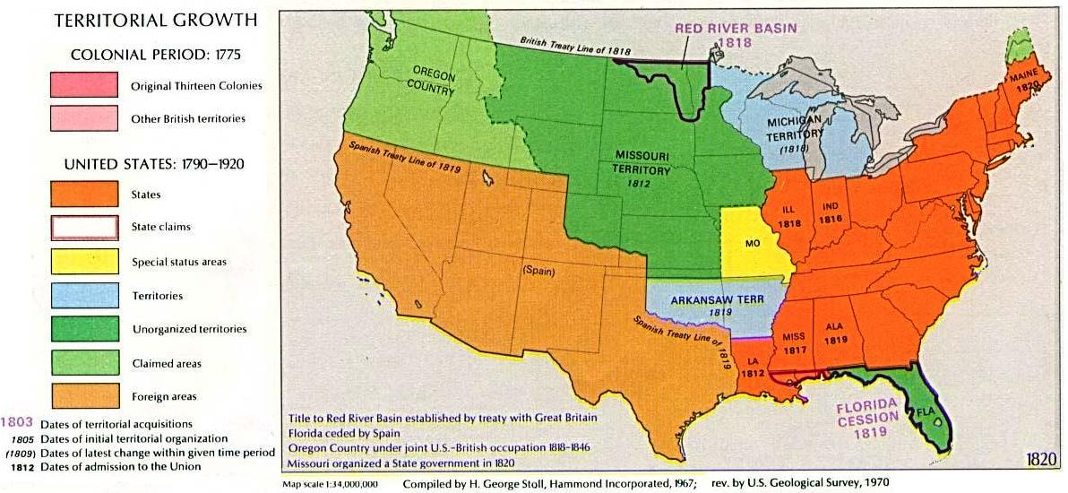
Picture of Missouri Compromise

