Slide 1
Chapter One: The Seventeenth and Early Eighteenth Centuries
(1600 to 1750)

Slide 2
Native Americans in Pre-Columbian North America
Chapter One, Section A

Slide 3
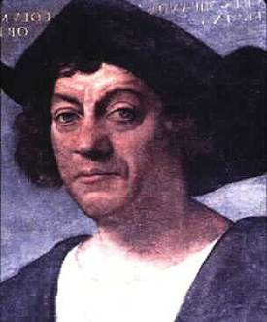
Pre-Columbia Era
Pre-Columbian: before the arrival of Christopher Columbus

Slide 4
Native Americans
Native Americans=/=Native-born Americans
Descendants of migrants from Asia
Came in waves, 40,000 years ago to 15,000 years ago. Planet was colder. Water was frozen. Polar ice sheets
Sea levels were down
They walked across the land bridge. Stretched from Russia (Siberia, specifically) to Alaska

Slide 5
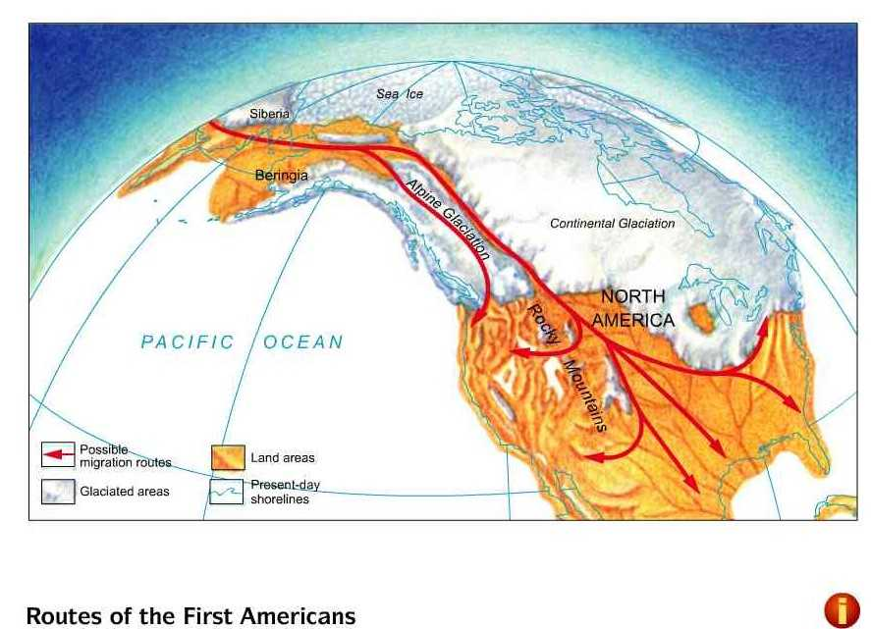
Land Bridge

Slide 6
Bering Strait
The planet warms
Sea levels rise
The land bridge goes back underwater
The Bering Strait is formed
The migrants go south
  Some by boat (along the Pacific coast)
  Some by an ice-free corridor east of the Rocky Mountains
They populate North and South America

Slide 7
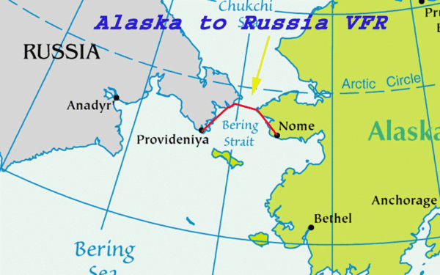
Bering Strait

Slide 8
Pre-Columbian Times
Before Columbus gets here…
  Between 1 and 7 million Native Americans live in Canada/modern U.S.
  Another 20 million live in Mexico
Diverse cultures
  Some are nomadic hunter-gatherers
  Others live in urban empires in South America.
  In 1500, the Aztec capital of Tenochtitlan has more people than any city in Europe. Both Aztec and Mayans known for astronomy, architecture, and art.

Slide 9
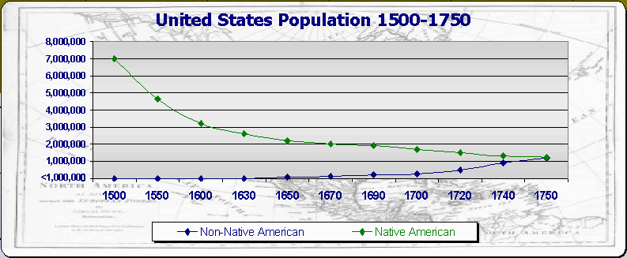
Native American Population Estimate

Slide 10
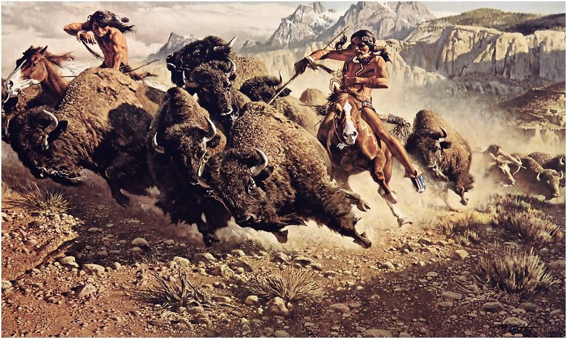
Hunter-Gatherers

Slide 11
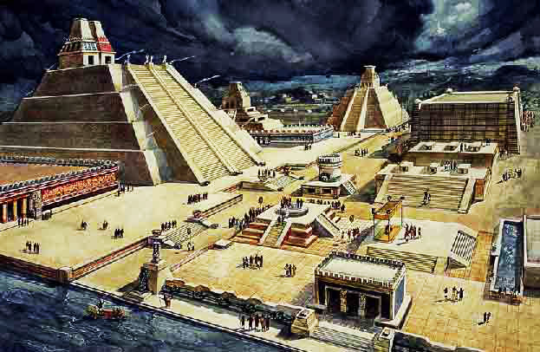
Tenochtitlan

Slide 12
North American Natives
Pueblo People
  Live in Southwest desert. Multistory stone houses, hundreds of rooms
Mississippian culture
  Earthen mounds
Columbus encountered smaller tribes
  Lived along Atlantic Ocean
  Columbus thought he was in the East Indies
  Called them “Indians”

Slide 13
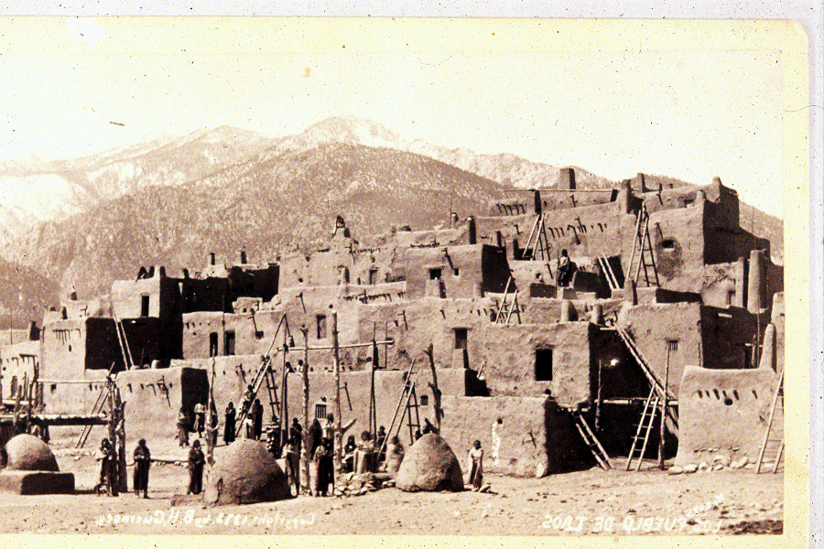
Pueblo People

Slide 14
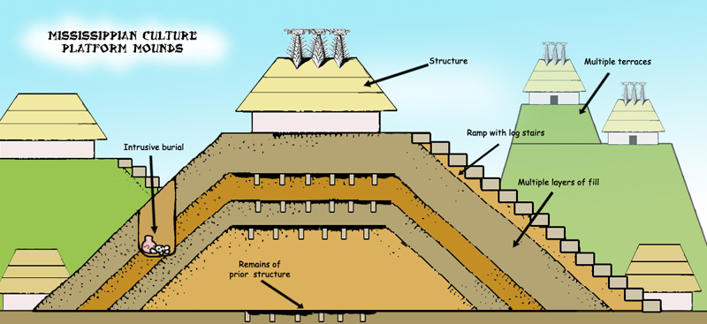
Mississippian Mounds

Slide 15
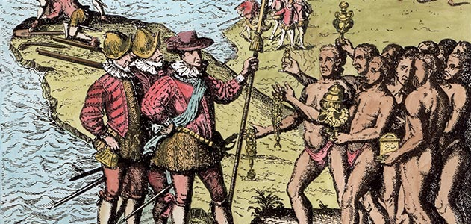
Columbus and Natives

Slide 16
Cahokia
Located near modern St. Louis, Missouri
Largest North American city north of Mexico (before settlers came)
In 13th century, as many people as large European cities
No American city had as many people ‘till the U.S. declared independence
Had Monks Mound
  Artificial hill, 100 feet high, covered 17 acres
  Made of soil transported in baskets

Slide 17
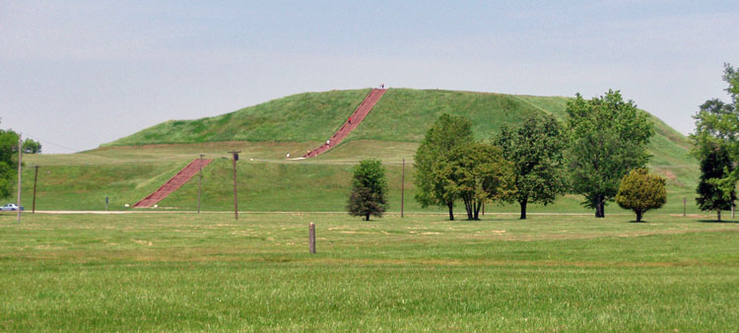
Monks Mound

Slide 18
True or False?
Native American cultures had a minimal impact on the environment

Slide 19
False!
Many Native societies used fire
  Encouraged the growth of useful plants
  Attracted game animals
  European settlers commented that everything looked flat, like parkland

Slide 20
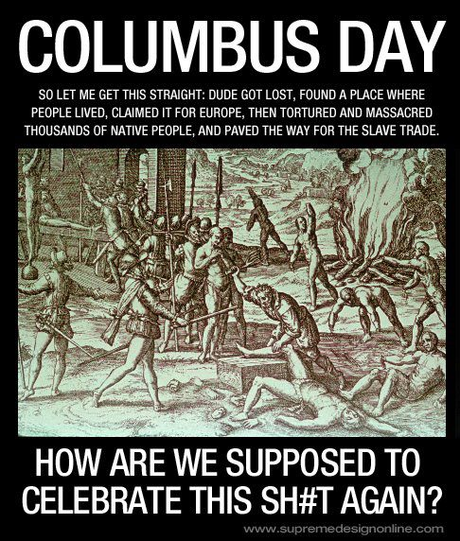
Prelude to Disaster…
Should we celebrate Columbus Day?

Slide 21
Early Colonization of the World (1492 to 1650)
Chapter One, Part B

Slide 22
Spain Colonizes the New World
Columbus arrives in the New World in 1492
  “In 1492, Columbus sailed the ocean blue!”
Not the first European to reach it
  Norse arrived in Canada in 1000 C.E.
His arrival marked beginning of Contact Period
  Europe sustained contact with Americas
  Introduced exchange of plants, animals, foods, diseases, ideas
  This exchange is called Columbian Exchange

Slide 23
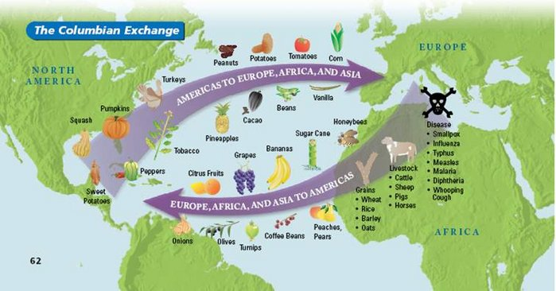
The Columbian Exchange

Slide 24
Columbus Is Special
Vikings like Leif Eriksson, Bjarni Herjolfsson arrived first
Columbus is better remembered
He came when Europe had resources to establish colonies
  Colony: territory settled/controlled by a foreign power
Columbus returns to Spain, reports that there’s an easily colonized New World, opens up European expansion/colonialism

Slide 25
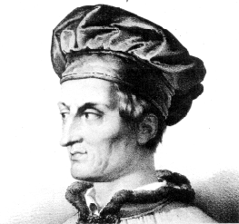
Amerigo Vespucci
Italian navigator, namesake of our country
Sailed in 1499
On second trip out of three, realized South America wasn’t India
Columbus found New World, Vespucci realized it WAS New
A German amateur geographer named the New World after Amerigo in 1507: “I see no reason why anyone should justly object to calling this part ... America, after Amerigo, its discoverer, a man of great ability.”

Slide 26
Spain’s Rise
Spain in control from around 1500 to 1600
Coastal colonies in Central American, South America, and West Indies
Conquistadors conquer natives, collect wealth, export the resources
Spain’s encomienda system
  Crown gives colonists authority over natives
  Colonist protects natives, then converts to Catholicism
  Colonist gets legal rights to natives’ labor
  Form of slavery

Slide 27
Cortes and Montezuma
Hernan Cortes of Spain
Came to Mexico in 1519
Found Tenochtitlan
Laid siege to it, stole its goods, destroyed the Aztec civilization
Aztec Chief Montezuma
Believed Europeans were Gods
Followed old Aztec prophecy
Welcomed them into his city
Eventually fought back, but it was too late

Slide 28
De Soto and Pizzaro
Hernando de Soto
Sought gold in America from 1539-1542
Went from Florida to the Mississippi river
Set dogs on Natives, used iron collars
Died of disease
Body thrown in river so Natives wouldn’t mutilate it
Francisco Pizzaro
Spanish conquistador
Came to South America
Crushed Incas of Peru in 1532
Took their jewels

Slide 29
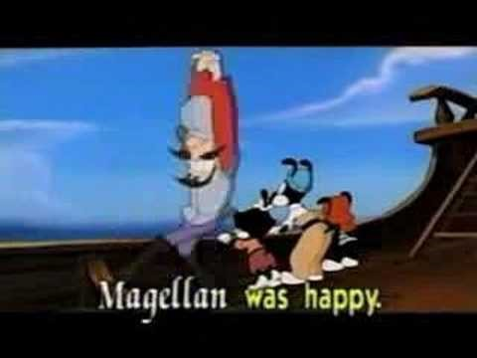
Ferdinand Magellan

Slide 30
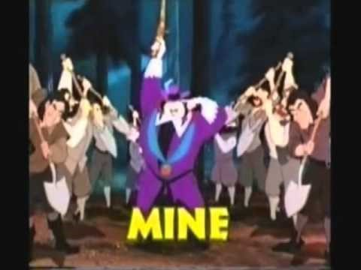
Mine, Mine, Mine!

Slide 31
Spanish Armada
Spain’s navy was the Spanish Armada
Kept other European powers from getting land in the New World
In 1588, the English navy beat the Armada
Made it easier for France and England to colonize North America

Slide 32
Disease
Why did Europeans kill Natives so effectively?
More advanced technology?
  No, Native was superior in some ways
  Canoes better at navigating American rivers
  Moccasins better than boots
Disease mattered
  Natives never exposed to European microbes
  No immunity
  Smallpox wiped out Native communities, up to 95% of some populations

Slide 33
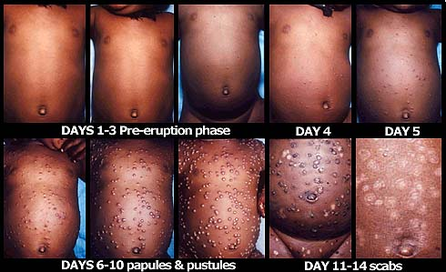
Smallpox

Slide 34
The English Arrive
English first attempt was one year before Spanish Armada lost
Sir Walter Raleigh
In 1587, he made settlement on Roanoke Island (now part of North Carolina)
By 1590…it had disappeared completely
It’s now called the Lost Colony
  Maybe they merged with Natives
  1709, the book A New Voyage to Carolina--some Hatteras Indians had grey eyes and claimed to have white ancestors
  Maybe they tried to sail back and died along the way

Slide 35
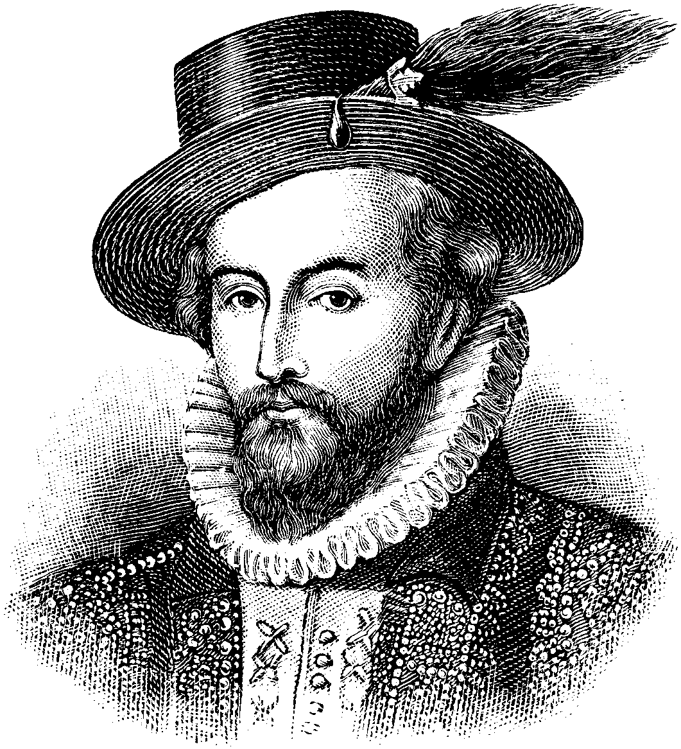
Sir Walter Raleigh, the Sexier Shakespeare

Slide 36
Jamestown
Second English attempt to colonize
Set up Jamestown in 1607
Funded by joint-stock company
  Group of investors who bought the ride to make New World plantations from the King of England
This company was called the Virginia Company
  Named for Queen Elizabeth the First, called “The Virgin Queen”
Settlers were mostly English gentlemen
  Bad at being settlers; cared more about getting gold than planting crops
  Found lots of pyrite (fool’s good), no real gold, but they couldn’t tell

Slide 37
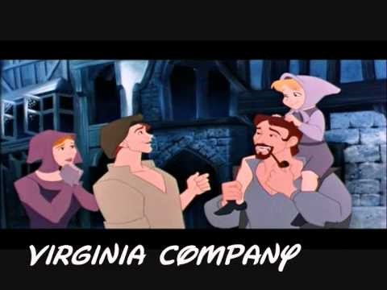
Virginia Company

Slide 38
Company Troubles
Within three months, most original settlers were dead
Starvation and disease
Jamestown only survived because more colonists kept coming from England
Captain John Smith helps out
  “He who will not work shall not eat”
  Friendly with Powhatan Confederacy of Natives
  Injured in an explosion, sails back to England
  Then Powhatans stop helping out and giving Jamestown food

Slide 39
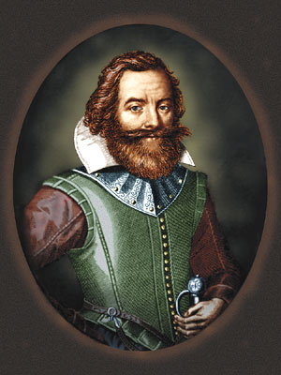

Fact Versus Fiction
The Real John Smith
Disneyfied John Smith

Slide 40
It Gets Worse
The winter of 1609 to 1610 was called the starving time
Nearly 90% of Jamestown’s 500 residents died
  Some became cannibals
Survivors abandoned Jamestown
Traveled down river
Ran right into an English ship with more suppliers and settlers

Slide 41
John Rolfe
John Rolfe was one of the Jamestown survivors
He married Chief Powhatan’s daughter, Pocahontas
  Eased tensions
Began growing tobacco
  Long cultivated by Natives
  Used it as a cash crop, exported it back to England
  English public became addicted
  Helped keep Jamestown alive

Slide 42
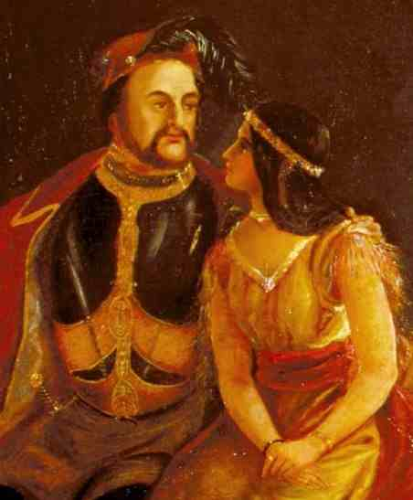
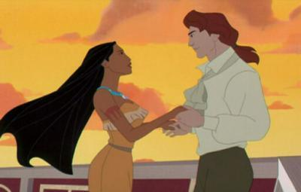
I Ship It
The Real Romance
Disneyfication

Slide 43
Thank You for Smoking
Tobacco requires a lot of land (acreage)
Depletes the soil
  Farmers have to keep finding new fields
Colonists had to keep expanding
Needed people in tobacco fields to handle product
  Developed plantation slavery
  By 1670, half of English males smoked tobacco daily
The entire area is known as Chesapeake Region
  It’s basically where Virginia and Maryland are today

Slide 44
Indentured Servitude
Many migrated to Chesapeake region for financial reasons
Overpopulation in England=famine, disease, poverty
New World=new life
Indentured servitude
  Free passage to the New World if you do seven years’ labor. After seven years, you’re free. Also received property
  With property, they could survive and vote. Right to vote is tied to ownership of property, like in England
  Difficult life, nearly half of indentured servants died. More than 75% of 130,000 Englishmen who came to the Chesapeake during 17th century were indentured servants

Slide 45
Headright System
In 1618, Virginia Company introduced headright system
  Wanted to attract new settlers, address labor shortage; tobacco farming needed more and more workers
Headright=tract of land, usually around 50 acres, given to colonists/settlers
Men already in Virginia got two headrights, new settlers got one
Wealthy investors got a lot of land by paying to get more indentured servants and getting more headrights from the servants
Led to an aristocracy in colonial Virginia. Hurt democracy
Took land from Native Americans, who had a different idea of property

Slide 46
House of Burgesses
In 1619, Virginia creates the House of Burgesses, first law-making body in the English colonies
Any property-owning, white male can vote for laws and representatives
All decisions made by House must be approved by Virginia Company
1619 is the first year of real slavery in English colonies (more on that later, of course)

Slide 47
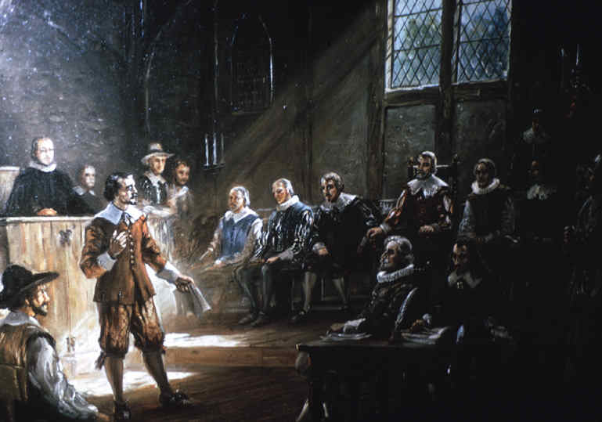
Burgesses: Old-School Congress

Slide 48
The French Arrive
English colonize Jamestown in 1607
French colonize modern Quebec (Canada) in 1608
French Jesuit priests want to make Natives Roman Catholics
Just like Spanish priests, more likely to kill with smallpox than convert
Wanted to find gold and trade shortcuts (mainly to Asia), like the other European powers

Slide 49
Not Quite So Bad
French had lighter impact on Natives than English or Spanish
Very few French came to North America
Single men, many intermarried with Natives
Kept moving around as coureurs du bois (runners in the woods)
Trading to get Native furs, which became stylish in Europe
Edict of Nantes in 1598 provides for religious tolerance of Hugenots (French Protestants) back in France, so they don’t flee en masse to the New World (like English Puritans)
Less colonists, less influence

Slide 50
Comparing the Colonists
Spain
France
Conquered and enslaved Natives
Tried to convert to Catholicism
Very male
Had children with natives
Created mestizos, people with Native/Spanish ancestry
Friendly with Natives
Adopted Native practices
So few settlements, would have been risky to try to conquer

Slide 51
Comparing the Colonists
The Netherlands
England
Tried to build trade empire
Settlements in America fell to English
One settlement, New Amsterdam, was renamed New York City
Other three powers relied on Natives as slaves, as allies, or as trade partners
English tried to exclude Natives. Whole families came, not just young men
Intermixing was rare, launched wars of extermination to kill Natives
Powhatan Confederacy was destroyed in 1650s by English “Indian Fighters”

Slide 52
The Pilgrims Arrive
In 16th century, English have a Protestant movement called Puritanism
Wanted to purify the English/Anglican church of Roman Catholic practices
Puritans persecuted by English monarchs
One Puritan group, Separatists, think Anglican church is too corrupt to stay near it
They go to Netherlands, don’t like it, so go to New World
In 1620, go to Virginia, but Mayflower ship lands in Massachusetts instead
They settle there because winter is coming, and call it Plymouth

Slide 53

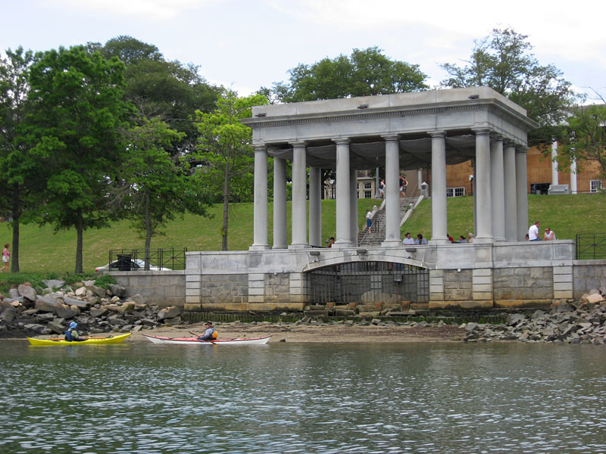
Plymouth Rock

Slide 54
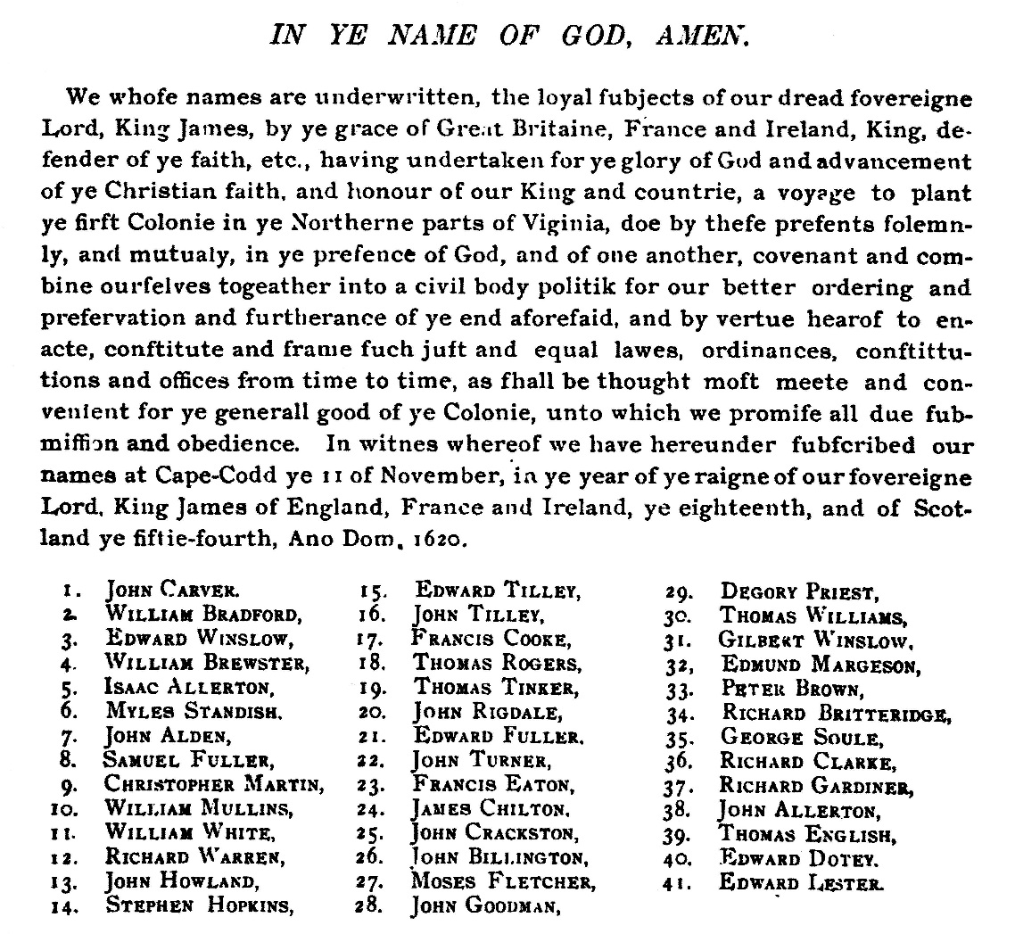
Mayflower Compact
The travelers, Pilgrims, sign Mayflower Compact during the trip
Creates legal authority and assembly
Claims that government’s power comes from consent of governed, not God
Contrary to English monarchists who were also Absolutists

Slide 55
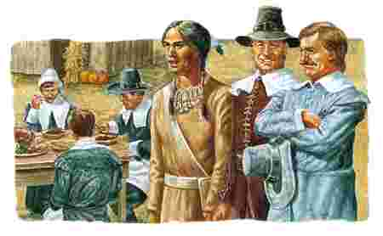

Squanto
Pilgrims landed at Patuxet village
Wiped out by disease but for a few
Tisquantum, known as Squanto, was alive
Captured years before, brought as a slave to Europe
Learned English in London, made it back home, and it was too late
Became interpreter/teacher to Pilgrims

Slide 56
Massachusetts Bay
In 1629, the large and powerful Massachusetts Bay colony is created
Congregationalists: puritans who wanted to reform the Anglican church from within
Begins the Great Puritan Migration (1629-1642)
Massachusetts Bay led by Governor John Winthrop
Winthrop delivers sermon, “A Model of Christian Charity,” atop his ship Arabella
We should be a “city on a hill,” others should be look up to us

Slide 57
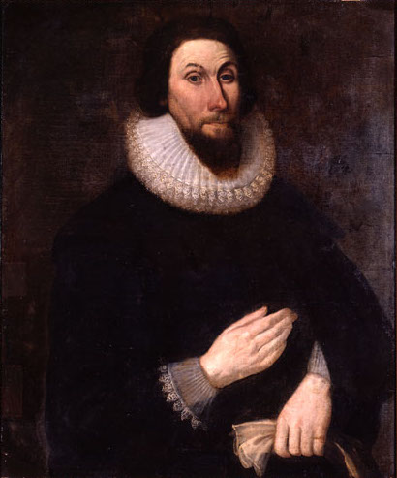
Governor John Winthrop (Shakespeare 2.0)

Slide 58
Covenants
Puritans thought they had covenant, a special deal, with God
Government was a covenant among the people
Work was to serve the community
The Puritan church brought everyone together
Both Separatists (early Pilgrims) and Congregationalists (later Pilgrims) DID NOT allow religious freedom
Ironic, since they fled religious persecution

Slide 59
Calvinism
Massachusetts Bay Colony settlers were Calvinists
Believe that the Church is wrong, that mankind is inherently sinful, that live is about finding salvation by rejecting natural sin
“Protestant Work Ethic”
Be as productive as possible
In order to be productive, needed tobacco farms
Used indentured servants and slaves
Productivity sowed seeds for Civil War, 200 years later

Slide 60
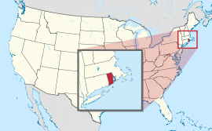
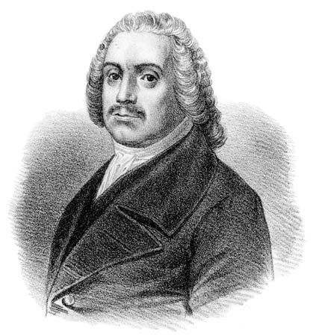
Rhode Island
Roger Williams
Minister in the Salem Bay settlement
Taught that church and state should be separate
Puritans banished him
Moved and founded Rhode Island
Allowed for freedom of religion
Did not force voters to join the church

Slide 61
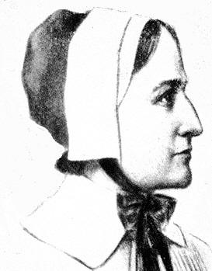
Anne Hutchinson
Believer in antinomianism
Faith and God’s grace alone get you into heaven
Contrary to belief that moral law and good deeds get you there
Challenged Puritan beliefs
Was an intelligent woman in a patriarchal society
Tried for heresy, convicted, and banished

Slide 62
English Civil Wars
English/Puritan immigration to New England slowed down between 1649 and 1660
Puritan Oliver Cromwell ruled as Lord Protector of England during this time
The Puritans, led by Cromwell, won the English Civil Wars
Cromwell died in 1658, Puritans lost a leader
By 1660, the anti-Puritan Stuarts took the throne back
This time was called the Interregnum (between kings)
Puritans had what they wanted in England: freedom of religion, representation in government
Only when Stuarts took over did Puritans again go to New World, this time with ideals of revolution

Slide 63
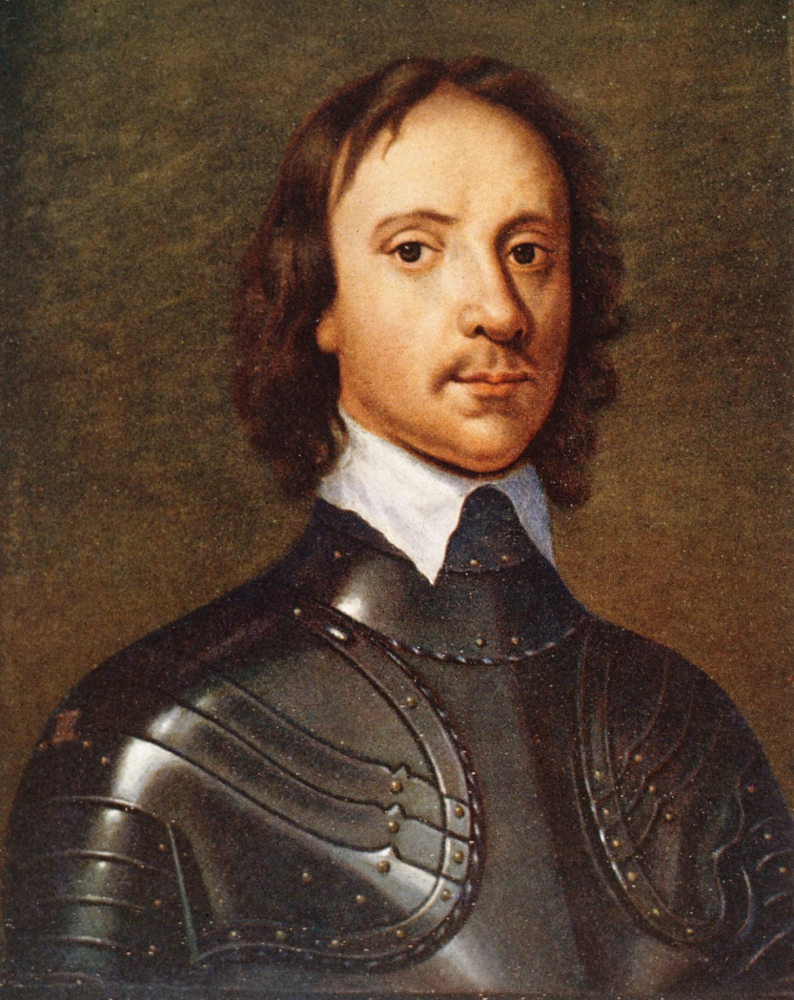
Picture of Oliver Cromwell

Slide 64
New England Versus Chesapeake
New England
Chesapeake
Entire families went to New England
Pleasant climate. Lived long. Larger families
Strong sense of community
Everyone was close to each other
More religious, settling around church meetinghouses
Single males went to Chesapeake
Tough climate. Less long-lived lives. Smaller families
Focus on production
Tobacco as cash crop
Smaller, spread-out farming communities

Slide 65
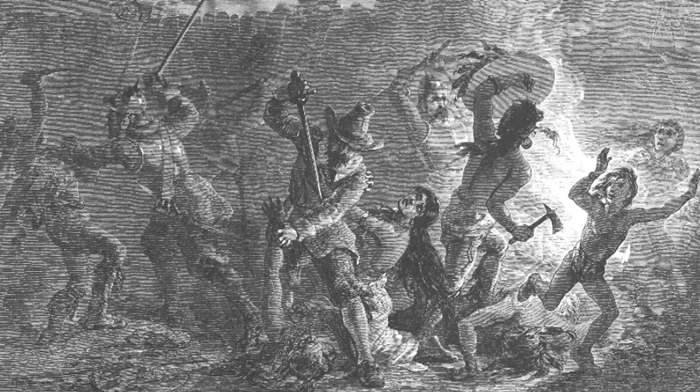
Pequot Panic
Massachusetts population grows
Try to expand in fertile Connecticut Valley, access to the sea (for trade)
Pequots, Natives, already there
Pequots attack English settlement in Wakefield, kill nine
Settlers respond by burning village, killing 400, many women and children
Near-destruction of Pequots is called Pequot War

Slide 66
Proprietorships
Proprietorships were colonies owned by one person who received land as gift from king
Connecticut was one. Received charter in 1635. Produced the Fundamental Orders, the first written constitution in British North America
Maryland was another. Granted to Lord Baltimore, Cecilius Calvert. Calvert wanted a haven for Catholics, faced persecution in Protestant England, wanted to make money growing tobacco
Calvert promised religious tolerance for all Christians. Protestants soon outnumbered Catholics. Interfaith tension happened anyway
After Oliver Cromwell led the Protestant uprising back in England, Maryland passed the Act of Toleration in 1649
Protects religious freedom of most Christians. Maryland devolved into bloody religious civil war for the rest of the century anyway

Slide 67
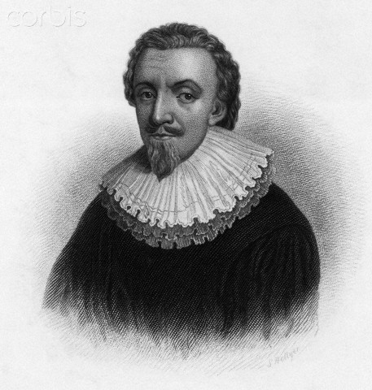
Picture of Lord Baltimore/Cecilius Calvert

Slide 68
New York, New York
A proprietorship/royal gift from King Charles II to his brother, James
Dutch Republic was biggest commercial power, rivaled the British
Established the Dutch New Netherland settlement in 1614, and a fort, New Amsterdam, in 1626
In 1664, King Charles II sent the navy to capture New Netherland
Dutch were weak from Native attacks, Governor Peter Stuyvesant surrendered. James became the Duke of York. When James became King in 1685, he called New York a royal colony
The Dutch were allowed to stay there, became a big part of the population
Charles II also gave New Jersey to friends, who sold it to Quaker investors

Slide 69
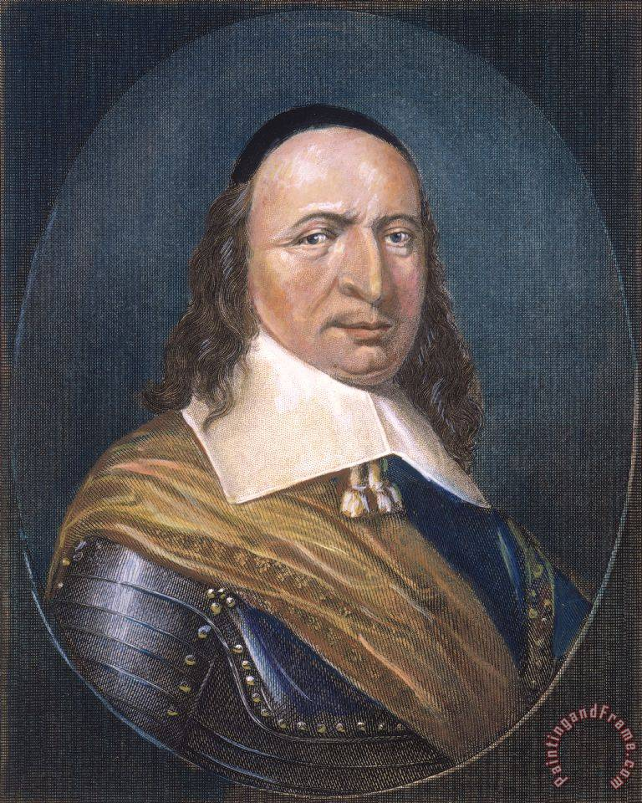
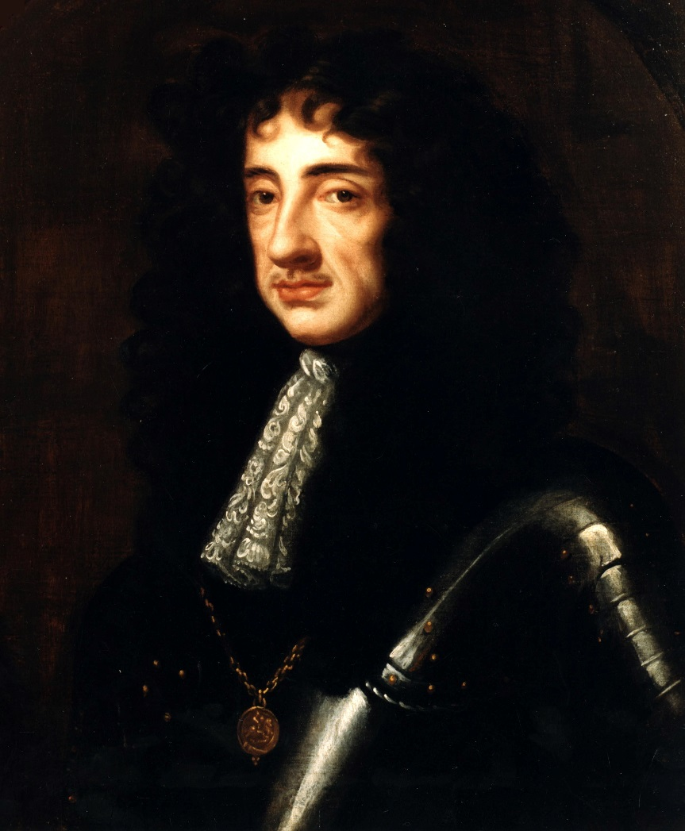
Pictures of Gov. Peter Stuyvesant and King Charles II

Slide 70
Pennsylvania
William Penn, a Quaker, close friend of King Charles II, granted proprietorship of Pennsylvania. Charles, like most Anglicans, saw equalitarian Quakers as dangerous, Charles was helping friend Penn and moving English Quakers far from him
Penn establishing religious freedom and civil liberties. Popular colony--advertising, natural bounty. Treated Natives fairly—attracted tribes, but also attracted European bullies
Penn made treaty with Delaware to take only as much land as could be walked in three days
He took a three-day stroll; his son, renegotiating it, hired three marathon runners for the same task

Slide 71
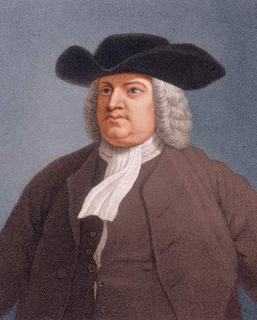
Picture of William Penn

Slide 72
Carolinas
Carolina was also a proprietary colony
In 1729, split into North and South Carolina
North Carolina was settled by Virginians
South Carolina was settled by descendants of Englishmen who conquered Barbados
Barbados exported sugar, used slave labor on plantations
Slavery existed in Virginia since 1619, but settlers from Barbados had seen the most widespread slavery
Beginning of the slave era in the colonies

Slide 73
Transition
Proprietary colonies became royal colonies
The ownership was taken over by the king
King could then have more control over them
By 1776, only Connecticut, Rhode Island, Pennsylvania, and Maryland were NOT royal colonies
Northern ones were mainly for religious freedom, southern ones for commerce

Slide 74
List of Colonies
New England colonies: Massachusetts Bay, 1628, Rhode Island, 1636, Connecticut, 1636, New Hampshire, 1639
Middle colonies: New York, 1664, New Jersey, 1664, Pennsylvania, 1681, Delaware, 1703
Southern colonies: Virginia (Chesapeake), 1607, Maryland (Chesapeake), 1634, North Carolina, 1663-1712, South Carolina, 1663-1712, Georgia, 1732

Slide 75
Slavery in the Colonies
Use of African slaves begins in American colonies when colonists from Caribbean (Barbados) settle the Carolinas
Until then, used indentured servants and some Natives
Tobacco growers (and rice, in South Carolina) need more labor
Feared that, if they used young, landless white males, there’d be organized revolts
Tough to use Natives. Natives already knew the land; could escape and not be found. Natives thought cultivation considered women’s work (cultural barrier)
European diseases kill off most of the population

Slide 76
Preying on the Weak
Landowners saw that African slaves were more vulnerable. Did not know the land, less likely to escape. Unable to communicate with each other, from different parts of Africa. Dark skin made it easier to identify on sight. English colonists began to associate dark skin with inferiority
Right up to the Revolution, majority of slave trade was directed towards Caribbean/South America
More than 500,000 African slaves brought to English colonies (out of 10 million brought to the New World)
By 1790, 750,000 blacks enslaved in English North American colonies

Slide 77
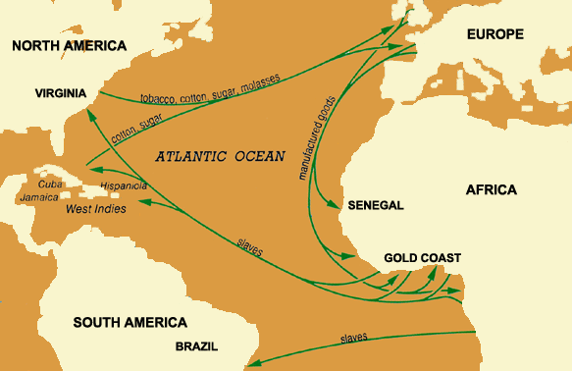
The Middle Passage
Shipping route that brought slaves to Americas: Middle Passage
It was the middle part of the triangular trade route
Three parts: Europe, Africa, and colonies. Conditions were brutal
One-fifth of Africans died on board (sickness, suicide, rebellions)
Congress ended American participation in the Atlantic slave trade on 1/1/1808 (slavery itself didn’t end ‘till 1865).

Slide 78
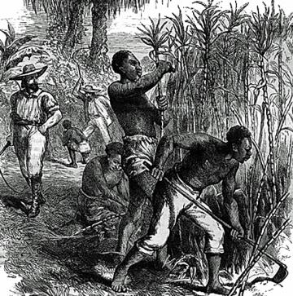
Slavery in the North and South
The Chesapeake and Carolinas farmed labor-intensive crops like tobacco, rice, and indigo. Plantation owners bought slaves for the work
Slaves used a little on farms in New York, New Jersey, and Pennsylvania, in shipping operations in Massachusetts and Rhode Island, domestic servants in New York City
Still slaves in New Jersey up to Civil War. Only the very wealthy owned slaves

Slide 79
The Age of Salutary Neglect (1650-1750)
Chapter One, Part C

Slide 80
Preview
British treatment of the colonies before the French and Indian War (also called the Seven Years’ War) is called salutary neglect or benign neglect
England regulated trade and government, but interfered with colonial affairs as little as possible
Set up absentee customs officials, colonies mainly self-governed
England sometimes ignored colonies’ violations of trade restrictions
Colonies developed rebellious identity, kept it up when England tried to be more in control later
Beginnings of new American culture!

Slide 81
English Regulation of Colonial Trade
Most colonial Europeans believed in mercantilism. They believed economic power was rooted in a favorable balance of trade (export more than you import) and the control of specie (hard currency, like gold coins). Thought colonies mattered mostly for economic reasons
British thought colonies in the West Indies that produced sugar were more important than North American colonies
Colonies on North American continent were seen as markets for British/West Indian goods
Also, sources of raw materials that would have been bought from a foreign country. Conquer the land, let people travel there, make them take the natural stuff, send it back to you, and then make ‘em buy your stuff

Slide 82
Tariffs
British encouraged manufacturing in England
Placed protective tariffs on imports that might compete with English products (made them more expensive, and therefore less competitive)
  Passed between 1651 and 1673. Included Navigation Acts, which required colonists to ONLY BUY goods from England, ONLY SELL certain products to England, and import non-English goods from English ports (and pay extra to England for ‘em). Also stopped colonies from manufacturing some goods England already goods. Sought to stablish English control over colonies
  Only somewhat successful; easy to smuggle goods in and out of colonies

Slide 83
Controlling the Colonies
Navigation Acts were strengthened in the 1690s
British set up vice-admiralty courts (military style courts) to try colonists in violation of the Navigation Acts
Defendants were not entitled to a jury
Most colonial juries sided with the accused smugglers, not the Crown
Boards of Trade were set up to better regulate colonial commerce
Also reviewed colonial legislation, revoked laws that conflicted with British laws, oversaw government appointments
Colonists didn’t protest too aggressively against this, since they totally depended on Britain from trade/military protection

Slide 84
Colonial Governments
Colonists had a lot of autonomy
Every colony has a governor who was appointed by a king or the proprietor
The governor had powers like the king’s in England, but was dependent on colonial legislatures for money
The governor was basically stranded in the New World
Relied on the cooperation of colonists, so didn’t rock the boat too often

Slide 85
Bicameral Legislatures
Except for Pennsylvania, which had a unicameral legislation (just one house), all the colonies had bicameral legislatures
Modeled after British parliament
Lower house was like today’s House of Representatives. Members were directly elected (by white male property holders). Had “powers of the purse” (control over government salaries, tax laws)
Upper was made of appointees. Advised the governor, had some legislative/judicial powers, most chosen from the local population, most cared about protecting colonial landowners

Slide 86
Central Governments
British never tried to make a powerful central colonial government
Colonists make small efforts towards centralized government
The New England Confederation was the most prominent of these efforts. No real power. Offered advice to northeastern colonies when disputes arose among them. Provided colonists from different settlements with a place to meet and talk their problems out

Slide 87
Major Events of the Period
Bacon’s Rebellion
Virginia’s western frontier, 1676
Coastal land was claimed, so newcomers were forced west
They were close to Natives, so they were raided
Westerners banded together to drive Natives out
The government stopped them at Jamestown, since they didn’t want to risk a full war with the Natives
Frontiersmen, former indentured servants, thought the eastern elites considered them “human shields” between the east and the Natives

Slide 88
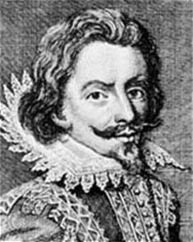
Nathaniel Bacon
Nathaniel Bacon was a recent immigrant
Wealthy, but came too late to settle the coast. Demanded that Governor William Berkeley give let him raise a militia to fight the tribes
Was refused, so he attacked the Natives away (included some tribes allied with English). Rebels then sacked and burned Jamestown. Bacon suddenly died of dysentery
The conflict between colonists and Native Americans was averted with a new treaty, but it was an early populist uprising

Slide 89
Bacon’s Rebellion: Implications
Many disgruntled former indentured servants allied themselves with free blacks who were disenfranchised/unable to vote
This alliance along class lines, instead of racial lines, frightened southerners
Eventually led to the black codes
As colonists pushed westward for land, away from commercial and political centers, they felt alienated
Wanted more political autonomy
Berkeley was the royal governor of Virginia, and the backcountry of Virginia was even further from London

Slide 90
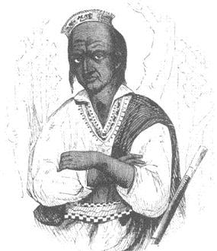
King Philip’s War
By the 1670s, the Wampanoags living in Narragansett Bay in Rhode Island were surrounded by whites
Led by Metacomet (King Philip), they attacked white settlements
He allied with local tribes, destroyed English towns, but ran out of supplies
When Metacomet died, the alliance fell apart. Colonists sold many tribes into slavery in West Indies
King Philip’s War marks the end of strong Native presence among New England colonists

Slide 91
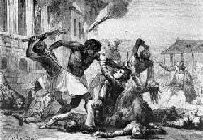
Stono Uprising
The first slave rebellion In 9/1739, 20 slaves met near Stono River outside Charleston, South Carolina
Stole guns, killed storekeepers and planters, liberated slaves. 100 rebels fled to Florida, hoped Spanish would help
The colonists caught up, killed and captured them (later to be executed)
Stono Uprising also sometimes called Cato’s Rebellion
Many colonies passed harsher laws against slaves. New York had “witch hunt,” when 31 blacks and four whites for killed for conspiracy to liberate slaves

Slide 92
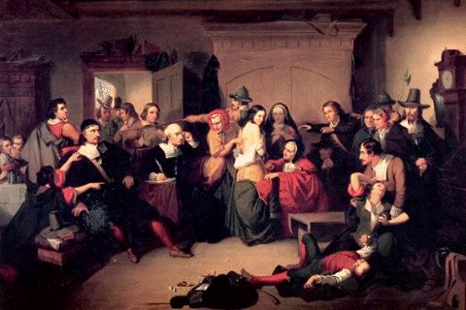
Salem Witch Trials
Salem Witch Trials in Salem, Massachusetts took place in 1692
Not the first witch trials in New England
  During first 80 years of English settlement in the region, 103 people (almost all women) were tried for witchcraft
During summer of 1692, more than 130 “witches” jailed/executed in England

Slide 93
Why the Craziness?
The region had just dealt with the Dominion of New England. English government attempt to clamp down on illegal trade. Massachusetts’ charter had been revoked, its assemblies dissolved. The governor who ruled for two years was granted powers normally held by absolute monarch
Dominion of New England ended with the Glorious Revolution, which happened in England. James II was overthrown, William and Mary took power
In 1691, Massachusetts became a royal colony under new monarchs, all Protestants got suffrage; previously, only Puritans could vote
War against French and Native Americans on the Canadian border (called King William’s War in the colonies and the War of the League of Augsburg in England) soon followed, causing regional anxiety

Slide 94
Puritans Panicking
Puritans thought their religion was being undermined by commercialism in cities like Boston. Second- and third-generation Puritans weren’t as passionate as Pilgrim and Congregationalists
Led to the Halfway Covenant in 1662, which changed the rules governing Puritan baptisms. Before, if you didn’t experience God’s grace, your child wouldn’t be baptized. Puritans decided to baptized all children whose parents were baptized. But those who hadn’t experienced God’s grace couldn’t vote
Caused mass hysteria in Salem in 1692. Witch trials ended when (mainly teenage girl) accusers accused prominent citizens of consorting with the Devil, which turned town leaders against them

Slide 95
First Great Awakening
In 1700, women were majority of active church members. In 1730-1740s, the colonies/Europe experience religious revival in Great Awakening
Congregationalist minister Jonathan Edwards and Methodist preacher George Whitefield exemplified the period. Edwards preached severe, pre-deterministic Calvinism, graphic descriptions of Hell (“Sinners in the Hands of an Angry God” speech)
Whitefield, an English native, preached about emotionalism and spirituality, led to Southern evangelism
First Great Awakening is response of the devout to European Enlightenment, intellectual movement that borrowed from ancient philosophy and focused on rationalism over emotionalism/spirituality

Slide 96
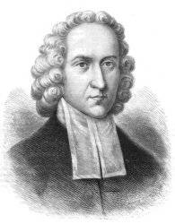
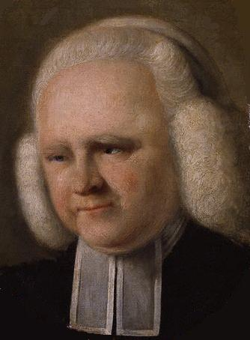
Praise the Lord
Jonathan Edwards
George Whitefield

Slide 97
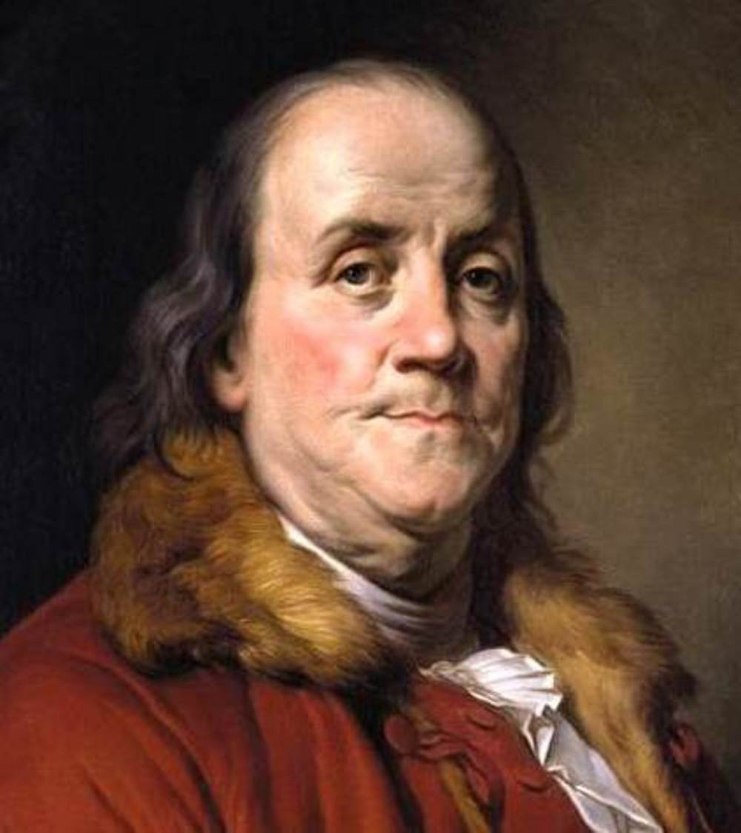
(It’s All About the) Benjamin Franklin
Ben Franklin was a self-made, self-educated man, personified the Enlightenment in the colonies. Printer’s apprentice, became a respected printer
Poor Richard’s Almanac was his recurring publication. Popular, influential collection of advice, predictions, stats, quotes (“a stitch in time saves nine,” “a penny saved in a penny earned”)
Did pioneering work in electricity, invented bifocals, the lightning rod, and the Franklin stove; founded the colonies’ first fire department, post office, and public library
Later on, he was ambassador in Europe, where he negotiated an alliance with the French and a peace treated that ended the Revolutionary War

Slide 98
Life in the Colonies
Population in 1700 was 250 thousand. Population in 1750 was 1 million, 250 thousand
Scotch-Irish, Scots, and Germans all settled in large numbers. English settlers came as well. The black population in 1750 was over 200 thousand
In a few colonies (like South Carolina) they outnumbered whites by 1776
Over 90% of colonists lived in rural areas. Life for whites in the countryside was rugged but tolerable
Labor was gender-divided. Men did outdoor work, farming. Women did indoor work, housekeeping and childrearing
Opportunities for social interaction outside the family limited to shopping days and rare community events
Children and women subordinate to men; it was a patriarchy. Women couldn’t vote, own property, draft a will, or testify in court
Children’s work came before their education

Slide 99
Slave Life
Blacks, most of whom were slaves, lived in the countryside and in the South
Conditions were worst in the South. Labor was difficult, climate tough for hard work. Slaves on large plantations/with special skills like carpentry/cooking did better than field hands
Developed kinship ties and community to cope with servitude and threat of families separated by sale
In the North, black population was small; tough to develop community
Conditions in the cities was worse than country. Most immigrants settled in cities. Work paid too little, poverty was widespread
Sanitary conditions sucked, epidemics (like smallpox) common. Cities were centers for progress/education
Wider contact with residents/outside world than in rural areas
Citizens with more than rudimentary education were rare; nearly all colleges existed to train ministers

Slide 100
Differences
New England society centered on trade. Boston was the colonies’ major port city. The population farmed for subsistence, not for trade, and mostly was super Puritan
The middle colonies (NY, NJ, Pennsylvania) had more fertile land, focused on farming (known as bread colonies because of grain exports). Philadelphia and New York City were trade centers. Population more homogenous than New England
Lower South (Carolinas) concentrated on cash crops like tobacco and rice. Slavery was major part of plantations. Majority of Southerners were subsistence farmers, had no slaves. Blacks were up to half the population
Colonies on the Chesapeake (Maryland and Virginia) combined features of middle and lower South. Slavery and tobacco played a part. Chesapeake residents also farmed grain. Had some major cities, unlike rural lower South

