Slide 1
Chapter Four: Beginnings of American Democracy
(1824-1844)

Slide 2
Election of 1824
The election of 1824 = important
Prior to 1824, electors (who select presidents) in electoral college chosen by variety of methods
  State legislatures (law-makers, not the common people) chose electors
  Congressional Caucuses (groups of Congressmen) chose nominees
  Electors were friends of Congressmen, and didn’t challenge choices

Slide 3
Election of 1824, Part II
By 1824, though, majority of states let voters choose their electors directly
With more direct votes for electors, there’s less voter support for arbitrary nominees
When Democratic-Republicans chose William H. Crawford in 1824, others challenged it (John Quincy Adams, Henry Clay, Andrew Jackson)

Slide 4
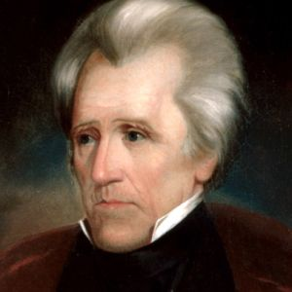
Picture of Andrew Jackson

Slide 5
End of the Caucuses
Clay/Jackson/Adams’ opposition ended the caucus system. Of the four, Jackson got the most votes, but nobody had a majority (51%). The election was decided in the House of Representatives
Speaker of the House Clay supported Adams, so Adams won; Clay was named Secretary of State (considered the gateway to presidency). Jackson called it the corrupt bargain and vowed to destroy them in 1828
Quincy Adams was a believer in postmillennialism—Jesus would return after humanity enjoyed a 1000-year golden age
Adams’ presidency was skewered by pro-Jackson Congressmen. Adams, the son of John Adams, was put under scrutiny any time he tried to expand the central government’s power ‘cause he was a Federalist

Slide 6
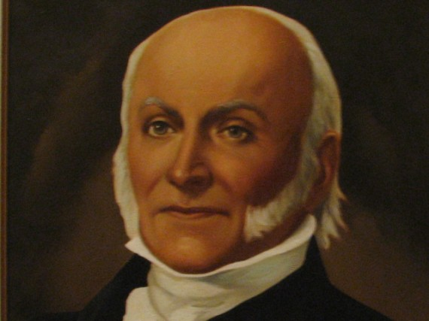
Picture of John Quincy Adams

Slide 7
Jackson v. Adams
Quincy Adams believed in new protective tariffs, new interstate highways, new federal schools and research centers. Jackson’s Congress stopped all of those things from happening because he wanted t to be up to the states
Ultimately, Jackson strikes back. Furious at losing in 1824, he makes a support network (political organizations, newspapers, community leaders). This becomes the new Democratic Party
Jackson’s men called Adams a corrupt career politician, Adams’ men called Jackson a violent, dumb drunkard
Jackson was furious that his wife was accused of bigamy (which was true, since she married Jackson before getting divorced to husband #1)
The Coffin Handbill accused Jackson of murdering his men during the Indian Wars

Slide 8
Jackson’s Victory
Jackson wins in 1828 by a large margin (becomes first president not from Virginia or named “Adams”). Seen as a self-made man, looked out for the West
He dismissed government officials, replaced with his supporters. This was common…but because he was a political outsider, he replaced the officials with friends who didn’t have the right experience
Public criticized Jackson for this; trading jobs for political favors is called the spoils system

Slide 9
Jacksonian Democracy
Jacksonian Democracy replaced Jeffersonian Republicanism
Jefferson wanted a nation with wealthy educated property holders; government’s only big as necessary to provide necessary services (military). Jefferson envisioned farmers who owned their land (yeoman farmers) with liberty protected by LIMITING the central government
Jacksonian democracy was all about universal white male suffrage, meaning extension of voting rights to all white males, even those who did not own property
Jackson used his popularity to challenge Congress and the Supreme Court

Slide 10
What the “West” Refers To
Any settlement not located against the Atlantic was called the West in colonial times
By the early 1800s, The Northwest consisted of northern states west of the Appalachians (Ohio/Indiana/Illinois), which is now called The Midwest
By the early 1800s, the Southwest was southern states west of the Appalachians (Alabama/Mississippi), now called the Deep South
Henry Clay/Jackson were called Westerners, and they were from Kentucky/Tennessee.

Slide 11
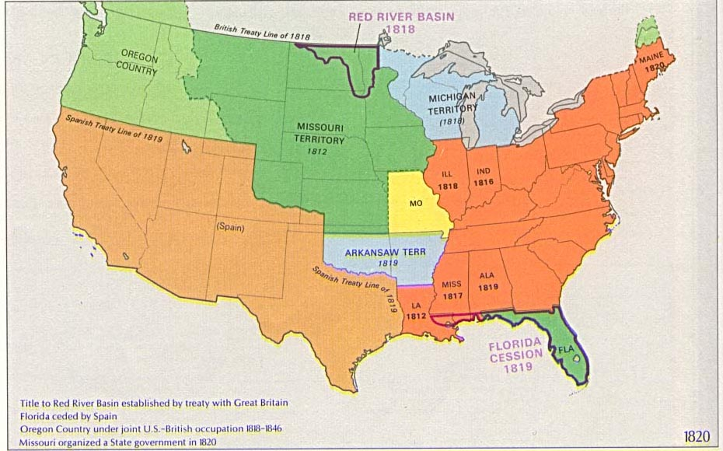
Map of the U.S. (1820)

Slide 12
Indian Removal Act: Context
Jackson passed the Indian Removal Act through Congress in 1830
Originally, it had been British who called Native Americans “foreign nations” and as such governments could declare war on them. Often these treaties established “Indian territory,” as was the case in the Proclamation of 1763 at the end of the French and Indian War
When Americans gained their independence, US government continued bad treatment of Natives
Thomas Jefferson thought Natives could assimilate, if they gave up their culture

Slide 13
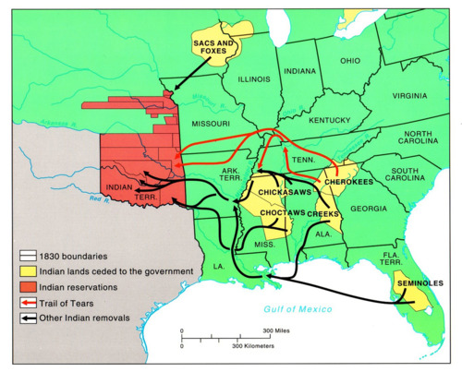
Picture of Indian Removal Act

Slide 14
Indian Removal Act: More Context
When Jackson was president, there were “Five Civilized Tribes” living in the South (near the Mississippi River). The Cherokee developed a written language, converted to Christianity, even owned black slaves. They developed their own government, called themselves an independent state inside Georgia
Problem: gold discovered on Cherokee land, citizens of Georgia wanted Natives gone
Indian Removal Act: “get out, go to Oklahoma, that’s your territory”
Jackson: “you’re safer away from white men”

Slide 15
The Court Hears the Case
Natives take their case to the Supreme Court
Chief Justice John Marshall sides with the Natives in Cherokee Nation v. George (1831) and Worcester v. Georgia (1832), but Andrew Jackson ignores that. “Marshall made his decision; now let him enforce it” (or, “come at me, bro”)
Between 1835 and 1838, thousands of Cherokees walked to Oklahoma
Many died of disease/starvation (some given smallpox-invested blankets)
Forced march by the US Army called the Trail of Tears

Slide 16
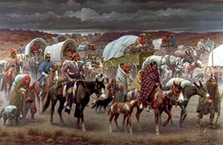
Picture of Trail of Tears

Slide 17
Nullification
Nullification was first expressed by Jefferson/Madison in the Virginia and Kentucky resolutions. It means Individual states can disobey federal laws if the laws are unconstitutional
John Marshall established that only Supreme Court had power of judicial review in Marbury v. Madison (1803)
The Tariff of 1828, aka the Tariff of Abominations, was passed during the Adams administration, but it became a problem during the Jackson administration
In 1828, John C. Calhoun (South Carolina, Jackson’s VP) anonymously published the “South Carolina Exposition and Protest. “Argued that states who felt that a 50% tax was too high could ignore/nullify it

Slide 18
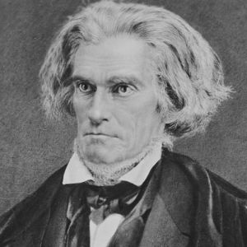
Picture of John C. Calhoun

Slide 19
The Crisis
By 1830s, southern states are openly talking about nullifying things (for example, protectionist tariffs which cut into trade with Britain – the South needed to trade cotton and buy British wools to keep its economy going)
Jackson liked states’ rights, but thought that nullification took it too far. After his first attempt, the Tariff of 1832, tried to lower rates to an acceptable level and was STILL met with disapproval, South Carolina nullified it
Jackson then had Congress pass the Force Bill, which let him send in troops to enforce the tax
Calhoun and Clay brokered a behind-the-scenes compromise to lower the tariff and diffuse tensions. South Carolina accepted it, but no resolution was reached on the legality of nullification (becomes an issue during the Civil War)

Slide 20
Jackson’s Economic Policies
Showed his distrust of big government and Northeastern power brokers. Spent time “downsizing” federal government and using his VETO
He fought against reform movements that wanted government activism against social/economic problems
Made the Second Bank of the United States fail by vetoing Congress’s attempt to re-charter it, and by withdrawing federal funds to deposit in his state “pet” banks. Felt that the BUS protected Northeastern interests, hurt the West. Argued that the bank was unconstitutional (Supreme Court disagreed in McCulloch v. Maryland in 1819)

Slide 21
Jackson’s Economic Policies, Part II
Suspicious of paper money, preferring “hard currency” like gold/silver
His Specie Circular ended the policy of selling government land on credit (now, you had to pay hard cash)
Caused a money shortage and a decrease in the treasury, leading to the Panic of 1837, so Congress overruled that policy in the final days of his last term

Slide 22
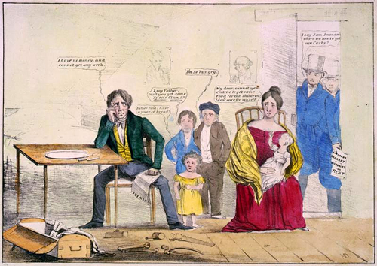
Picture of Specie Circular

Slide 23
Clarification: Bank of the United States
In the 19th century, paper money was issued by private banks, not the federal government. If you want $100 loan, the bank prints up money for you, but it didn’t need $100 worth of gold in its vaults to do this—as long as no more than 10% of its money is cashed in it at the same time. What kept it from just printing 1 trillion dollars at a time? People could pay their taxes with paper money, and the paper was collected at the Bank of the US. The private banks were afraid that the BUS could ask for all its money back in gold at once, so they didn’t overprint
Once Jackson killed the second BUS, some wildcat banks sprung up and printed money all over the place…but the government wasn’t accepting paper money for land…so people started seeing paper money as worthless, leading to depression…now only gold and silver seemed to have value

Slide 24
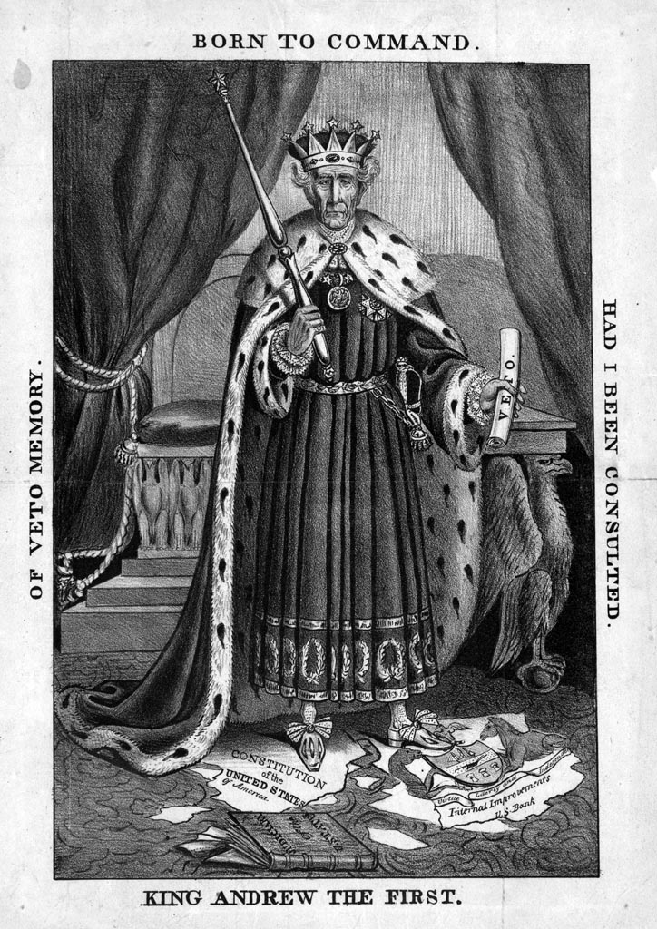
Picture of King Veto

Slide 25
Slavery During Jacksonian Times
Northern abolition movement grows stronger, South experiences slave revolts. Made slaveholders even more brutal
Most famous was Nat Turner’s Rebellion. Turner was a well-read preacher. Had a vision from God (allegedly) that a black liberation movement would succeed. Rallied a gang that killed/mutilated 60 whites. In retaliation, 200 slaves were killed (some had no connection to him)
Southern states passed black codes in response, prohibiting blacks from congregating, or learning to read
Other states outlawed whites questioning slavery. Virginia thought about ending slavery, but didn’t follow through

Slide 26
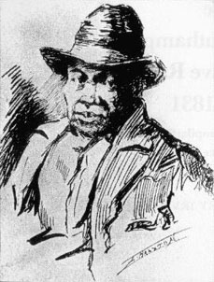
Picture of Nat Turner

Slide 27
Election of 1836
Jackson’s Democratic couldn’t represent the Northern abolitionists, Southern plantation owners and Western pioneers at the same time
A new opposition party, the Whigs, was formed
By 1834, they had almost as much support as the Democrats
Democrats favored limited federal government, Whigs believed in government activism
Many Whigs were very religious, supported temperance movement (less drinking) and not working on the Sabbath; they all opposed the Democrats

Slide 28
1836 Continued
Jackson supported his VP, Martin Van Buren. Van Buren took over as the economy was entering the Panic of 1837
He made the situation worse by favoring hard currency (gold/silver) like Jackson. The economic downturn lasted through his election, so he wasn’t re-elected
In 1841, former military hero William Henry Harrison becomes the first Whig President…and then dies of pneumonia a month later
His vice president, John Tyler, a former Democrat, began championing states’ rights. Tyler vetoed Whig bills, alienating Whig leadership; his entire cabinet resigned in protest. Now, he’s called the “president without a party.”

Slide 29
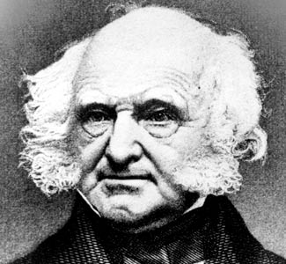
Picture of Martin Van Buren

Slide 30
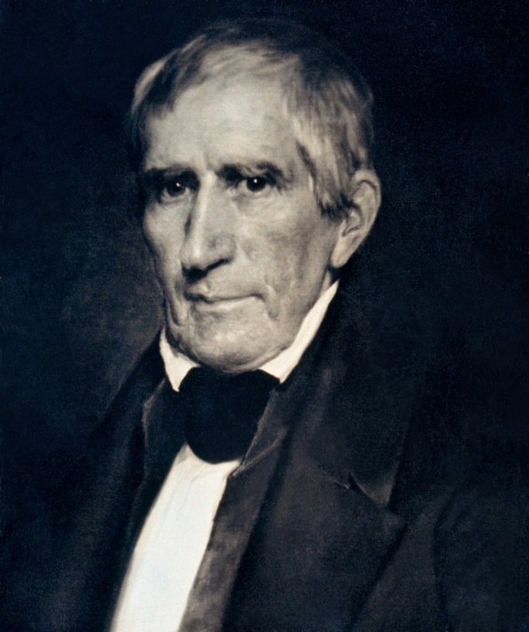
Picture of William Henry Harrison

Slide 31
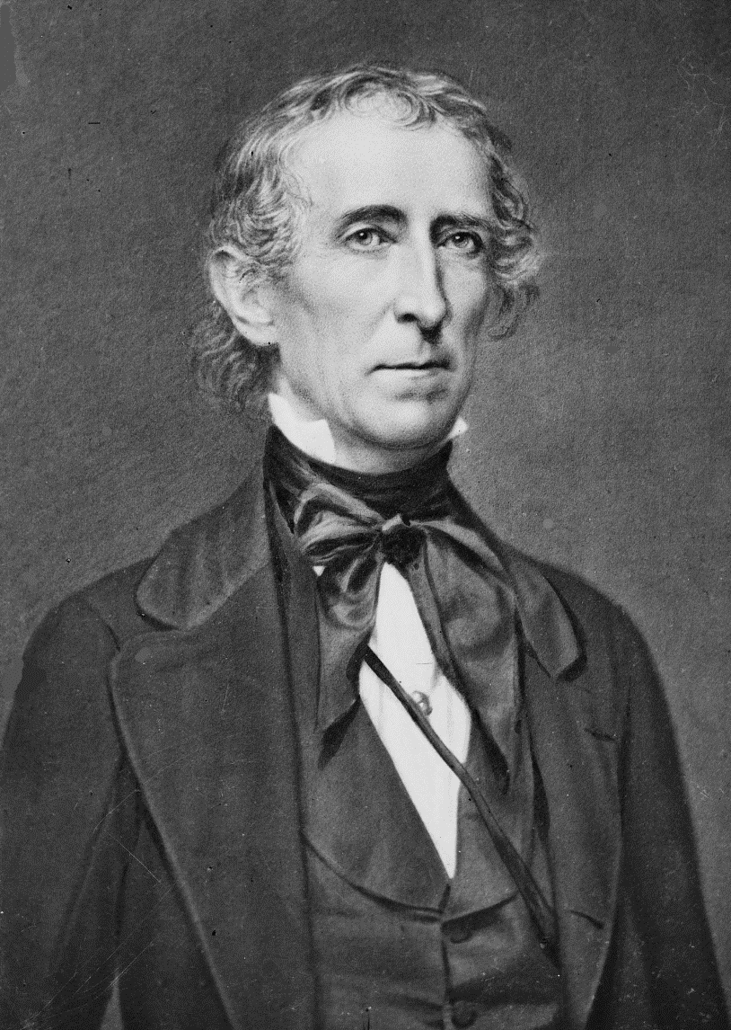
Picture of John Tyler

Slide 32
Beginnings of a Market Economy
From the time they first arrived ‘till the Revolutionary War era, most settlers in the US raised crops to survive, not to sell. Most people made their own clothing, built their own furniture and houses. People used ledgers to keep track of who owed what to whom
Developments in manufacturing/transportation changed that. By making it possible to mass-produce goods and transport them across the country, a market economy began to develop. Market economy: people trade their labor/goods for cash, then use it to buy other peoples’ labor/goods. Favors those who specialize (farmers who grow a single crop usually do better in a market economy, since they offer buyers more of what they want…but the farmers are no longer self-sufficient, and will need to buy the other crops from other people!)

Slide 33
Market Economy Growth
Market economies grow more quickly/provide more services than subsistence economies, and make people more interdependent (reliant on each other)
More prone to change; many things can cause an economic crash (like in 1819 and 1937)
The changes are called boom and bust cycles
During the first decades of the 1800s, the US became a market economy

Slide 34
The Cotton Gin
The War of 1812 forced the US to be less dependent on other nations/imports, so we had to develop a stronger national economy
Two key advances helped us do this, both developed by Eli Whitney. The cotton gin, invented in 1793, revolutionized Southern agriculture by making it easier to remove the seeds from cotton plants (5,000 percent more efficient than humans) It made it easier/cheaper to use cotton for textiles, so increased the demand for cotton…as demand grew, so did cotton productive in the South…because cotton farming is labor intensive, the spread of cotton intensified the South’s dependence on slave labor

Slide 35
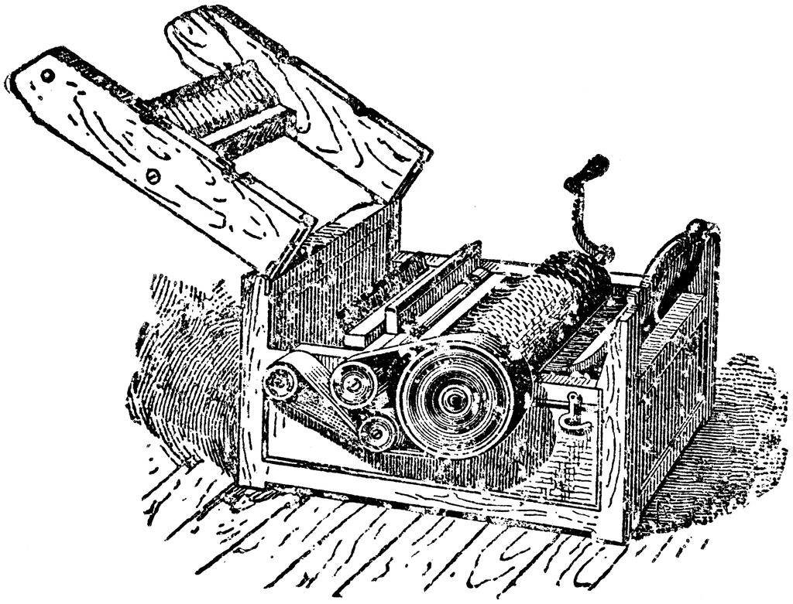
Picture of the Cotton Gin

Slide 36
Eli Whitney, Continued
Whitney used interchangeable parts in manufacturing. First thought of it when mass-producing rifles
Before, they built weapons by hand, custom-fit parts. Replacement was difficult
Whitney demo’d the process to Jefferson/Madison in person; it was a success
Led to machine-tool industry, which made specialized machines for textiles/transportation
Promoted assembly line production (each worker=one task; uniform!)

Slide 37
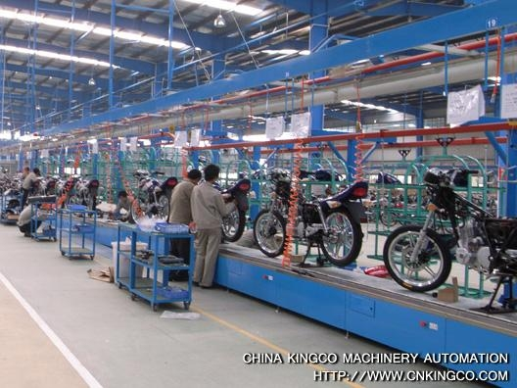
Picture of Assembly Line Production

Slide 38
Textile Industry
Advances in machines + U.S. Embargo on British goods during War of 1812: more textile mills in New England
During 1800-1810, mills produced thread, hired local women to weave the thread into cloth at home; mills would buy the finished cloth and sell it
Invention of power loom in 1813 meant that textile manufacturers make thread and finished fabric in their own factories quickly/efficiently
High quality AND inexpensive! GO AMERICA.

Slide 39
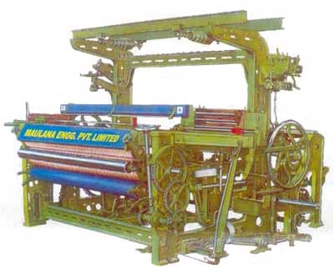
Picture of Power Loom

Slide 40
Labor Shortage
Textile manufacturers had to entice laborers (mostly women from nearby farms)
Most famous program was Lowell system or Waltham System, named after two Massachusetts town in which mills were located
Lowell system guaranteed housing in boardinghouse, cash wages, and participation in cultural and social events organized by the mill
System lasted until Irish immigration in 1840s/50s made labor plentiful
When working conditions got worse, workers organized in labor unions
Met with opposition from industry, but ultimately succeeded

Slide 41
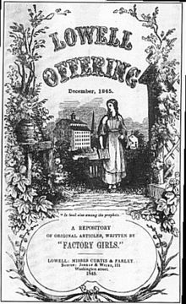
Picture of Lowell System

Slide 42
Other Industries
Clothing manufacturers, mainly in Northeast
Retailers sell clothing
Brokers were middlemen
Commercial banks lent money to everyone
Transportation industry grew as a result of need to ship these across the country

Slide 43
Transportation
Before 1820s, travel/shipping along east-west was tough; most trade went north-south along Ohio/Mississippi River
National Road from Maryland to West Virginia made east-west travel easier, but the big change was 1825’s Erie Canal
Funded by state of New York, linked Great Lakes to New York (and thus to European ships)
It was lucrative for Midwestern farmers to sell products to eastern buyers, so Northeast became center of commerce
By 1835, Erie Canal had to be doubled to handle traffic
When railroads developed, by 1850, canal era ended

Slide 44
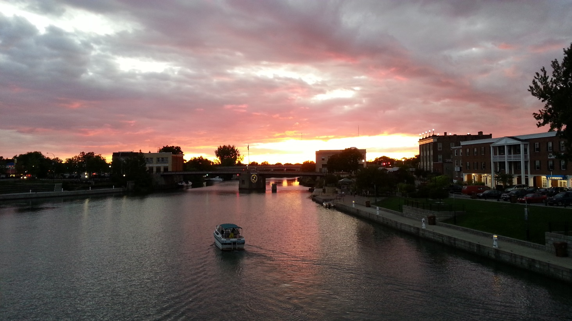
Picture of Erie Canal

Slide 45
Steamships
Invention of steam engine led to steamships when traveled faster than sailing vessels
Important freight carriers, replaced sailing ships for long-term voyages
By 1850, passengers can travel by steamship from NY to England in 10 days; by sail it would take a month or more
Sometimes, their boilers exploded. Whoops.

Slide 46
Railroads
America’s first railroads were built in the 1830s, connecting just two cities
Problem—different railroad lines couldn’t be connected to one another because the width, or gauge, of their tracks was different
So rail development went slowly
Government often paid the bill to make railways compatible even though they were privately owned
By 1853, NY/Chicago were linked by rail
By 1855, cost to send things across America had fallen to 1/20th the cost of 1825—and arrived in 1/5th the time!

Slide 47
Communication
Increase in travel/shipping helped by invention of telegraph, allowed immediate long-distance communication for FIRST TIME
It was like telephone, but people communicate in Morse Code
Transatlantic telegraph cables not made ‘till 1866, after Civil War
All these developments favored the Northeast/West (now called the Midwest)
Northern rail development gave them a HUGE advantage in the Civil War

Slide 48
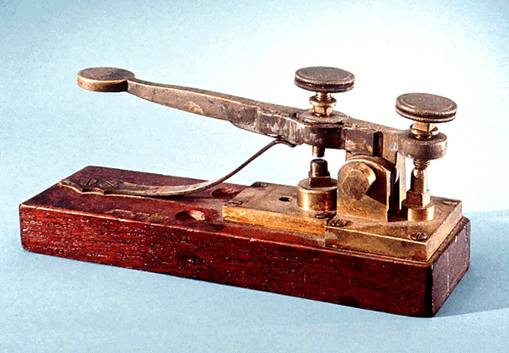
Picture of Telegraph

Slide 49
Farming
Agriculture was most important source of livelihood through 1850
Mechanization changed farming (mechanical plow, sower, reaper, thresher, baler, cotton gin)
In 1820, 1/3rd of food grown in US went to market; by 1860, 2/3rd did!
Farming in Northeast was tough; rocky, hilly terrain didn’t work with machines
Farmland had been over-farmed, so quality of soil was poor
Unable to compete with Midwestern grain farmers, New England farmers raised livestock/fruits/vegetables instead OR went to cities for other jobs

Slide 50
Midwest
Midwest became America’s chief source of grains such as wheat and corn
Midwestern farms—much larger than New England farmers—more adaptable to new technology, production doubled
Banks sprang up lend farmers capital necessary to buy modern equipment, and the trade routes created by rail and ship provided access to the markets these farmers needed to sell their crops in order to pay off their loans
The system worked well, except for financial crises of the first half of century (Panic of 1819/1837 resulted in bank foreclosures across nation)

Slide 51
South
Plantation focused primarily on cotton especially in the Deep South
Tobacco continued to be a major cash crop in the Upper South
The majority of Southerners owned small farms and did not own slaves
In 1860 approximately one-quarter of white Southern families owned slaves

Slide 52
Westward Expansion
Louisiana Purchase removed one major obstacle to US western settlement, and the resolution of the War of 1812 removed another by depriving Native American of their ally (Great Britain)
By 1820, the US had settled the region east of the Mississippi River and was quickly expanding west
Americans believed they had a God-given right to the Western territories, an idea that came to be known as Manifest Destiny
Some took idea of Manifest Destiny to its logical conclusion; argued that Canada/Mexico/all of the land in the Americans would be annexed by US

Slide 53
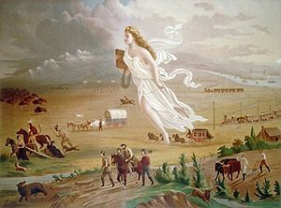
Picture of Manifest Destiny

Slide 54
Difficulties
Western settlement was dangerous
The terrain and climate could be cold and unforgiving, and these settlers from the East had to fight Natives and Mexicans
Texas is a good example—Mexico declared independence from Spain in 1821, the new country included what is now Texas and much of the Southwest, including California
Mexican government established liberal land policies to entice settlers, and tens of thousands of Americans (cattle ranchers) flooded the region
In return for land, settlers supposed to become Mexican citizens, but…

Slide 55
Texas
Settlers rarely became Mexican citizens
Ignored Mexican law, especially the one prohibiting slavery
Mexican attempted to regain control, and settlers declared independence
The battle at the Alamo was fought (1836)
Texas was an independent country, called Republic of Texas
Existence of slavery guaranteed Congressional battle over statehood, and it wasn’t admitted to the Union until 1845

Slide 56
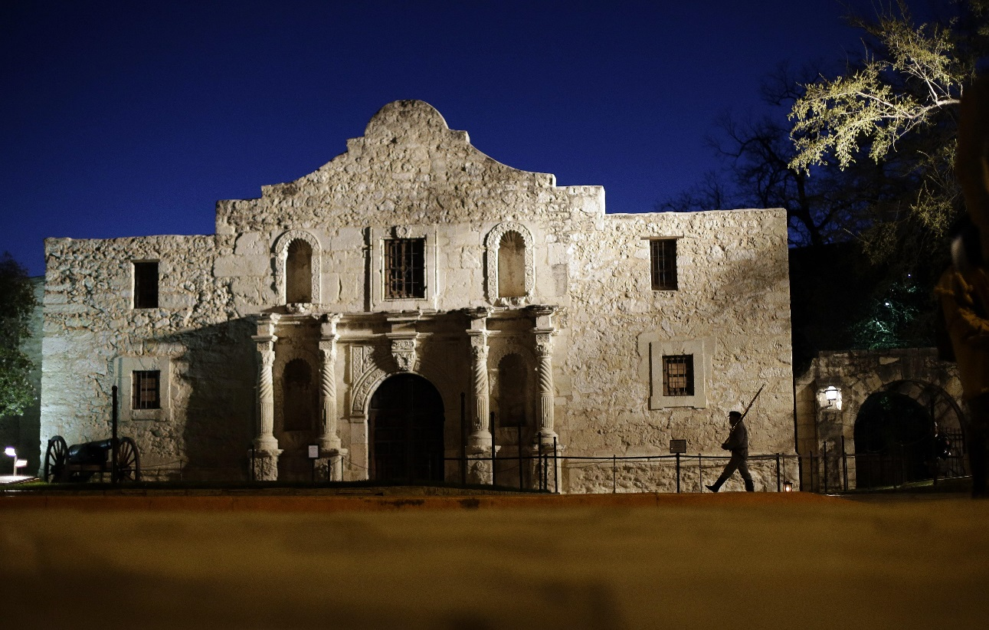
Picture of the Alamo

Slide 57
Oregon Trail
Settlers went to Oregon Territory
During the early 1840s, thousands of settlers traveled to the Willamette Valley, braving 6-month journey on the Oregon Trail
They encountered natives and British, claiming territory for Canada
Russians also staked a claim, and both British/Americans were threatened
President James K. Polk eventually settled it by signing a treaty with England

Slide 58
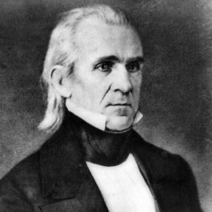
Picture of James K. Polk

Slide 59
Gold Rush
By late 1840s, those heading along the Oregon Trail had a new destination—California
In 1848, discovery of gold in CA mountains set off Gold Rush, attracting over 100,000 people in just 2 years
Most of these people didn’t strike it rich, but they settled the area after discovering that it was very hospitable to agriculture
Its access to the Pacific Ocean allowed cities like San Francisco to develop as trade centers

Slide 60
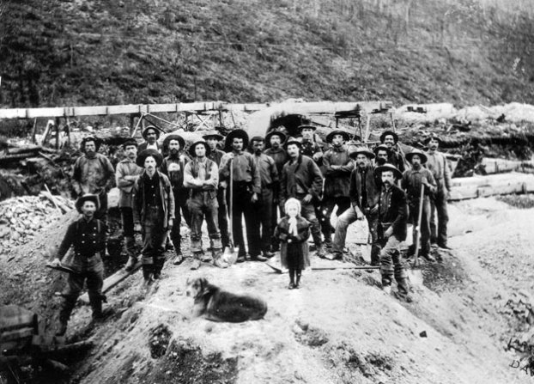
Picture of the Gold Rush

Slide 61
Sectional Strife
North was becoming industrialized; advances in communications/transportation/industry/banking made it nation’s commercial center. Farming not AS important, legal slavery less common
South was mainly agrarian; chief crops were tobacco and cotton; required land and slavery, tried to get influence in Congress to fight Northerners who wanted slavery to be illegal
Western interests were about commercial farming, fur trapping, real-estate; distrusted the North (powerful banks trying to steal land), little use of the South (hierarchical society at odds with their belief in equality); Westerners ignored slavery, even though their expansion provoked more debate

Slide 62
SOCIAL HISTORY, 1800-1860
Growth of American economy brought numerous social changes
Invention of cotton gin, coupled with advent of Industrial Revolution in England, altered Southern agriculture, resulting in the region’s increased reliance on slave labor
Development of commerce led to larger middle class, especially in the North but also in Southern and Midwestern cities
Industrialization resulted in bigger cities with large/impoverished migrant and immigrant neighborhoods
Westward migration made a new frontier culture, pioneers dealt with uniqueness of West’s climate/landscape

Slide 63
The North and American Cities
North became nation’s industrial/commercial center during the first half of 19th century
North became home to many of nation’s major cities
In early years, American cities faced numerous problems, chiefly the lack of powerful urban governments to oversee their rapid expansion
Modern waste disposal, plumbing, sewers, and incineration were a long way off; cities could be toxic
Proximity in which people lived/worked, coupled with sanitation problems, made epidemics inevitable

Slide 64
City Life
Cities had jobs
Northern farmers, unable to compete with cheaper produce carted in from West/South by steamship and rail; moved to cities to work in new factories
Craftsmen like tailors/cobblers/blacksmiths, found it easy to make a living
Second, cities offered more opportunities for social advancement
In the 1830s/1840s, as municipal governments grew, cities began to provide important service, such as public schooling
Labor unions began to form
Americans in cities made clubs/associations; leisure in theater/sports!

Slide 65
Distribution of Wealth
An elite few controlled most of the personal wealth, led lives of power and comfort
Beneath them was the middle class, made of tradesmen, brokers, professionals
They worked so that women in families could home-make, not work; many middle-class women in teens/twenties worked become settling down
As wage-earning labor was performed away from home, the idea grew that men should work while women raised kids at home
This notion was called the Cult of Domesticity, supported by novels/magazines

Slide 66
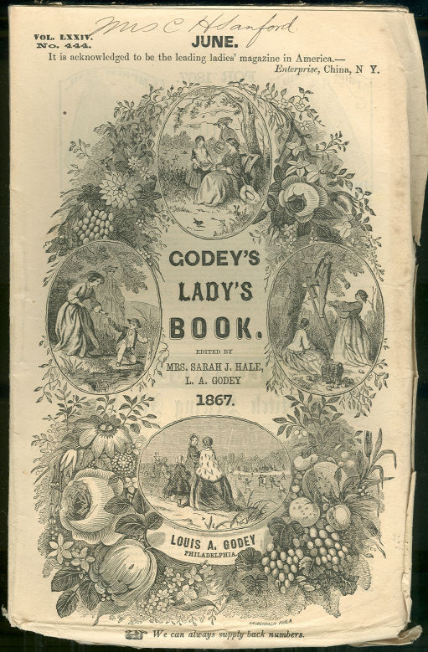
Picture of the Cult of Domesticity

Slide 67
Working Class
Members of middle class rose from working class
In working-class families, men often worked in factories or at low-paying crafts; women worked at home, sewing or as domestic servants
They lived just above the poverty level, and any calamity (loss of job, injury, sickness, a death in the family) plunged them into debt
Those in poverty were recent immigrants
Numbers swelled in 1840s/50s when immigration waves from Ireland (to the North) and Germany (to the West) reached the U.S.
Immigration waves met with hostility (“they took our jobs”)

Slide 68
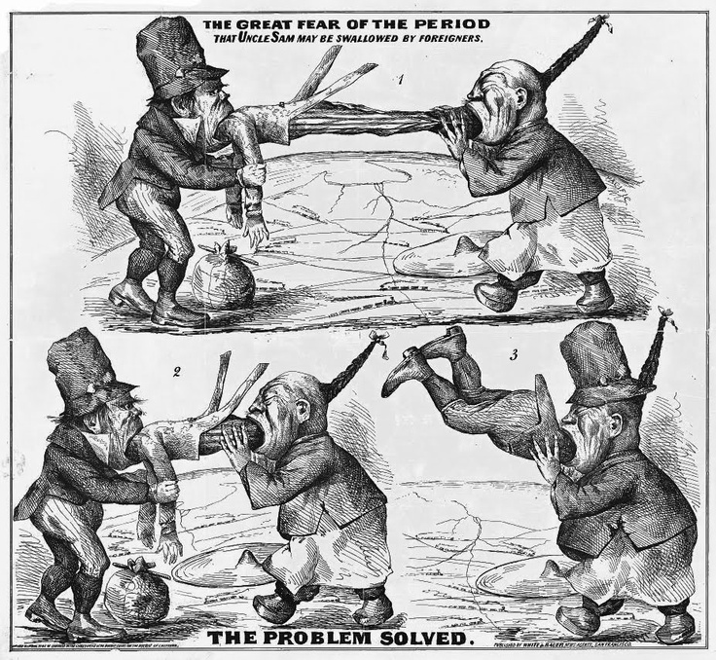
Picture of Anti-Irish Propaganda

Slide 69
Discrimination
Irish were discrimination against due to Catholicism and their education level being lower than the Germans
Tensions would boil over, cities had riots
In the 1830s/40s, religious, ethnic, or class strife could escalate to violence/fatalities
Such disturbances were responsible for the formation of municipal police departments, which replaced privately run security companies in enforcing the peace

Slide 70
South and Rural Life
Few major urban centers in the South
The majority of Southerners lived in rural areas in near isolation
In 1860, the population density Georgia was 18 people per square mile
Family played a dominant role in social life
After family came the church, and after the church, little else
There weren’t enough people around to support organized cultural and leisure events

Slide 71
Commerce in the South
With almost no major cities, South had few centers of commerce
South’s infrastructure was limited
Major city of South, New Orleans, replied on waterways for trade routes, so grew more slowly than Northern cities like NY/Boston
South didn’t get a strong market economy, like the North
Wealthiest were plantation owners, as in the North, wealthy were a minority, but in the South, they dominated politically/socially/economically
Less than 1% of white Southerners had over 100 slaves; over 75% had no slaves; only 2% had over 20 slaves

Slide 72
Cotton
Plantation owners grew cotton throughout Deep South and tobacco in Middle Atlantic, alongside crops they needed to support families and slaves
Most convinced themselves that the slave system benefitted everyone, including slaves
Called Southern paternalism, relied on perception of blacks as childlike and unable to take care of themselves
Many slaves discovered life was easier for them when they reinforced paternalistic instincts, adopted a submissive/grateful demeanor
Slave owners converted slaves to Christianity

Slide 73
Slave Poverty
Slaves housed in one-room cabins with many families, overcrowded/unsanitary
Although work conditions varied from region to region/farm to farm, most worked long hours at difficult labor, worse in the Deep South
Any concern owners had for slaves might because they couldn’t buy new ones; since importing slaves from Africa was banned in 18-8
Most slaves lived in fear that their families would be broken up by sale, and abused

Slide 74
Culture
Most survived physical/psychological degradation of slaves by blending African roots with Christianity
Slave revolts were rarely successful, but many slaves developed subtle methods of resistance (sneaking out at night to meet a loved one, reading and writing)
Majority of Southerners farmed smaller tracts of land
Planters (with 20 or more slaves) were in the minority; remaining landowners were yeomen, sometimes had a few slaves, often none at all, working small tracts of land with families
Most were of Scottish/Irish descent, farmed in the hills, where you can’t have plantations

Slide 75
Landless Whites
Landless whites farmed as tenants or hired themselves out as manual laborers. Elevation from this social stratum to the level of yeoman proved very difficult
South was home to 250,000 free blacks, descendants of slaves freed by owners or freed for having fought in the Revolution
Black codes prevented them from owning guns/drinking liquor/assembling in groups of more than three (except in church)
Most worked as tenant farmers/day laborers
Some were “mulattoes” (biracial individuals), and some lived well in New Orleans

Slide 76
West and Frontier Living
By 1800, western frontier was east of the Mississippi
By 1820, western frontier was the Louisiana Purchase
Settlers moved to Texas (then a part of Mexico) in the 1820s, and 1830s
By early 1840s, frontier included the pacific Northwest
In 1849, the Gold Rush drew settlers, Forty-Niners, to California
US government encouraged westward expansion
It gave away or sold at reduced rates large tracts of land to war veterans, and loaned to civilians; some settlers, called squatters, ignored the requirement to buy land and just took it

Slide 77
Settlers
Settlers in the Ohio Valley found that the area was good for grain production/dairy farming
Much of the area was flat, could be farmed by things like the reaper/mechanical plows
Transportation advances made shipping easy/profitable; Midwest came to be known as “the nation’s breadbasket”
Fur trading was common on the frontiers; fur traders were called “over-mountain men”
They were often the first pioneers in a region, ahead of farmers

Slide 78
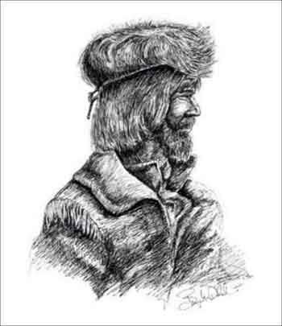
Picture of Fur Traders

Slide 79
Fur Traders
When fur traders reached Oregon, they were out of places to go, and had nearly hunted beavers to extinction
A group of former trappers formed the first American government in the Oregon Territory and lobbied for statehood
Frontier life was rugged
To survive, settlers struggled against climate, elements, Native Americans
Offered opportunities for wealth, freedom, social advancement (less common in competitive East and aristocratic South)
Women made a good living running hotels/boardinghouses

Slide 80
Religion/Social Movements
Early social reform movements grew out of the Second Great Awakening (religion revival among Methodists, Presbyterians, and Baptists); began in the burned-over district of Western New York and spread throughout the country, sparking an intense period of evangelicalism in the South and West
Burned-over district was burned by flames of religious revival—no people left to convert
Numerous churches formed in places where they had been none (called revivals)
Mainly in the Northeast (erase social evils like drinking/poverty)

Slide 81
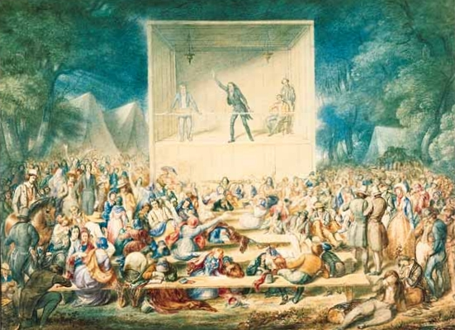
Picture of Second Great Awakening

Slide 82
Connections
Burned-over district was in Western New York
During same time, Erie Canal was built
First Great Awakening was reaction against Enlightenment
Second G.A. was reaction against commercialism/capitalism

Slide 83
Reform Societies
Most active members of reform groups were middle/upper class women
Temperance societies tried to encourage people not to drink/prohibit liquor, were powerful until the adoption of 18th Amendment in 1919 for nationwide prohibition
Prohibition succeeded at the same time it became evident to politicians that women would gain the right to vote
Groups battled against gambling; by 1860, every state had outlawed lotteries
Many northern states prohibited alcoholic beverages
“The Female Moral Reform Society” fought prostitution in the cities

Slide 84
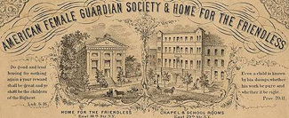
Picture of Female Moral Reform Societies

Slide 85
Dorothea Dix
Reform societies brought about penitentiaries, asylums, and orphanages by popularizing the notion that society is responsible for the welfare of the least fortunate
Asylums, orphanages, houses of refuge for the poor are built to care for those who would previously have been imprisoned/run out of town
Leadership from Dorothea Dix, penitentiaries tried to rehabilitate criminals by teaching them a morality/work ethic

Slide 86
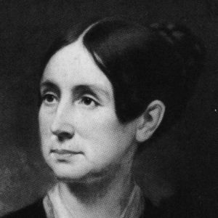
Picture of Dorothea Dix

Slide 87
Shakers
Shakers were a utopian group that splintered off from Quakers, believed that churches were too interested in world, too neglectful of afterlives
Shakers followed Mother Ann Lee, isolated themselves in communes where they shared work and its rewards; granted near-equal rights to women, allowed women to become priests
Believed that sex caused evil, practiced celibacy…so their numbers diminished
Ended during 1840s/50s
Other Utopian groups included Oneida community in NY, New Harmony community in Indiana

Slide 88
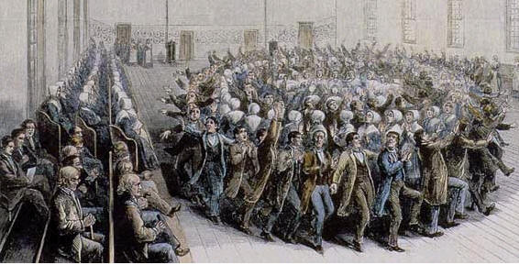
Picture of Shakers

Slide 89
Brook Farm
Well-known utopian community, established near Roxbury, Massachusetts in 1841. Brook Farm was home to Transcendentalists, group of nonconformist writers and philosophers
Believed that humans contained elements of the divine, and they had faith in man’s/society’s perfectibility
Most famous were Nathaniel Hawthorne (The Scarlet Letter), Ralph Waldo Emerson and Henry David Thoreau
Thoreau wrote Walden (lived two years alone in a cabin on Walden Pond)
Refused to pay taxes on a government that waged war on Mexico (civil disobedience)

Slide 90
Painters
Hudson River School painters were the first distinct school of American art
Created a vision—painted landscapes that portrayed an awe for the wilderness and beauty of wild America
Like the transcendentalists, painters were influenced by European romanticism

Slide 91
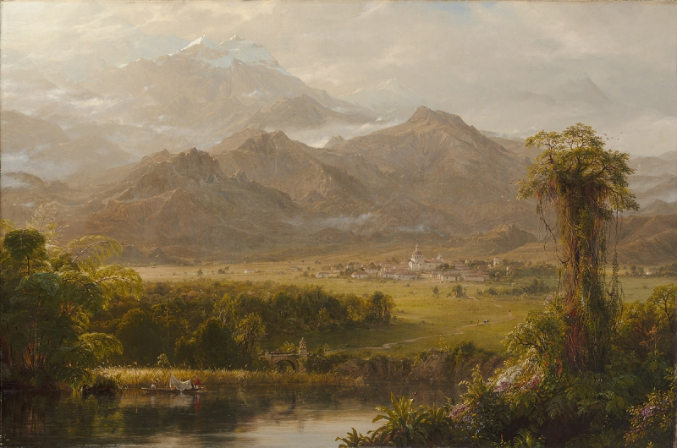
Picture of Hudson River Schools

Slide 92
Mormons
Joseph Smith formed the Church of Jesus Christ of Latter-Day Saints to 1830
Smith’s preaching, particularly his acceptance of polygamy, drew strong opposition in the East and Midwest, culminating in his death by a mob while imprisoned in Illinois
Mormons journeyed to Salt Lake City, Utah, led by Brigham Young
They transformed the area from desert into farmland through irrigation
Success was caused by strong sense of community

Slide 93
Second Great Awakening
By 1820s/30s, most founding fathers were dead, but them left a legacy of freedom/equality
In the 1830s, We the People still just meant white males
Women were excluded from an anti-slavery convention in 1840, so Elizabeth Cady Stanton and Lucretia Mott held the first women’s rights convention in 1848 in Seneca Falls in NY (in the Burned over district)
They published the Declaration of Rights and Sentiments of Women, editing Declaration of Independence to include females
Four years later, Stanton teamed up with Susan B. Anthony and founded the National Woman Suffrage Association in 1869

Slide 94
Public Education
Horace Mann pushed for public education and reform
Lengthened the school year, established a school for teacher training, used standardized books (McGuffey’s Reader was used by 80% of public schools)
He believed that education was the great equalizer

Slide 95
The Abolition Movement
Before 1830s, few whites fought for liberation of slaves
Quakers thought it was morally wrong, most sought gradual abolition and a movement to put blacks back in Africa
Religious/moral fervor of the great awakening persuaded more and more whites/Southerners that slavery was EVIL
White abolitionists were moderates or immediatists
William Lloyd Garrison published a popular abolitionist newspaper called the Liberator in 1831, founded the American Anti-slavery Society in 1833
His early subscribers were mostly free blacks, but it caught on with whites

Slide 96
William Lloyd Garrison
He fought against slavery and against moderates, decrying plans for blacks going back to Africa as racist/immoral
Southern states banned his paper, and prohibited anyone from discussing it
Congress opted for a gag rule that prevented its discussion
It prevented Congress from enacting new legislation pertaining to slavery
The rule lasted from 1836 to 1844, along with South restrictions on free speech, and outrage Northerners

Slide 97
Free Blacks
Abolition associations formed in every large black community to assist fugitive slaves and publicize the struggle against slavery
These groups met at a national convention every year after 1830 to coordinate strategies
In the 1840s, Frederick Douglass began publishing his influential newspaper The North Star
Douglass, an escaped slave, gained fame as a gifted writer/advocate for freedom
His Narrative on the Life of Frederick Douglass is one of the great American autobiographies

Slide 98
Tubman and Truth
Harriet Tubman escaped slavery and returned south repeatedly to help more than 300 slaves escape via the underground railroad (a network of hiding places and “safe” trails)
Sojourner Truth campaigned for emancipation and women's rights
Abolitionists’ determination and South’s inflexibility led to the Civil War

Slide 99
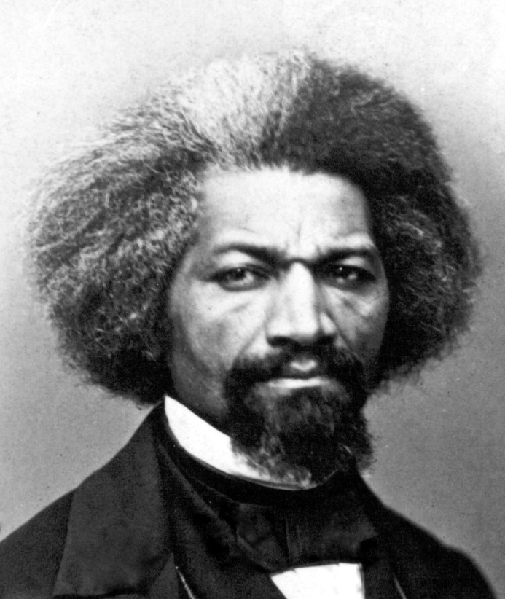
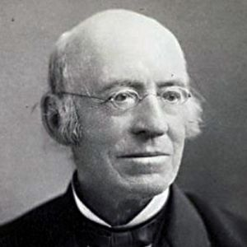
Pictures of Frederick Douglass and William Lloyd Garrison

Slide 100
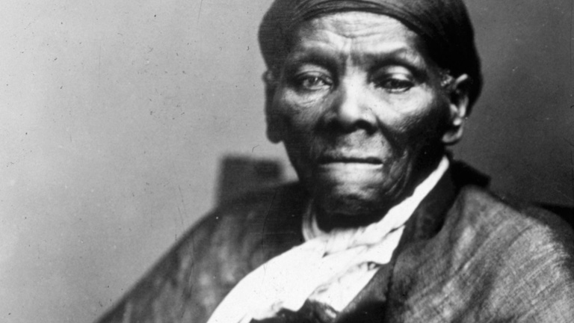
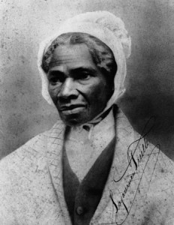
Pictures of Harriet Tubman and Sojourner Truth

