Slide 1
Chapter Five: Towards the Civil War and Reconstruction
(1845-1877)

Slide 2
Political/Judicial Activity Before the War
Election of 1844: James Polk versus Whig leader Henry Clay
Whigs wanted internal improvements (bridges, harbors, canals)
Democrats are expansionists (borders)
  Government should let private entities fix private lands
Whig-dominated New England (towns and factories) versus Democratic South (isolated plantations)
Election was close, Polk won

Slide 3
The Polk Presidency
Polk had four goals, wanted to complete them in one term
1, Restore practice of keeping government money in the Treasury
  Jackson had kept them in pet banks
2, Reduce tariffs (taxes)
1 and 2 were done by 1846
Last days of Tyler administration, Tyler wanted to annex Texas
Northern Congressmen were scared, since it was so big, it would tip the slave/free state balance (Missouri Compromise)

Slide 4
Texas Resolution
North demanded Polk get all of Oregon Country, which stretched from Mexican territory in CA to Russian territory in Alaska
Polk recognized that US couldn’t fight with Mexico and Great Britain, the other claimant to Oregon Country
He negotiated the Oregon Treaty with Britain in 1846, letting US get Oregon, Washington, Idaho, Wyoming, Montana; established our current border with Canada

Slide 5
Mexican-American War
Polk tried to buy Southwest from Mexico
Failed, so he provoked Mexico into attacking American troops on the border
Mexico was already angry about Texas, so they attacked
Polk used it to get a declaration of war; Mexican-American War began in 1846
Whigs, such as Abraham Lincoln, questioned that Mexico fired first

Slide 6
Public’s Reaction to War
Northerners feared that new states in West would become slave states
Opponents argued that Polk provoked Mexico at the request of slaveholders
The rich Southerners who were “pulling the strings” were called Slave Power by Northerners
The gag rule in 1836 raised more suspicions of a Slave Power
The defeat of the Wilmot Proviso, a congressional bill stopping extension of slavery in new Mexico territory, reinforced it

Slide 7
Wilmot Proviso
The Wilmot Proviso House of Representatives vote was split between sectional lines, not party ones (Northern Whigs AND Dems voted for it; Southern Whigs AND Dems voted against it)
In the 1840s, Dems become even more South-dominated, while Whigs split between anti-slavery Northern “conscience” Whigs and pro-slavery Southern “cotton” Whigs
Soon, it becomes extinct; replaced by Free-Soil Party, a regional, single-issue party devoted to passing the Wilmot Proviso

Slide 8
Mexican War
US won in Texas, so Polk sent the army to Mexico, and sacked Mexico City
In the Treaty of Guadalupe Hidalgo (1848), Mexico handed over almost all of the modern Southwest: Arizona, New Mexico, California, Nevada, and Utah
This is known as the Mexican Cession
The US paid $15 million for it all
Increased nation’s wealth; gold was found at Sutter’s Mill during the year that the treaty was signed

Slide 9
Continued Slavery Debate
Southerners now saw a future in which slavery was confined not to the southern half of the country, but the southeastern quarter of the country
They thought they might be outvoted, so they decided they should ignore the Missouri Compromise and introduce popular sovereignty
  This meant that the new territories themselves would vote on if they wanted slavery or not
Abolitionists had very little political power; the primary opposition came from white farmers who didn’t care about slaves’ health, but didn’t want to compete with black labor

Slide 10
The Compromise of 1850
Californians opposed slavery, so Southerners opposed Californian statehood
Proslavery forces argued that southern California should be forced to have slaves in accordance with the Missouri Compromise boundary
The debate was so intense that the South began openly taking about seceding/breaking away
Democrat Stephen Douglas and Whig Henry Clay hammered out the Compromise of 1850; it was defeated in Congress as a complete package, so Douglas broke it up and passed it all separately

Slide 11
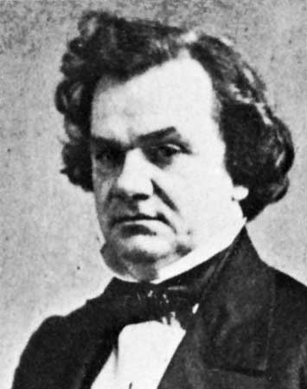
Stephen Douglas

Slide 12
Details of the Compromise
It admitted CA as a free state, but made a stronger fugitive slave law
Created territories of Utah and New Mexico, but let them decide if they wanted slaves or not (popular sovereignty)
It abolished the slave TRADE, but not slavery itself, in Washington D.C. (immoral to buy or sell human flesh in the shadow of the nation’s capital)
The definition of popular sovereignty was so vague that Northerners/Southerners could interpret it however they wanted
New fugitive slave law made it easier to retrieve escaped slaves, but forced citizens of free states to cooperate it giving them back

Slide 13
Uncle Tom’s Cabin
In 1852, Uncle Tom’s Cabin was published by Harriet Beecher Stowe
Stowe, a Northerner, based her damning depiction of plantation life on abolitionist propaganda
It sold more than 1 million copies and became plays that toured Europe/America
Like Thomas Paine’s Common Sense, it was extremely powerful and played on the emotions of the common man

Slide 14
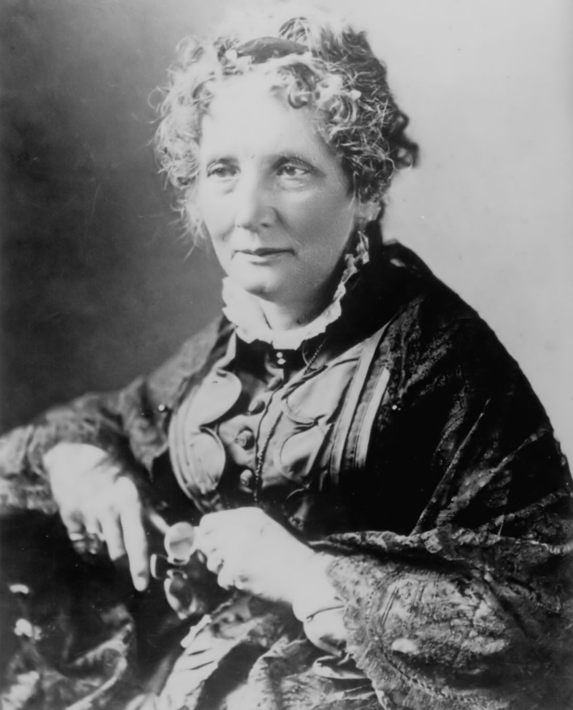
Harriet Beecher Stowe

Slide 15
Kansas-Nebraska Act
After CA, no new states would be admitted ‘till 1858, but Kansas and Nebraska territories had no civil authority; Congress wanted to build railways, but needed some form of government there
Stephen Douglas wrote the Kansas-Nebraska Act of 1854
He left it up to members of the territories to determine when/how they decide if they want slaves
It repealed the Missouri Compromise
Northerners called it a betrayal, blamed Slave Power, passed personal liberty laws to weaken fugitive slave act (guaranteed trial by jury for all fugitives and guaranteed them a right to a lawyer)

Slide 16
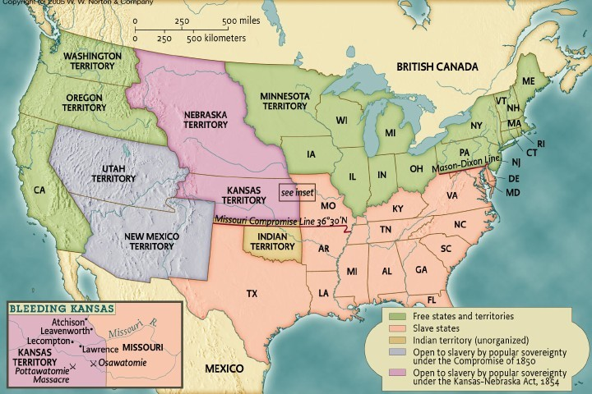
Kansas-Nebraska Act (Picture)

Slide 17
New Party
Anti-slavery Whigs joined Northern Democrats and Free-Soilers to become the Republican Party
Republicans wanted to keep slavery out of territories
Wanted more national roads, more land distribution in the West, increased protective tariffs
Midwestern merchants and farmers, Western settlers, Eastern importers all agreed with Republicans
In the North, it won a majority of Congressional seats in 1854
Now, it’s Democrats v. Republicans (pro-slavery, anti-slavery)

Slide 18
Know-Nothings
The American party, aka the Know-Nothing party, met privately and remained secretive, rallied around hating foreigners (nativism)
They grew quickly, spread anti-Irish, anti-German, anti-Catholic propaganda
It seemed like it would be the Democrats’ chief competition, but it imploded because its Northern and Southern wings disagreed about slavery

Slide 19
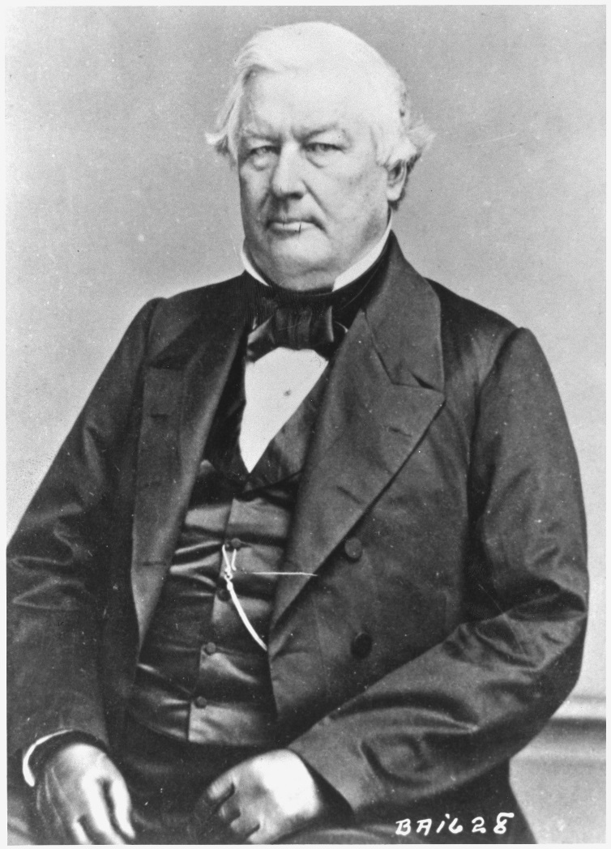
Millard Fillmore

Slide 20
Violence
Kansas-Nebraska Act provoked violence in territories
Both abolitionists and pro-slavery groups rushed in, wanting to form gvts quickly
Thousands of proslavery Missourians (aka Border Ruffians) temporarily moved to Kansas to vote in slavery
President Franklin Pierce, a “doughface” (Northerner who supported the South), recognized the proslavery movement and made Kansas a slave territory
Proslavery forces then destroyed the free-soil city of Lawrence, Kansas

Slide 21
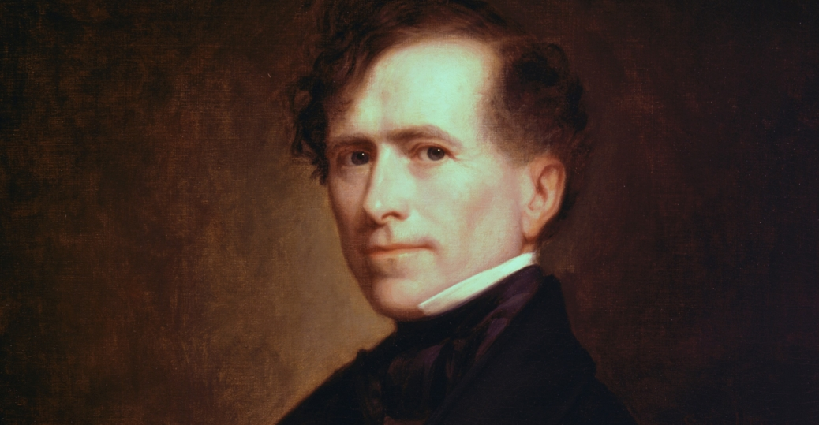
Franklin Pierce

Slide 22
Bleeding Kansas
Radical abolitionist John Brown led a raid on a proslavery camp, murdering five
Then, gangs from both sides roamed Kansas and killed each other
200 died in the conflict, so Kansas was called Bleeding/Bloody Kansas during this time

Slide 23
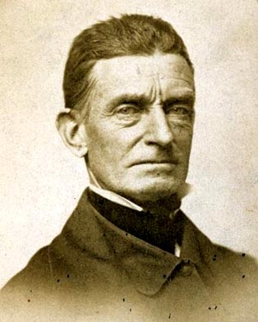
John Brown

Slide 24
More Violence
In Congress, Preston Brooks beat abolitionist Charles Sumner on the head with a cane when Sumner attacked the South and Butler using sexual metaphors about slavery
The crisis destroyed Pierce’s political career, so Democrats switched to James Buchanan as their 1856 candidate
Buchanan’s best asset was that he was out of the country for the last four years, so couldn’t be blamed for Kansas-Nebraska Act
Buchanan won the South, while the North split between Buchanan and Republican John Fremont; the Know-Nothings ran Millard Fillmore, who got 20% of the vote, and then broke up

Slide 25
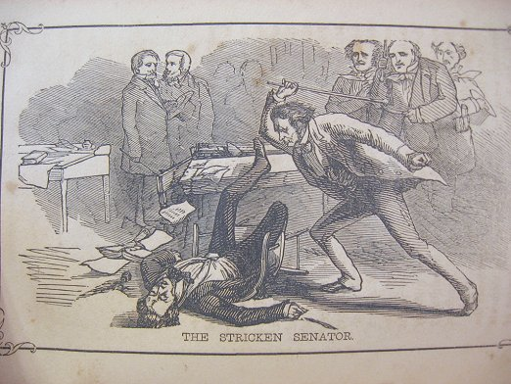
Brooks-Sumner Caning

Slide 26
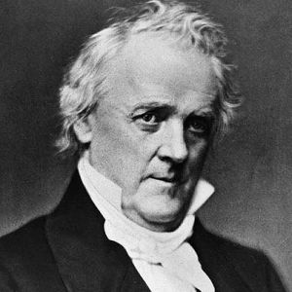
James Buchanan

Slide 27
Buchanan’s Presidency
As president, Buchanan tried to keep things the same
Enforced fugitive slave act, opposed abolitionists in South/West
Didn’t know what to do about slavery
Two days after Buchanan took office, Supreme Court ruled in Dred Scott v. Sandford
Scott was a slave whose master had taken him to territories where slavery was illegal; declared himself free and sued
Scott won the case, lost the appeal, went to Supreme Court…they ruled he was a slave

Slide 28
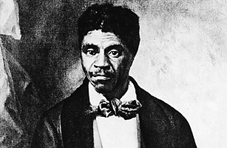
Dred Scott

Slide 29
Dred Scott Details
Chief Justice Roger Taney said that slaves were property, not people, and that no blacks could ever be a citizen of the US, so they couldn’t sue in courts
Said that Congress could not regulate slavery in territories (as it had done in passing the Northwest Ordinance in 1787 under the Articles of Confederation government and again in 1820 with the Missouri Compromise)
This nullified Missouri Compromise, Kansas-Nebraska Act, and Wilmot Proviso

Slide 30
Decade of Crisis
In exercising judicial review, Taney was saying that slavery could go anywhere
The Republicans’ goal of preventing the spread of slavery into the new territories was destroyed
This was a major victory for Southerners
In the North, the Court’s decision as denounced; the press called it Slave Power that would soon dominate the whole country
The Democrats were dividing under regional lines, raising the possibility that Republicans could control the gvt

Slide 31
1858
In 1858, Stephen Douglas ran for Illinois Senate against Abraham Lincoln, a rising Republican star
The race of Illinois’ Senate seat got national attention because of railroad and telegraph
Stephen Douglas was seen as the leading Democrat, while Lincoln gained his reputation as a Whig opposed to the Mexican War and Kansas-Nebraska Act
Lincoln-Douglas Debates gave voice to issues; Lincoln said that we were a “House Divided” and “this nation cannot exist permanently half slave and half free”
Douglas destroyed his political career in his attempt to defend popular sovereignty in his Freeport Doctrine

Slide 32
Lincoln-Douglas Debates
Lincoln skillfully backed Douglas into a corner where he pushed him to reconcile popular sovereignty with Dred Scott
Douglas suggested that slavery couldn’t exist without local laws to protect it
He contended voters of a territory could exclude slavery by not protecting a man’s property
Douglas alienated Northern/Southern voters with his ambiguous stance and destroyed nay chance for winning the presidency in 1860
Douglas: “the little giant”; Lincoln: “the giant killer”

Slide 33
John Brown’s Raid
In 1859, John Brown raided Harper’s Ferry
Brown hoped to spark a slave revolt, but it failed
After his execution, news spread that Brown had received financial backing from Northern abolitionists
Brown became a martyr, celebrated in the North

Slide 34
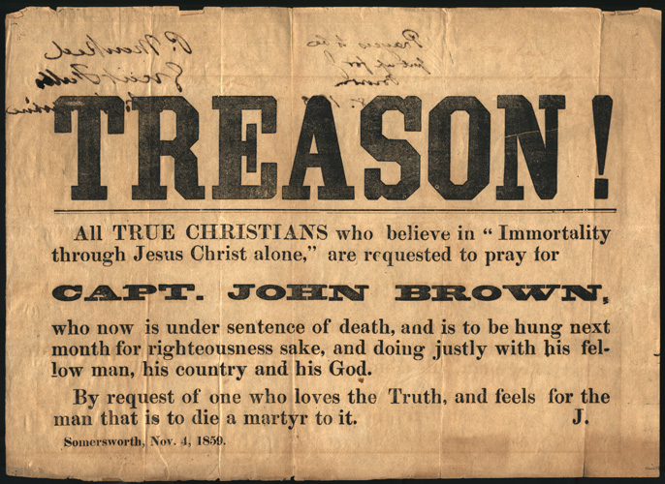
John Brown

Slide 35
Democrats in 1860
Northern Democrats still backed Stephen Douglas, Southerners backed John Breckinridge
The election showed that the nation was on the brink of fracture
In the North, it was between Douglas and Lincoln; in the South, Breckinridge was against independent John Bell. Lincoln didn’t even appear on their ballots
The North had the majority of electoral votes, and Lincoln had a clean sweep, so he won the election
The South responded by formally proposing secession

Slide 36
Breaking Up
Immediately after the election, Southerner leaders who wanted to maintain Union came up with Crittendon Compromise
Lincoln refused to soften the Republican demand that slavery not be extended to territories
Lincoln wouldn’t abandon principles of his supporters, and was banking on the hope that the South was bluffing
In December of 1860, three months before Lincoln’s inauguration, South Carolina seceded
Within months, six other states joined them and became the Confederate States of America, chose Jefferson Davis to lead them
On April 12, 1861, the South attacked and captured Fort Sumter; no one died in the first battle of the Civil War

Slide 37
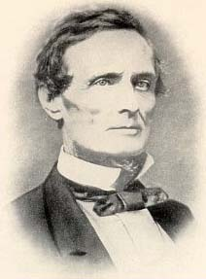
Jefferson Davis

Slide 38
What Was It About
Civil War wasn’t just about slavery
Missouri, Kentucky, Maryland, and Delaware, the Border States, were slave states that fought for the Union
Except for active abolitionists, most Northerners believed they were fighting the preserve the Union
Most Southerners described their cause as fighting for states’ rights to govern themselves
But slavery caused this argument to escalate to war
As late as 1862, Lincoln said “If I could save the Union without freeing any slaves, I would do it…I do because…it helps to save the Union”

Slide 39
Confederate Government
Though South fought to gain control, the Confederacy brought them under great central control
Jefferson Davis understood the Northern advantage in population, transportation, and economics
He took control of Southern economy, imposing taxes and investing in infrastructure; he took control of railroads, and made a government bureaucracy to deal with the economy
He forced the South to compensate for losing Northern trade

Slide 40
Southern Response
South didn’t want to pay taxes, so Davis declared martial law and suspended writ of habeas corpus, which requires proper authority and a paper trail before people can be tried/imprisoned
Lincoln was upsetting Northerners with some of the exact same steps, but use of presidential power chafed badly in the Confederacy, where they seceded to avoid things like this
Davis modernized the South a LITTLE, but not to the Union’s extent
Rapid economic growth brought with it rapid inflation; prices rose so quickly that paychecks and payments for crops became worthless almost as soon as they made

Slide 41
Conscription
In 1862, Davis imposed a military draft, conscription
It required small farmers to serve in the Confederate Army
This act caused even greater poverty in the country, as many families could not adequately tend their farms without their men
Confederate conscription created class conflict
The government allowed the wealthy to hire surrogates to perform military service in their place and exempted anyone with more than 20 slaves on the grounds that their plantations fed the soldiers
So the wealthy didn’t serve, the poor had no choice, led to class tensions and desertions later on

Slide 42
Civil War in the Union
Northern economy got a boost from the war (demand for uniforms and weapons increased manufacturing)
Loss of Southern trade was offset by this boom
Some traders overcharged the gvt. for war supplies (war profiteering)
Some sold the Union gvt. bad food and clothes while gvt. bureaucrats were bribed into silence
Corruption eventually prompted a yearlong congressional investigation
North experienced accelerated inflation, but not as much as the South (North had 10-20% price raise, South had over 300%/year)

Slide 43
Jobs in the War
Workers formed unions, businesses blacklisted union members, forced new employees to sign non-union contracts, used violence to break strikes
Republican Party believed that gvt should help business, but regulate them as little as possible, so supported anti-union rules
Lincoln increased power of central gvt, like Davis; made economic development programs without waiting for Congress, made gvt loans/grants to businesses, raised taxes, suspended writ of habeas corpus in border states to easily arrest secessionists, printed national currency (his treasury secretary, Salmon P. Chase, printed greenbacks, gvt-issued paper money that led to modern currency)

Slide 44
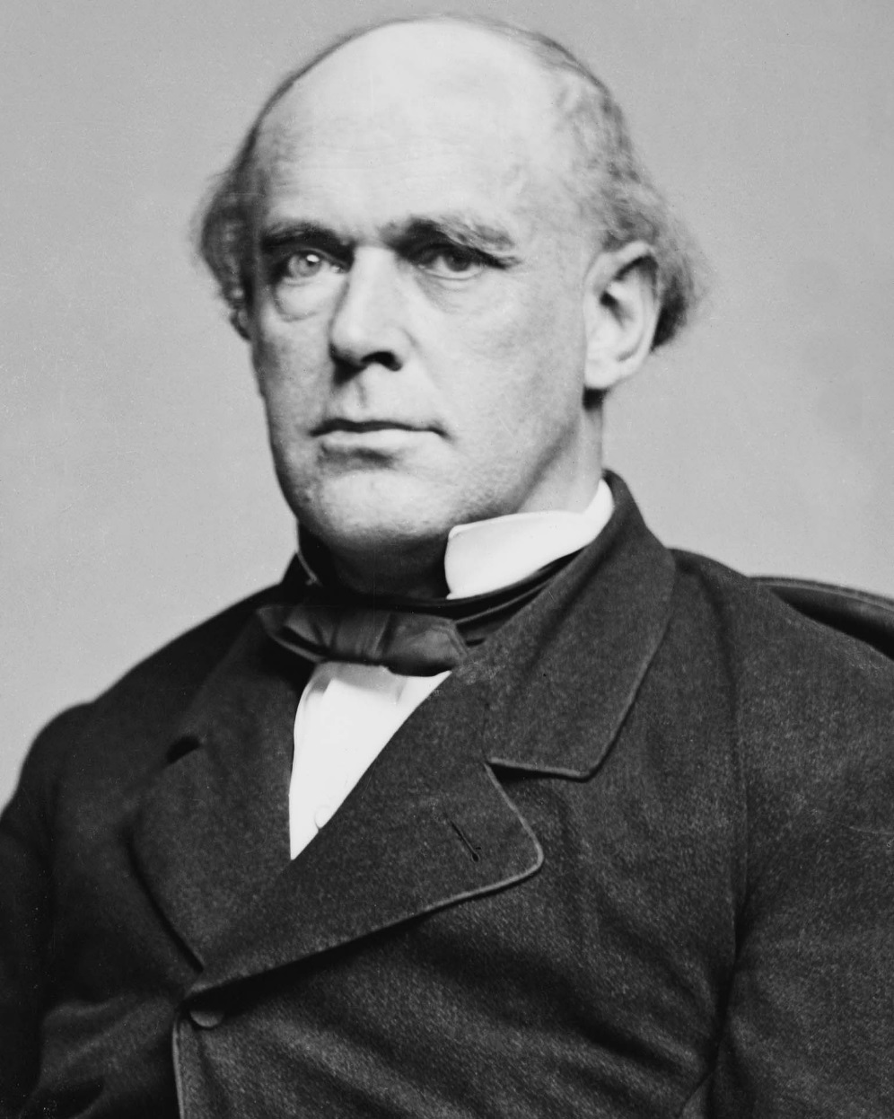
Salmon P. Chase

Slide 45
Emancipation of Slaves
Lincoln argued for gradual emancipation, compensating slaveholders, and colonizing free slaves in Africa (as a candidate)
When the Union dissolved and the South left, Congress was very liberal
The Radical Republicans wanted immediate emancipation, and introduce the confiscation acts
The first (1861) gave the gvt the right to seize any slave used for “insurrectionary purposes”
The second (1862) let the government liberate any slave owned by anyone who supported the rebellion

Slide 46
Slavery, Continued
Lincoln refused to enforce the second confiscation act
He wanted to emancipate because slaves indirectly supported the Southern war effort, grew crops and cooked meals
After they were captured/taken by the gvt, they had to be freed, or the Union gvt would be the world’s biggest slaveholder
Making the freedom of slaves important also kept Britain and France out of the war
Jefferson Davis hoped Europe would support the South because they wanted Southern cotton, but when Lincoln talked about freeing slaves, Europe didn’t want to come over and be killed by slave rebels

Slide 47
Slavery, etc.
Emancipation also provided more soldiers to the Union side—but he didn’t want to make the move until the North won a big victory, or it would seem desperate
In 9/1862, the Union won at Antietam, so Lincoln issued the Emancipation Proclamation
It actually freed no slaves, but said that on 1/1/1863, the gvt would liberate all slaves residing in rebel states
Throughout the war, Lincoln never acknowledged secession, and always referred to the Confederacy as “states in rebellion”
Proclamation didn’t liberate slaves in border states, or in Southern states where the North had already won

Slide 48
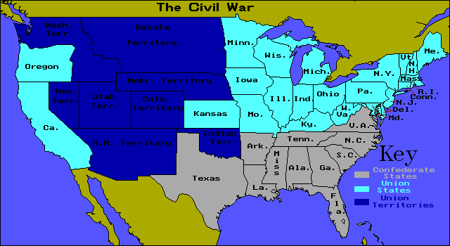
Civil War Map

Slide 49
Emancipation Proclamation
Lincoln had no legal power to end slavery in the areas governed by the U.S. Constitution
Abolitionists complained that Lincoln banned slavery where he had no legal right to do so and kept slavery where he could have liberated them
The Proclamation also gave southerners the chance to rejoin the Union and keep slavery
But it did declare that the war was a war AGAINST slavery

Slide 50
Complete Emancipation
When Lincoln ran for reelection, he supported complete emancipation (two years later)
He lobbied for a constitutional amendment prohibiting slavery (the thirteenth amendment)
After his reelection, he considered letting defeated Southern slates vote on the 13th
Tried to negotiate a settlement with Southern leaders at the Hampton Roads Conference, and offered a five-year delay on implementing the amendment, AND $400 million to slave-owners
Jefferson Davis wanted complete independence, so it failed

Slide 51
Election of 1864
Both North and South wanted the war to end
Lincoln’s opponent, General George McClellan campaigned on a peace platform; in the South, citizens ignored Davis
As the war dragged on, small non-slave holding farmers resented the Confederacy and the war, and started blaming Slave Power
Some “War Democrats” in the North admitted that the war was necessary to preserve the Union
The Copperheads accused Lincoln of instigating a national social revolution and criticized his policies as trying to destroy the South

Slide 52
New York City
New Yorkers hated the war, there were draft riots in New York City in 1863
Irish immigrants were already victims of nativism, and resented being drafted into a war being fought to end slavery
Many immigrants feared that once freed, former slaves would migrate into Northern cities and compete with them for low-paying labor jobs

Slide 53
End of War
Just when a stalemate might have forced an end to the war, things began improving for the North
Victories throughout the summer of 1863 helped Lincoln gain reelection
By spring of 1865, Union victory was assured, gvt established Freedman’s Bureau to help liberated blacks get food, housing, and schools
It might be the first social welfare program in the US
In 4/1865, Confederate leaders surrendered; days later, actor John Wilkes Booth killed Lincoln

Slide 54
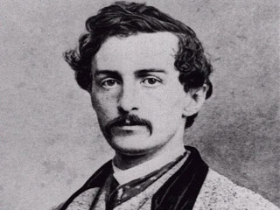
John Wilkes Booth

Slide 55
Cost of War
More than 3 million men fought, more than 500,000 died, at least the same number seriously wounded
During Union General Sherman’s march from Atlanta to the sea in the fall of 1864, the Union Army burned everything to destroy Confederate morale and deplete resources (scorched earth policy)
Southern Robert E. Lee surrendered to Ulysses S. Grant at Appomattox Courthouse in 1865
From a political perspective, war permanently expanded the role of government

Slide 56
Reconstruction
At war’s end, three questions: what conditions it take for the Southern states to be readmitted? What would the status of blacks be? What should be done with rebels?
Reconstruction refers to 1865 to 1877—the end of civil to when the Union army withdrew from the South
Process of reconstruction involved getting the Southern states back, physically rebuilding the South, and integrating free blacks into America
Lincoln didn’t want to punish the South, and wanted them to be reunited

Slide 57
Lincoln’s Plans
Lincoln’s 10 Percent Plan required that 10% of the voters who voted in 1860 swear an oath of allegiance to the Union and accept Emancipation under the 13th Amendment; these men would reorganize their state government and reapply for admission into the Union
Congress viewed Southern states as “conquered territory,” Radical Republicans said they were under the jurisdiction of Congress, not the President
Republicans enacted the Wade-Davis Bill in 1864, said that former Confederate states be ruled by a military governor, required 50% of the electorate to swear an oath of allegiance, THEN a state convention would be organized to repeal their secession statement and abolish slavery

Slide 58
Black Suffrage
Neither the 10% Plan nor the Wade-Davis Bill mentioned blacks voting
Lincoln pocket-vetoed the Wade-Davis Bill (if a president doesn’t sign a bill within 10 days, and Congress adjourns at the end of the 10 days, the bill dies and must be reintroduced later; they wait it out)
Then, Lincoln was assassinated by Booth
Vice President Andrew Johnson, a Southern Democrat who always supported Lincoln, became president; when he did, Congress was in recess, so Johnson was totally in charge

Slide 59
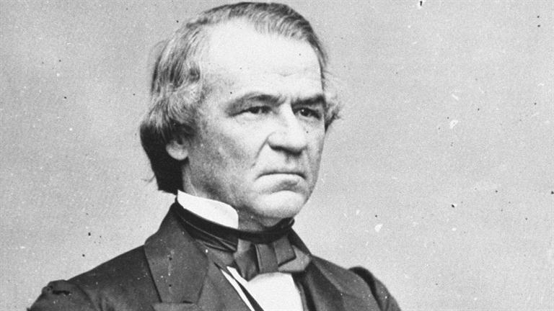
Andrew Johnson

Slide 60
Johnson’s Plan
Johnson’s Reconstruction Plan called for the creation of provisional military governments to run the states until they were readmitted
It required ALL Southern citizens to swear a loyalty oath before being readmitted
It barred many of the former Southern elite from taking the vow, prohibiting their readmission
The provisional governments would hold state constitutional conventions to write up new constitutions, eliminating slavery; he didn’t require that blacks be given the right to vote

Slide 61
Did It Work?
The plan failed, since Johnson pardoned many of the Southern elite who were supposed to have been excluded from the process
After the states drafted new constitutions and elected new governments, former Confederate leaders were in power again
Many new constitutions barely changed the old ones
They passed new black codes limiting free blacks’ rights to assemble and travel, making curfews, and requiring blacks to carry passes
Some state legislatures just replaced the word “slaves” with “freedmen”
When Congress reconvened in 12/1865, they voted not to seat the new Southern delegation (it included Confederate leaders)

Slide 62
Analyzing Johnson’s Plan
Congress was divided by conservative Republicans (agreed with Johnson), moderate Republicans, and Radical Republicans (wanted more Democracy in the South)
Following the Civil War, most political positions were held by appointees (not directly elected)
Most radical wanted a reconstruction program that punished the South
Historians suggested that revenge was the real motivation behind the passage of the Thirteenth Amendment
Under General “Scorched Earth” Sherman’s Special Field Order #15, land seized from Confederates would be given to blacks, but Johnson rescinded it, so freedmen were never given 40 acres and a mule

Slide 63
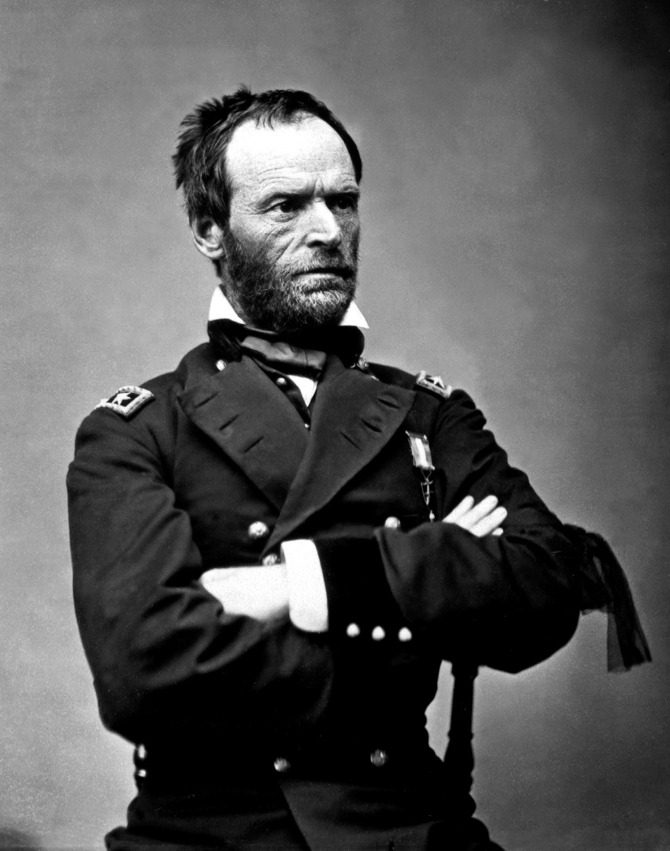
William Tecumseh Sherman

Slide 64
Compromise
Johnson refused to compromise with modifying Reconstruction, and declared it over and done with, vetoing a compromise package
Congress overrode the vetoes, increasing tension
Radicals drew up the plan that came to be known as Congressional Reconstruction; its first part was the Fourteenth Amendment to the Constitution
It said 1) if you are born in the United States, you are a citizen of the United States and you are a citizen of the state where you reside, 2) prohibited states from depriving any citizen of “life/liberty/property without due process of law”, 3) prevented states from denying citizens “equal protection”, 4) gave states choice to give freedmen the right to vote OR stop counting them among voting population, 5) barred prominent Confederates from political office, 6) excused the Confederacy’s war debt

Slide 65
Fourteenth Amendment
First three points are most significant; part of a lot of modern civil rights lawsuits
The Bill of Rights protects individuals from the federal gvt, the 14th Amendment protects individuals from the state government
It was intended to clarify issues with newly freed slaves, address the issue of citizenship after the Dred Scott decision, and limited the effects of the black codes
Radicals hoped to force states to extend suffrage to blacks or lose power in Congress
In his Swing Around the Circle speaking tour, Johnson campaigned against the amendment and lost; in the congressional election of 1866, the North voted for a Congress weighted toward the radical group

Slide 66
Military Reconstruction
Congress quickly passed the Military Reconstruction Act of 1867, it imposed martial law on the South, called for new state constitutional conventions, forced states to let blacks vote
The act required each state to ratify the 14th Amendment and send its new constitution to Congress for approval
Congress then passed laws to limit the president’s power
The House Judiciary Committee initiated impeachment proceedings against Johnson for violating the Tenure of Office Act (which stated that the president had to get the consent of the Senate before removing his appointees once they’d be approved—he fired his Secretary of War)

Slide 67
Aftermath
Johnson was impeached because he got in the way of Reconstruction
He was acquitted by one vote in the Senate, but it made it politically impotent and had no hope of reelection
Next, war hero Ulysses S. Grant was elected
The Fifteenth Amendment, proposed in 1869, finally required states to enfranchise black men (Women’s suffrage would have to wait another half-century)
The Fifteenth Amendment passed because Southern states HAD to ratify it to get back in; a lot of the North voted against it.

Slide 68
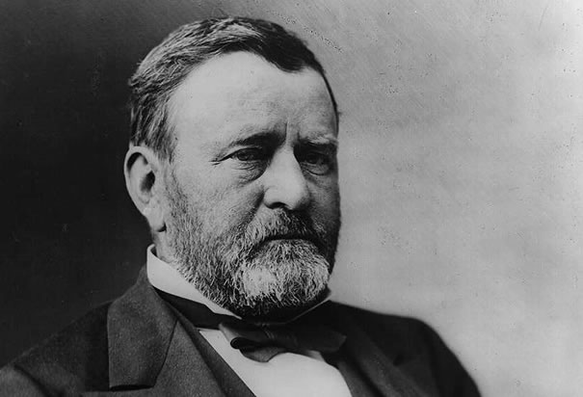
Ulysses S. Grant

Slide 69
Failure of Reconstruction
It worked when the North was in the South, keeping watch
New state constitutions allowed all Southern men to vote (not just those with property) and replaced appointed governors with elected ones
New governments stimulated industrial/rail development in the South through loans/grants/tax exemptions
Blacks served in Southern governments for a time
But these new economic plans cost a lot of money; high taxes turned public opinion hostile

Slide 70
Propaganda War
Opponents of Reconstruction called Southerners in favor of it scalawags and Northerners in favor of it carpetbaggers (the name came from the suitcases they carried, implying they came to the South to stuff their bags with tax money); Many who participated were corrupt, selling votes for money
The period after the Civil War was called the Gilded Age, not the “Gold Age,” because the shine was just surface-deep
Grant’s administration was wracked with scandal; Grant, who wasn’t a politician, was oblivious and innocent...just elected ‘cause he was a war hero
Grant appointed his friends to office, like Jackson

Slide 71
Grant’s Scandals
Black Friday, 1869
Credit Mobilier scandal, 1872
New York Custom House ring, 1872
Star Route frauds, 1872-1876
Sanborn incident, 1874
Whiskey Ring, 1875
Delano Affair, 1875
Trading post scandal, 1876
Alexander Cattell & Co. scandal, 1876
Safe burglary, 1876

Slide 72
Racist Groups
A new war of intimidation began, spearheaded by insurgent groups ranging from terrorists like the Ku Klux Klan, who murdered black freedmen, to openly operating para-military forces like the White League, who tried to murder Republicans
In the Carolinas, local judges tended to be members of the KKK, so they were tough to stop
In some towns, the whole adult white male population fought against Reconstruction
Southern officials explained that they couldn’t help blacks/Republicans...because if they jailed every insurgent, there’d be no more workforce

Slide 73
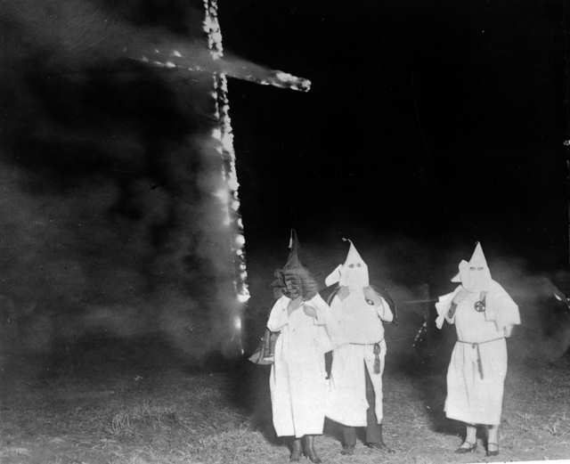
Ku Klux Klan

Slide 74
Power Distribution
Reconstruction did nothing to redistribute South’s wealth or guarantee that freedmen would own property, so it didn’t change the power structure of the South
The Southerners knew that, when Northerners left, things would go back to what they were like before Reconstruction
In 1869, the federal gvt indicated that they were easing up; Grant didn’t really enforce the laws
During the 60s and 70s, the gvt restricted the Fourteenth/Fifteenth Amendments

Slide 75
Court Decisions
In the Slaughter-House cases, the court ruled that the Fourteenth Amendment only applied to the Federal government, not the state governments, and backed that up in United States v. Cruikshank
In United States v. Reese, the court cleaned the way for “grandfather clauses,” poll taxes, literary tests, property requirements, and other restrictions on voting privileges
Soon, nearly all Southern states had restrictive laws that effectively prevented blacks from voting
Because Grant’s administration was so corrupt, Reconstruction was tainted even further

Slide 76
Election of 1872
Moderates called themselves Liberal Republicans and abandoned the coalition that supported Reconstruction
Angered by widespread corruption, the group hoped to end federal control of the South
Their candidate, Horace Greeley, did not defeat Grant, but they made gains in congressional/state elections
Grant moved further way from the radical position, closer to conciliation
Several Congressional acts, among them the Amnesty Act of 1872, pardoned most of the rebels

Slide 77
Other Crises
The financial Panic of 1873 drew the nation’s attention away from Reconstruction
By 1876, Southern Democrats had regained control of most of the region’s state legislatures
They called themselves Redeemers, and the use of the word “redemption” suggested they wanted to reverse Republican policies and redeem the South

Slide 78
Election of 1876
This election had both parties accuse each other of fraud
Samuel J. Tilden, governor of New York, had gone after “Boss” Tweed, a notorious political corrupt boss
He won the popular vote by a little, but needed to win the electoral vote
Republicans challenged the election results that favored him in South Carolina, Louisiana, and Florida
Congress created a special electoral commission to investigate
They created the Compromise of 1877

Slide 79
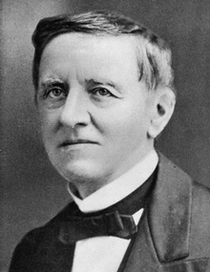
Samuel Tilden

Slide 80
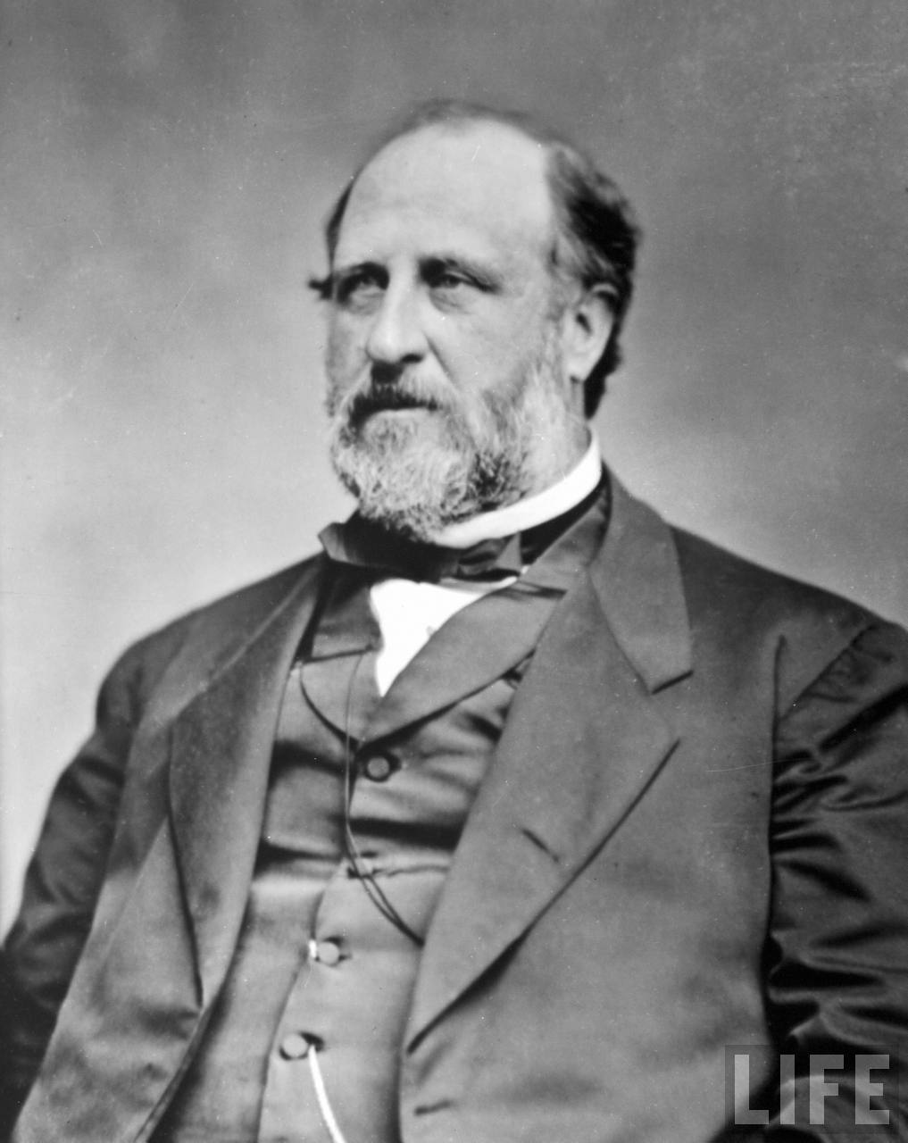
“Boss” Tweed

Slide 81
Compromise of 1877
It was agreed that if Rutherford B. Hayes won the presidency over Tilden, he would end military reconstruction, pull troops out of South Carolina/Louisiana, let Democrats take back control
And he won!

Slide 82
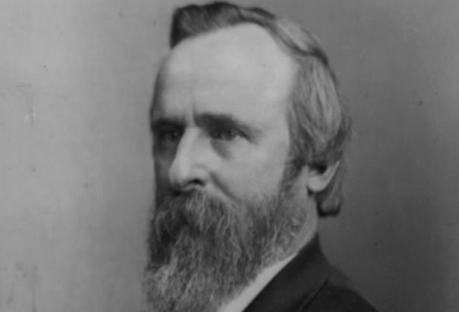
Rutherford B. Hayes

Slide 83
Southern Blacks
At the end of the Civil War, many slaves stayed on plantations as sharecroppers (if their old masters had treated them okay), or left for the North if their masters were mean
Many tried to find family members
The Freedman’s Bureau helped them find new jobs and housing, gave money and food, established schools for blacks (Fisk University, Howard University)
When Reconstruction ended, the Freedman’s Bureau had no more funding

Slide 84
Sharecropping
The government failed to redistribute land, Freedman’s Bureau failed at setting up a system where blacks would contract labor to whites
Blacks preferred sharecropping, where they traded some of their crop in return for the right to work someone else’s land
The system worked at first, but shady landowners used the system to keep poor farmers in a state of debt/near slavery
Abuses of the system were widespread, no court would fairly try a case of a sharecropper suing a landowner
It existed well into the 1950s, and included more whites than blacks

Slide 85
Great Migration
Disenchantment with white society led many freedmen to found communities as far removed from whites as possible
Black churches continued to be a place for blacks to bond
When Reconstruction ended, many blacks moved to the North
The Great Migration (they went en masse to places like Chicago and Detroit) didn’t happened until the 1910s, though

