Slide 1
Chapter Six: The Machine Age (1877-1900)
APUSH Test Date: Friday, May 8th

Slide 2
Thomas Edison
In 1876, Thomas Alva Edison built a workshop in Menlo Park, New Jersey
He patented many inventions, including the light bulb
He pioneered work in power plants
His advances allowed for the extension of the workday (used to end at sundown), since we could now work with artificial light, and a wider availability of electricity (for industry and home)
1875-1900 is called the Age of Invention because of technological advances

Slide 3
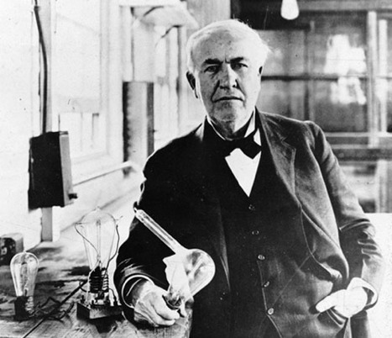
Edison Picture

Slide 4
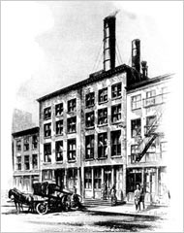
Power Plant Picture

Slide 5
Mass Production
Advances generate more opportunities for mass production, which then causes the economy to grow at a tremendous rate
The people known as the “captains of industry” to their fans and “robber barons” to their enemies owned and controlled the new manufacturing enterprises, became extremely rich and powerful during this period

Slide 6
Economies of Scale
As faster machines became available, businessmen realized that the cost per unit DECREASED as the number of units INCREASED (a gun is less expensive if you make 100 than if you make 10)
The more raw product they bought, the cheaper the suppliers’ asking price
The closer to capacity they kept their new machines running, the less the cost of labor AND electricity per product
The lower the costs, the cheaper they could sell the products; the cheaper the product, the more they sold; this is the economies of scale

Slide 7
Assembly Line Production
The downside of this new efficiency is that employees had to work as repetitively as machines
Assembly line production began to take a hold when Eli Whitney developed interchangeable parts, but reached a new level in Henry Ford’s car-plants in the early 1900s
It required workers to perform a single task again and again for 12 to 14 hours per day
Factories were dangerous; machine malfunctions and human error results in over 500,000 injuries to workers per year

Slide 8
Concerns
Businessmen wanted rapid growth and profits
The government didn’t know how to regulate this growth, so there was corruption between businessmen and bureaucrats
The courts were very pro-business
Businesses such as railroad companies followed the path that led to greater economies of scale, which meant larger and larger businesses
This pro-corporate structure is called corporate consolidation

Slide 9
New Forms of Businesses
One new form of business organization is called a holding company
A holding company owned enough stock in various companies to have a controlling interest in the production of raw material, the means of transporting that material to a factory, the factory itself, and the distribution network for selling the product
The logical conclusion is a monopoly, or complete control of an entire industry
One holding company gained control of 98% of the sugar refining plants in the United States; while their didn’t own the whole sugar industry, they controlled a crucial aspect of it

Slide 10
Integration
The most common forms of business consolidation (businesses joining together) were horizontal and vertical integration
One is legal, one is not, both were practiced by “robber barons” in the Gilded Age
Horizontal integration made monopolies in a particular industry
The best-known example was Standard Oil, created by John D. Rockefeller
In horizontal integration, several smaller companies within the same industry are being destroyed through practices like cutthroat competition or pooling agreements

Slide 11
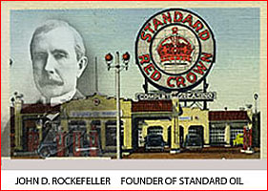
Picture of Rockefeller

Slide 12
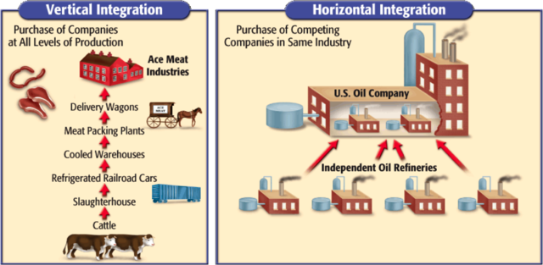
Picture of Integration

Slide 13
Vertical Integration
Vertical integration is still legal today, so long as the big company doesn’t become a trust or a holding company
(A trust is an organization set up to control assets/property, made INSTEAD of a corporation, so they could avoid restrictions placed on corporations; it doesn’t get a charter from the state, just support from the voluntary actions of people who support it)
V.I. must allow companies in the same industry to survive
One company buys out all of the factors of production they need (from raw materials to finished product), but not EVERY factor of production (McDonalds v. Burger King have separate factories)

Slide 14
Problems
Rapid growth required a lot of money
Businessmen borrowed a lot of money, so if they failed, the banks would lose out
During 1875-1900, the US went through a financial panic every decade
The lower classes suffered the most, as jobs/money became scarce
Monopolies created a class of powerful rich men, increasing public resentment; the government passed laws to restrict monopolies, but the courts overturned those laws

Slide 15
Example
The back-and-forth battle among the public, government, and courts is exemplified by the Sherman Antitrust Act of 1890
Public pressure led to the law being passed, when forbade “any combination…or conspiracy in the restraint of trade”
The wording of the Act was ambiguous, so the Supreme Court twisted it
In 1895, the Court ruled that E.C. Knight, a company that controlled 98% of sugar refineries in the US, didn’t violate the Act because local manufacturing couldn’t be controlled by Congress’s dealings in interstate commerce (U.S. v. E.C. Knight Co., 1895)

Slide 16
Divide
On the other hand, labor unions were often found to be in “restraint in free trade” and declared illegal
The loophole was closed in 1914 with the passage of the Clayton Antitrust Act, which made allowances for collective bargaining/unions
Public pressure for reform came from wealthy industrialists, too
Steel producer Andrew Carnegie promoted a philosophy based on the work of Charles Darwin, the evolutionist
Carnegie said that in business, as in nature, unrestricted competition meant only the “fittest” would survive – called “Social Darwinism”

Slide 17
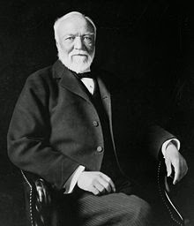
Picture of Andrew Carnegie

Slide 18
Social Darwinism
Carnegie’s argument was inconsistent; while he argued against government regulation, he also supported all types of government assistance to businesses (like tax refunds, grants, protective tariffs)
He argued that the concentration of wealth among a few was natural and efficient and the best result of capitalism
Carnegie also asserted that great wealth brought with it social responsibility
He called it the Gospel of Wealth and advocated philanthropy, by building libraries and museums and funding medicine, but NOT charity

Slide 19
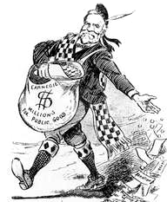
Picture of the Gospel of Wealth

Slide 20
Factories and Civil Life
Manufacturers tried to maximize profits at every turn, reducing labor costs by hiring women and children
In cities, where most factories were located, manufacturers hired the many newly arrived immigrants who were anxious for work
Because manufacturers paid as little as possible, the cities in which their employees lived suffered many problems of poverty (crime, disease, lack of housing)
Many families had at least one member who was disabled at work
Insurance/workmen’s compensation didn’t exist

Slide 21
Transportation
Those who could afford to move away from cities did so
As factories sprung up, cities became dirty and unhealthy
Advances in mass transportation, like more railroad lines, streetcars, and subways, allowed the middle class to live in nice neighborhoods and commute to work (managers, secretaries, bureaucrats, merchants)
Immigrants/migrants made up the majority of city populations
In 1880, the majority of immigrants arrived from southern/eastern Europe (before then, most were from northern/western Europe)

Slide 22
Prejudice
Prejudice against new Europeans was widespread, and many immigrants settled in ethnic neighborhoods usually in tenements; worse were black and Latino migrants, who were refused everything but the worst jobs
Most Americans expected churches/charities to help the poor, but these services were provided by corrupt political bosses
The bosses, like Boss Tweed, helped the poor find homes/jobs, apply for citizenship/voting rights, built parks, funded special police forces, special fire departments, made roads/sewage lines…in return, they required obedience

Slide 23
Political Machines
The bosses also wanted “donations” to fund “community projects”
Political bosses’ organizations were called political machines, and created services that communities wouldn’t have otherwise received
But since the bosses used criminal means to accomplish their goals, the cost of their services was high
“Boss” Tweed of Tammany Hall in New York City was the most notorious boss (mentioned in the last chapter)

Slide 24
Seeking Change
Labor unions tried to counter the poor treatment of workers; unions were considered radical organizations, and the courts were hostile
Hired goons and even federal troops would break up union strikes
Before the Civil War, the few unions that existed were small, regional, or local and represented workers within a specific craft/industry
One of the first national labor unions was the Knights of Labor, founded in 1869 by Uriah Stephens, a Philadelphia tailor

Slide 25
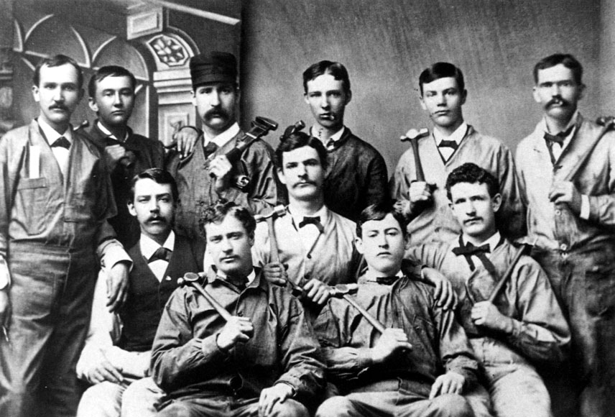
Picture of Knights of Labor

Slide 26
Labor Growth
The Knights organized skilled and unskilled workers into one union
They wanted an eight-hour workday, equal pay for equal work for men and women (which didn’t become a law ‘till 1963), child labor laws, including prohibiting children 14 and younger from worker, safety/sanitary codes, a federal income tax (not enacted ‘till the 16th amendment in 1913), and government ownership of railroad/telegraph lines
Although the Knights wanted arbitration, not strikes, they became violent; by 1880s, after a series of unsuccessful strikes under the leadership of Terrence Powderly, the popularity became to decline

Slide 27
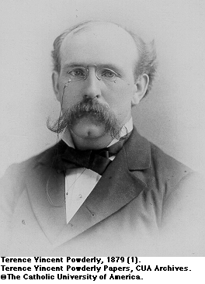
Picture of Terrence Powderly

Slide 28
Haymarket Square Riot
American public began to associate unions with violence/political radicalism
Propagandists claimed that unions were subversive forces—which was reinforced by the Haymarket Square Riot
During an 1886 labor demonstration in Chicago’s Haymarket Square, a bomb went off and killed police
Many blamed union workers, though no one knew who set off the bomb

Slide 29
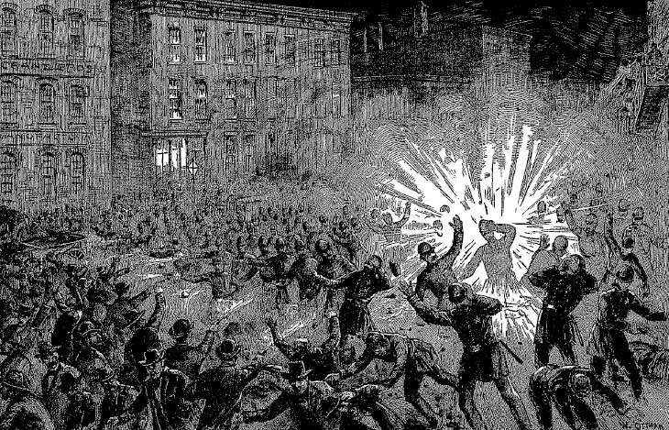
Picture of Haymarket Square Riot

Slide 30
Development of Unions
Many early unions did subscribe to utopian and/or socialist philosophies
Later on, the American Federation of Labor, led by Samuel Gompers, avoided those larger political questions, concentrating on such “bread and butter” issues like higher wages/shorter workdays, an approach that proved successful
Gompers realized that his union could gain more power if it excluded unskilled workers; the AFL was formed as a confederation of trade unions (unions made up of workers within a single trade)
Unions didn’t let immigrants/blacks/women in their membership

Slide 31
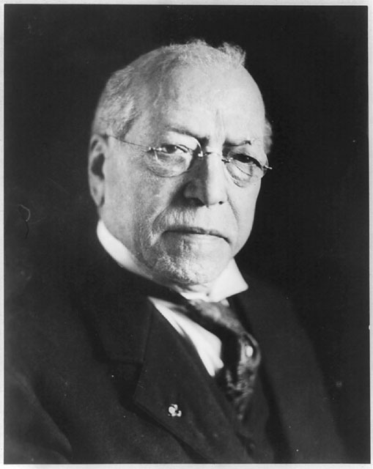
Picture of Samuel Gompers

Slide 32
Urban Reform
Women ran charitable middle-class organizations, trying to make local governments fix building-safety codes, sanitation, and public schools
Members also founded/lived in settlement houses in poor neighborhoods; these houses became community centers, providing schooling, childcare, and cultural activities
In Chicago, Jane Addams founded Hull House to give English lessons to immigrants, day care for children of working mothers, childcare classes for parents, playgrounds for children; wanted government to help in the slums, got the Nobel Peace Prize in 1931

Slide 33
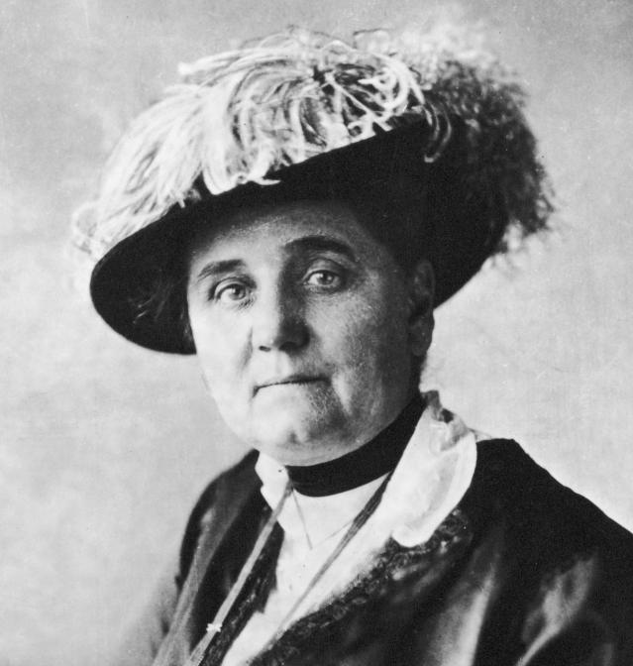
Picture of Jane Addams

Slide 34
Quality of Life
While poor suffered, life improved for the wealthy/middle class
More wealth meant more luxuries/leisure time
Sports, theater, vaudeville, and movies developed
Popular novels and newspapers began to circulate
The growth of the newspaper industry was the responsibility of Joseph Pulitzer and William Randolph Hearst, both of whom understood the commercial value of bold, screaming headlines and lurid tales of scandal (before that, papers were dry and boring)
This new style of reporting was known as yellow journalism

Slide 35
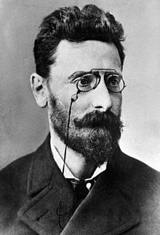
Picture of Joseph Pulitzer

Slide 36
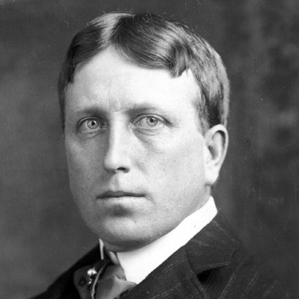
Picture of William Randolph Hearst

Slide 37
Developments in the South
Most of the advances of the machine age affected mainly Northern cities
In the South, agriculture was still the main form of labor
Textile mills EVENTUALLY sprung up around the South, reducing cotton farmers’ reliance on the North; tobacco processing plants also employed some workers, but the VAST majority remained yeoman farmers
Postwar economics forced farmers to sell their land, which wealthy landowners bought and turned into smaller farmers; landless farmers (black and white) became sharecroppers

Slide 38
Southern Systems
Blacks/white farmers rented land, which was called the crop lien system; designed to keep the poor in debt to the rich
Because these farmers had no cash, they borrowed what they needed to buy seed and tools, promising some of their crop as collateral
Huge interest rates on their loans and unscrupulous landlords pretty much guaranteed that these farmers would never overcome their debt, forcing them to borrow further and promise their NEXT crop as collateral
In this way, landlords kept the poor, both black and white, in a state of virtual slavery

Slide 39
Jim Crow
The advent of Jim Crow laws made matters worse for blacks; as federal government had less influence over the South, towns and cities passed new discriminatory laws
The Supreme Court ruled that the Fourteenth Amendment didn’t protect blacks from discrimination by privately owned businesses, and that blacks would have to seek equal protection from the states, not the federal government
In 1883, the Court REVERSED the Civil Rights Act of 1785, leading to legal (de jure) segregation
In 1896, the Court ruled in Plessy v. Ferguson that “separate but equal” facilities for different races…so segregation=okay

Slide 40
Black Progress
Booker T. Washington was a Southern black man born into slavery, and thought whites wouldn’t accept blacks as equals
Instead, he promoted economic independence as the means by which blacks could improve their lot
To pursue that goal he founded the Tuskegee Institute, a vocational/industrial training school for blacks
Some accused Washington of being an accommodationist, since he didn’t want immediate equal rights
In his “Atlanta Exposition,” a speech delivered in Atlanta, Georgia in 1895, Washington said that blacks needed to prove themselves

Slide 41
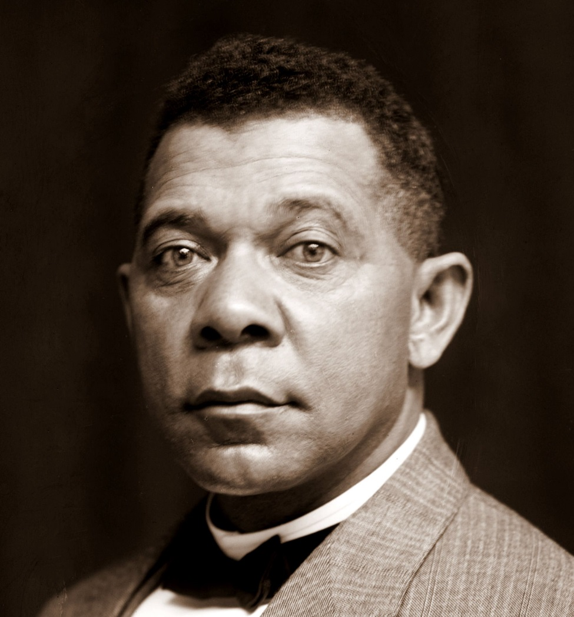
Picture of Booker T. Washington

Slide 42
The West
In the west, ranching and mining were growing industries
Ranchers drove herds across the western plains/deserts, ignoring property rights and Native American prerogatives to the land
Individual miners lacked the resources to mine and cart big loads, so mostly they prospected; when they found a rich mine, they staked a claim and sold their rights to a mining company
In the second year of the Civil War, Lincoln issued a challenge to America---before the decade was out, America would have a Transcontinental Railroad, connected the Atlantic to the Pacific

Slide 43
Railroad
Though the Transcontinental Railroad was owned privately, it was built at the public’s expense, through direct funding and substantial grants of land
Both federal/local governments were anxious for rails to be completed, and so provided substantial assistance
The public had paid for the rail system, but rail proprietors objected to any government control of their industry, so it took years for railroad rates to come under regulation
Until they were regulated, the railroads would typically overcharge wherever they owned a monopoly and undercharged in competitive markets…it hurt farmers in remote areas

Slide 44
Rail Development
As railroad construction crawled across the nation companies organized massive hunts for buffalo (to get them out of the way), driving them to near extinction, removing a resource for Native Americans
Some tribes, like the Sioux, fought back, so the government sent troops to kill them
The Natives won in some cases (killing racist, genocidal General George Custer at Little Big Horn), but the federal army ultimately won
Rails spread ideas and goods; “railroad time,” by which rail schedules were determined, gave the nation its first standardized method of time telling with the adoption of time zones

Slide 45
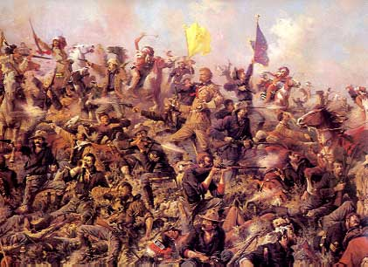
Picture of Little Big Horn

Slide 46
Rail Expansion
Rails pushed the country west, and settlers began filling in the territory
By 1889, North Dakota, South Dakota, Washington, and Montana were states; by 1890, Wyoming and Idaho joined ‘em
Progressive historian Frederick Jackson Turner said in 1890, after looking at the census, that the American frontier was gone
He said that the frontier 1) shaped the American character, 2) defined the American spirit, 3) fostered democracy, and 4) provided a safety valve for economic distress so that poor people could escape – all of this is called the Frontier Thesis or Turner Thesis

Slide 47
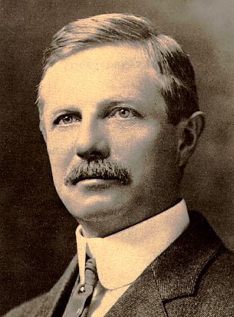
Picture of Frederick Jackson Turner

Slide 48
The Great Plains
In the Great Plains, farming/ranching were the main forms of employment; new farm machinery and access to mail made it easier, but it was still lonely
The government passed two laws in 1862 – the Homestead Act and the Morrill Land Grant Act
They offered 160 acres of land to anyone who would “homestead” it (cultivate the land, build a home, and live there for five years)
The land belonged to the Natives, though; private investors/railroad companies exploited the law. The Land Grant Act set aside land/gave money for agricultural colleges to make a new agricultural industry

Slide 49
Native Consequences
At first, Natives were called sovereign nations (made treaties). Settlers broke the treaties, causing war.
The new tack was to force Natives onto reservations, which were made up of the worst land in a tribe’s traditional region
The system failed because the land was inferior, the tribes were incompatible with each other, and the tribes weren’t allowed to manage their own affairs; in addition, some Westerners settled reservation lands anyway
Helen Hunt Jackson’s book A Century of Dishonor detailed the injustices of the system and called for reform

Slide 50
Dawes Severalty Act
In 1887, the Dawes Severalty Act broke up the reservations and gave the land to the head of each Native family; like the Homestead Act, they got 160 acres of land…if they lived there for 25 years. Then, the land would be theirs and they’d be American citizens
Its goal was to help Natives assimilate into White culture
Poverty drove many to sell their lands to speculators, leaving them homeless
By the time the Dawes policy was reversed in 1934, the Native nations were decimated

Slide 51
Gilded Age
Mark Twain called the time between Reconstruction and 1900 the Gilded Age of politics—gilded metals look like gold on the outside, but have a cheap base
America looked to have a lot of wealth because the 1% was REALLY wealthy, but a lot of people were impoverished
America looked to have democracy, but there was a lot of corruption (political machines and bosses)
The presidents weren’t generally corrupt, but they were pretty weak

Slide 52
Summary of Presidents
Rutherford B. Hayes (Corrupt Bargain), James Garfield (assassinated), and Chester A. Arthur cared about civil service reform; the spoils system pioneered by Jackson meant that when a new president took office, he needed to fill thousands of government jobs (even during the Civil War, Lincoln spent full days dealing with job applications)
Lincoln’s Republican Party split between Stalwarts, who thought ALL government jobs should go to other Republicans, and Half-Breeds, who thought that qualified Democrats could be hired
When Garfield was assassinated, Arthur signed the Pendleton Civil Service Reform Act to dismantle the old spoils system

Slide 53
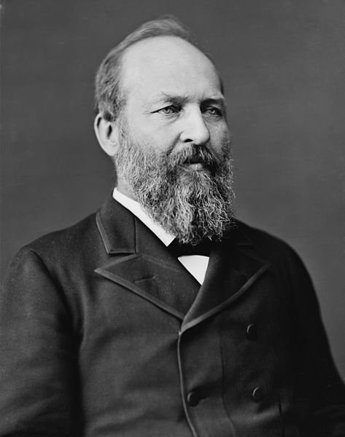
Picture of James Garfield

Slide 54
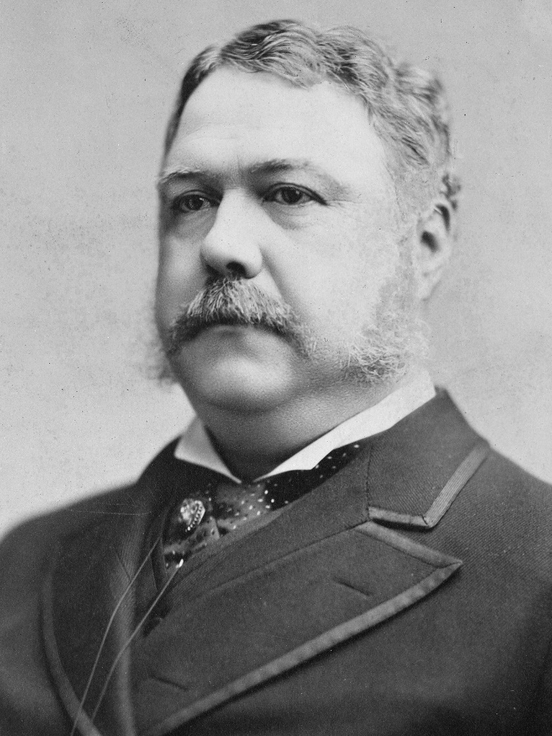
Picture of Chester Arthur

Slide 55
More Presidents
Grover Cleveland believed that the government shouldn’t get involved with governing
Benjamin Harrison passed everything from the nation’s first meat inspection act to banning lotteries to buying battleships
Harrison passed the Sherman Antitrust Act and the Morrill Land Grant Act
But Harrison’s activism and spending made his administration be called the Billion Dollar Congress, so Cleveland got elected a second time (Cleveland, Harrison, Cleveland)

Slide 56
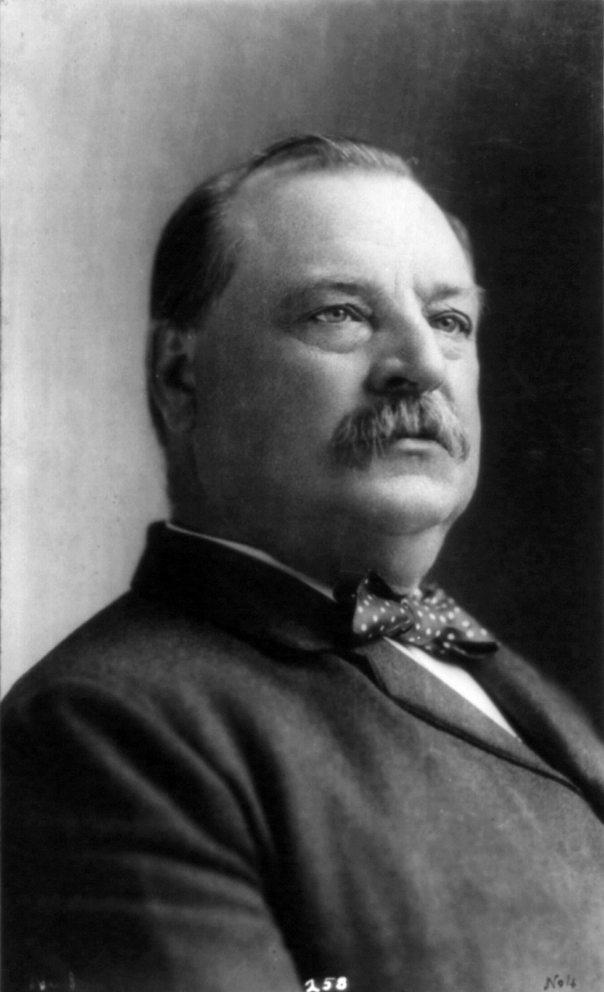
Picture of Grover Cleveland

Slide 57
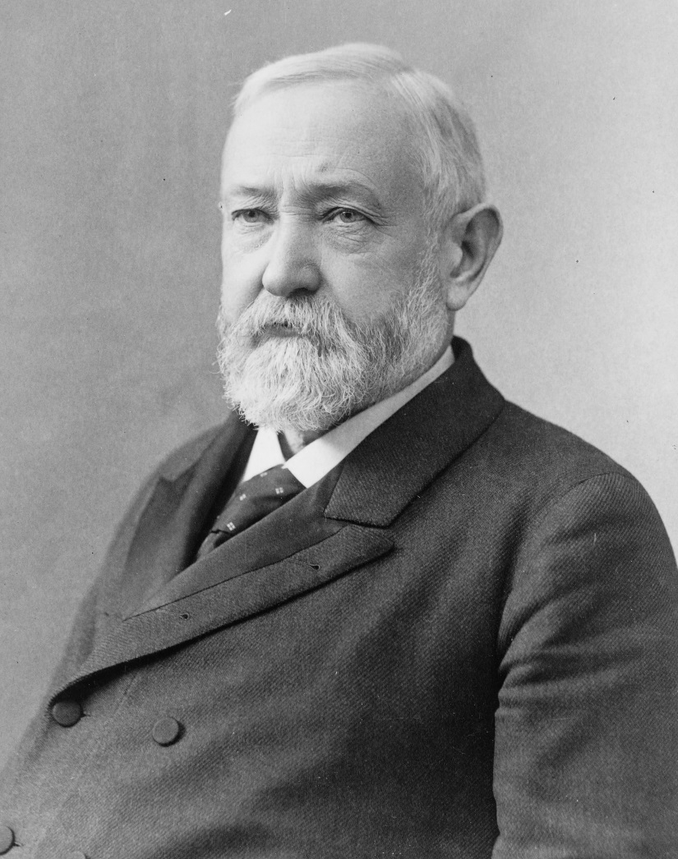
Picture of Benjamin Harrison

Slide 58
Government Regulation
In response to corruption, the states imposed railroad regulations to prevent railroads from price gouging (pricing things at a SUPER-HIGH price because nobody’s stopping it)
In 1877, the Supreme Court upheld an Illinois state law regulating railroads/grain elevators (stores grain) in Munn v. Illinois
The Court said that states can regulate private industry that served the public interest; normally, such regulation would be up to Congress
The Court reaffirmed Congress’s authority in the 1886 Wabash case, and ruled that states couldn’t establish rates involving interstate commerce

Slide 59
More Regulation
In 1887, one year after Wabash, Congress passed the first federal regulatory law in US history. The Interstate Commerce Act set up the Interstate Commerce Commission (ICC) to supervise railroad activities and regulate unfair practices (it was disbanded in the 1980s under President Reagan)
During this time, women’s suffrage became a big issue, led by Susan B. Anthony; organizations like the American Suffrage Association fought to add amendments to state constitutions. By 1890, women could vote on school issues; in 1920, the 19th Amendment was ratified and women could vote on everything

Slide 60
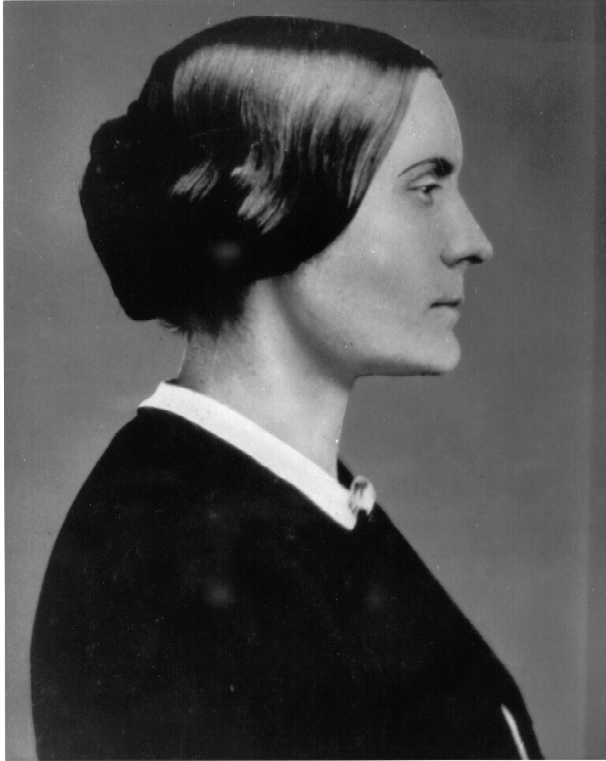
Picture of Susan B. Anthony

Slide 61
The Currency Issue
After the Civil War, production increased; greater supply led to a drop in prices. For farmers, lower prices meant less money, and they were already locked into long-term debts with fixed payments
Farmers thought increasing available money could make payments easier—AND cause inflation, which would make the farmers’ debts worth less. Banks opposed the plan, preferring to use only gold to back the money supply
The farmers’ plan called for use of silver coins; since silver was mined in the West, the Western miners backed it. So, it was the poor Western, Midwestern, and Southern farmers (silver+gold) versus wealthy Northern bankers (only gold)

Slide 62
Silver and Gold
The Grange Movement, which began in 1867, had 1,000,000 members by 1876; the Grangers started out as cooperatives, with the purpose of letting farmers buy machinery/sell crops as a group (remember economies of scale)
Soon, the Grangers endorsed political candidates; they died out due to lack of money, and were replaced by Farmers’ Alliances
The Farmers’ Alliances grew into a political party called the People’s Party, the political arm of the Populist Movement

Slide 63
People’s Party
The People’s Party had a convention in 1892
Aside from supporting the generous coinage of silver, the Populists called for government ownership of railroads and telegraphs, a graduated income tax (you’re taxed at a higher percentage depending on how much money you make), direct election of US senators, and shorter workdays
Their 1892 presidential candidate, James Weaver, came in third (Cleveland won), but got over 1,000,000 votes, awakening Washington to the growing Populist movement

Slide 64
Crisis
When Cleveland took office in 1893, the country entered a four-year financial crisis
Hard economic times made Populists more popular; it got so tough that some progressive/radical movements were popular
In 1894, the Socialists, backed by Eugene V. Debs, gained support
By 1896, Populists backed Democrat William Jennings Bryan against Republican William McKinley, and Bryan campaigned to “free silver”
Bryan is remembered for his “Cross of Gold” speech, saying that an easy money supply, even if it causes inflation, would weaken corrupt Northern banks. He lost, the economy improved, Populists=ended.

Slide 65
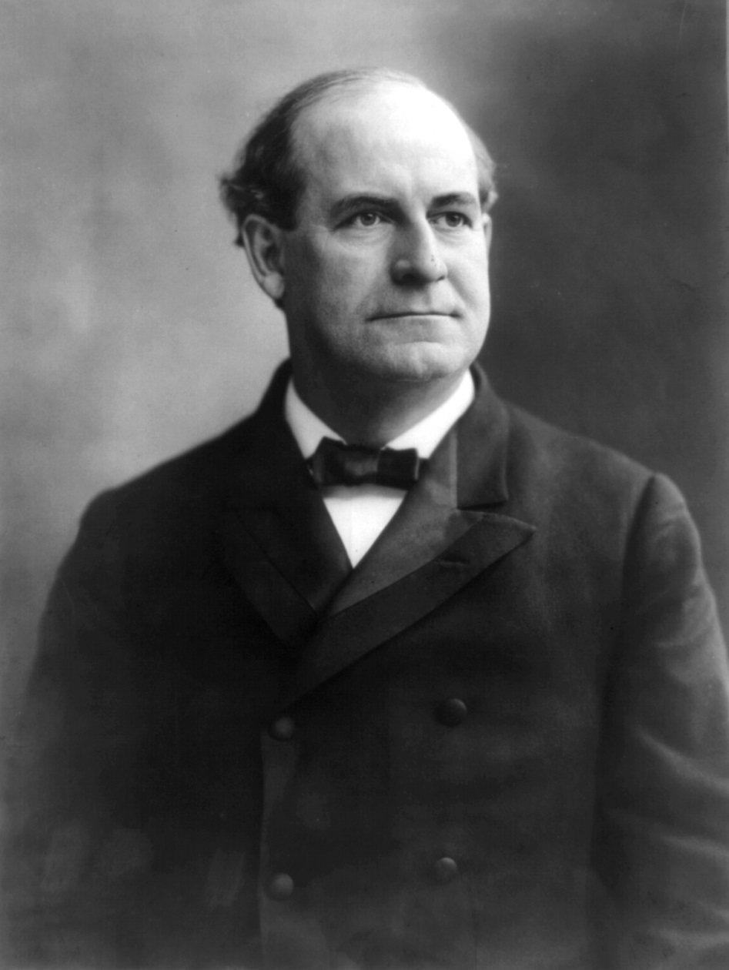
Picture of William Jennings Bryan

Slide 66
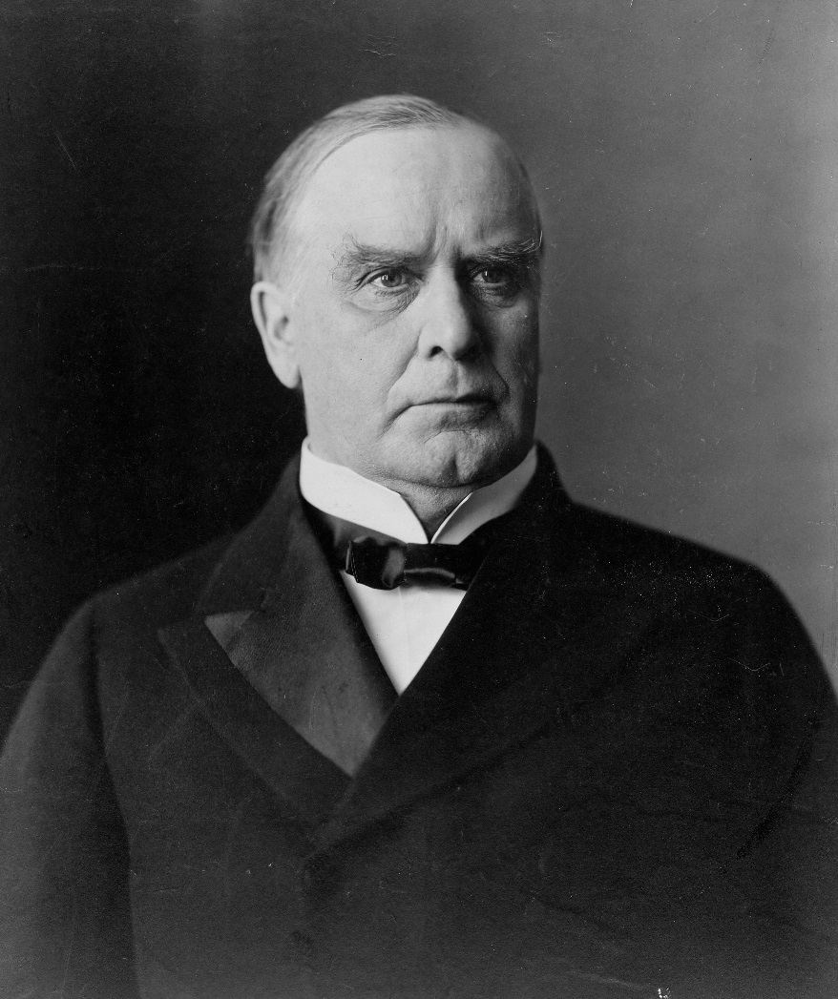
Picture of William McKinley

Slide 67
Wizard of Oz
L. Frank Baum wrote The Wizard of Oz as a political metaphor
Dorothy is the common man. Her silver shoes (changed into ruby slippers in the movie) were the silver standard, the scarecrow was the farmer, the Tin Man was the industrial worker, and William Jennings Bryan was the Cowardly Lion

Slide 68
Foreign Policy
Before the Civil War, most Americans got money by farming; by 1900, however, the US had become the leading industrial power in the world
There was no federal income tax until the Sixteenth Amendment was adopted in 1913; the most infamous tax was the Tariff of Abominations (1828), which triggered the nullification crisis
After the Civil War, tax policy was discussed a LOT, as industrialists who traded internationally wanted high protective tariffs (which limited what the common, poor consumer could buy)
Generally, Democrats supported lower taxes, Republicans wanted high protective tariffs

Slide 69
New Tariffs
In 1890, Congress enacted the McKinley Tariff, which raised the level of taxes on imported goods by nearly 50%
Certain products, like unprocessed sugar, were put on the duty-free list
In 1894, Congress passed the Wilson-Gorman Tariff, which looked like the schedule established by the McKinley Tariff, despite heated debate
The tariff issue also impacted foreign relations (the Wilson-Gorman Tariff led to the Spanish-American War, which we’ll discuss later)

Slide 70
New Growth
In the machine age, American production grew rapidly
Not every American had enough money to buy the products they made at work, so American looked overseas for new markets
Increased nationalism followed; America’s 100 year anniversary in 1876 heightened national pride. As we thought our way of life was best, we wanted to spread it around the globe
William H. Seward, secretary of state under Lincoln and Johnson, purchased Alaska and invoked the Monroe Doctrine to get France out of Mexico. Then, American businesses developed markets in Latin America, gaining power.

Slide 71
Imperialism
When America moved into new regions to do business, it was practicing expansionism
When the US took control of another country, it was practicing imperialism
Naval captain Alfred T. Mahan wrote The Influence of Sea Power Upon History in 1890, which piqued the government’s interest in imperialism
Mahan said that successful foreign trade relied on access to foreign ports, which needed overseas colonies, which needed a strong navy—this led to the New Navy idea, so the US upgraded its ships!

Slide 72
More States
The US went to Hawaii to get a port along the trade route to Asia
Foreign missionaries had arrived there in 1800, but U.S. sugar producers traded with Hawaiians in the 1870s
The Hawaiian economy collapsed in the 1890s: first, the US let the natives have tax-free access to American markets; then, when Hawaii became dependent on the US, the US made the tariffs REALLY high
The white minority overthrew the native government, and the US annexed Hawaii
Japan was outraged, since more than 40% of the residents were of Japanese descent

Slide 73
Cuba
Cuban natives revolted against Spanish control
The revolution in Cuba, like the Hawaiian revolution, was instigated by US tampering with the Cuban economy (by imposing high import tariffs)
A violent Cuban civil war followed, reported by “yellow journalists”
When an American warship, the Maine, exploded in the Havana (Cuban) harbor under mysterious circumstances, the public called for war, led by journalist William Randolph Hearst
The US drove Spain out of Cuba

Slide 74
Philippines
After taking Cuba, the US sent a fleet to the Spanish-controlled Philippines and drove the Spanish out of there too
In the Treaty of Paris, Spanish gave Cuba independence and gave the Philippines/Puerto Rico/Guam to America
They took Hawaii in the same year
This is the third Treaty of Paris in US history (the first ended the French/Indian War in 1763, while the second ended the Revolutionary War in 1783)

Slide 75
Staying in Cuba
Despite the Teller Amendment, where America claimed it would not annex Cuba after Spain left in 1898, US troops stayed in Cuba for three more years
In 1901, Cuba was forced to put pro-America provisions in a new Constitution (or our troops wouldn’t leave); these provisions were called the Platt Amendment
The US was give control of Cuba’s foreign affairs: 1) Cuba couldn’t sign a foreign treaties without the okay from America; 2) the US could intervene in Cuban domestic and foreign affairs; 3) the US could take Cuban land to build a naval base and coaling station

Slide 76
More Imperialism
The Platt Amendment (1901) was repealed in 1934, but the US still has a naval station at Guantanamo Bay in Cuba
Control of the Philippines was based on whether the US wanted to make it a state or give its people independence
One argument: if they got independence, the Europeans would just conquer it again. Another: Americans have a moral obligation to “Christianize and civilize” the natives. The idea that non-whites couldn’t rule themselves was called the “white man’s burden,” based on a poem by Rudyard Kipling in response to our choice to annex the Philippines.

Slide 77
Resolution
Opponents thought the US had a moral obligation to promote independence and democracy
To control the Philippines is just like King George controlling the colonies
The Senate voted to annex the Philippines, so Filipino nationalists waged a guerrilla war against the States.
We eventually regained control of the country, but then gave them independence in 1946

Slide 78
More Questions
As the US got more territories, the question became: Does the constitution follow the flag? Were colonial subjects entitled to the same protections and privileges granted to US citizens?
In the Insular Cases (1901-1903), the Supreme Court ruled that the Constitution didn’t follow the flag: Congress could decide what rights to give to conquered lands/peoples, irrespective of Constitutionality
McKinley sought an Open Door Policy for all Western nations hoping to trade with Asia. The European nations that had colonized China were not so keen on the idea; when Chinese nationalists (the Boxers) fought back in 1900, the U.S. sent troops to help Europeans, so Germany/France/England grew more receptive to helping America

